Slide 1
Substitute authorization Application
Board of Educational Examiners

Slide 2
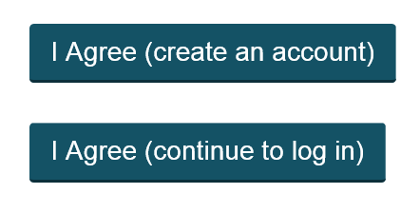
Home page BoEE
https://boee.iowa.gov/
First click the “Apply for/renew my license” then click “I agree…”
Click on I Agree (create an Account) if you have never held a license with the boee or not used this new system. (system started 3/18/2018).
Click on “I agree (continue to log in) if you have already set up an account after 3/18/2019. Skip to Slide 8.

Slide 3
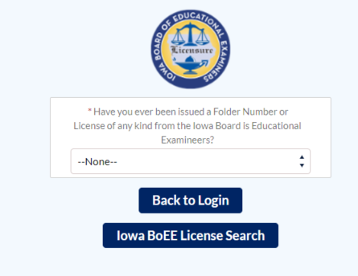
If you already hold a Coaching Authorization, Para. Certificate, you will
CHOOSE “Yes”
If you do not remember your folder number, you may look it up here. You will NEED your folder number to complete the application.
(GO TO SLIDE 4)
If you have NEVER HELD A LICENSE with the BoEE, you will choose “NO”. This will be most of you.
(SKIP TO SLIDE 5)

Slide 4
Existing folder Number “Yes”
Enter email that you will use as a login user name for this account and folder number
CLICK “SIGN UP”
(SKIP TO SLIDE 6)

Slide 5
Existing folder Number “No”
Complete all information. Please review carefully.
Errors can cause issues with future applications, background checks, and delays in processing.
Use a stable email (Gmail, yahoo etc.) that will not change much over your life.
Click “Sign Up”

Slide 6
An email will be sent to the address provided.
Click the link in the email to setup your new password and start your account.

Slide 7
Password
A request for a password will be sent to the email provided. Remember this password for future use.

Slide 8
Logging in with existing account
Use the email you used to set up your account previously
Password reset will be sent to the username email originally used to set up the account

Slide 9
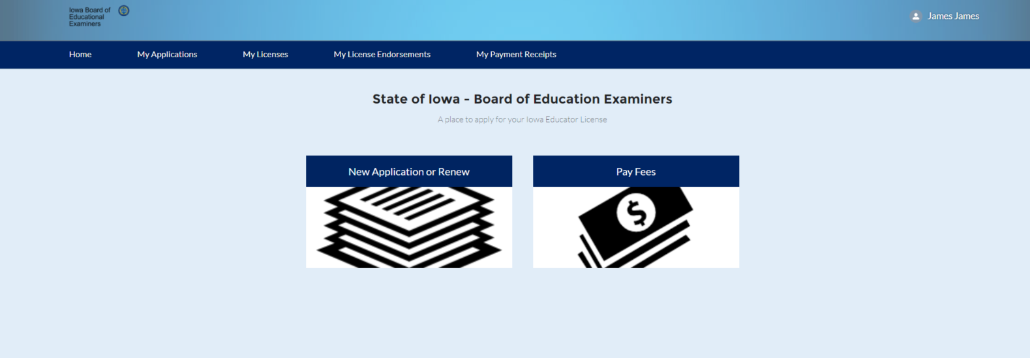
You are now logged in to the application system
Click the “New application or renew” to start an application.

Slide 10
You will have a few screens of verifying your demographic information.
If all is correct, click on the “Next Button” This should all be ok if this is your first application ever.

Slide 11
If you need to make a change, click the “No” radio button and make the appropriate changes.

Slide 12
You now need to choose what you will be applying for. As a new Substitute Authorization, you will be choosing “Apply for a new license”. Then click “Next”

Slide 13
Use the pull down menu to choose the category of license you will be applying for. In this case “Substitute”, then click “Next”

Slide 14
Use the pull down menu to choose the type of application. In this case, the “First Substitute Authorization” and click “Next”

Slide 15
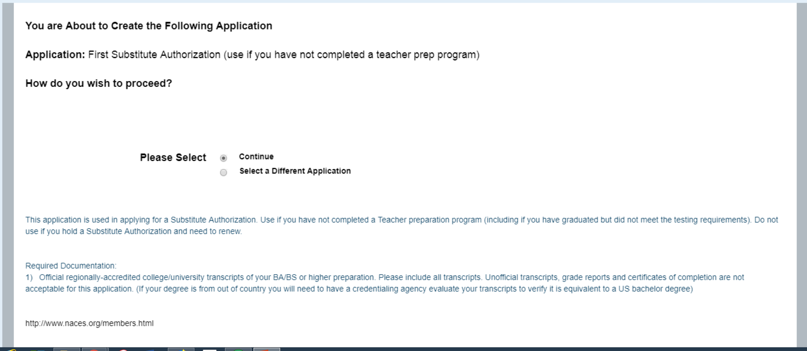
Brief instructions will outline what will be required, and necessary fees. If all seems correct, click the “Next” button.

Slide 16
Your application has been generated, click “Finish” to complete the setup and begin the application.

Slide 17
You will see general requirements, and necessary fees. If reviewing, and decided you chose the incorrect application, you may click the “Withdraw Application” button, and start over. Scroll down to the “Application’ section and click on the “Complete Checklist” button.

Slide 18
As you respond to each checklist question, click the “Save & Next” button and you will advance to the next section.

Slide 19
In some sections, your response may open another text box for you to provide more information. Many of these are freeform text boxes. Just type the information requested. In the case of past convictions, please list all and be specific. Failure to do so, may delay the processing of your application.

Slide 20
If you have never applied or held a license with the BoEE, you will need a full background check. Check “No”, and choose the way you will submit your fingerprints.
You may choose mail cards to me or come to the BoEE for fingerprinting. If you choose “Mail Cards to me” you will receive cards from our office in the mail to the address you included with this application.

Slide 21
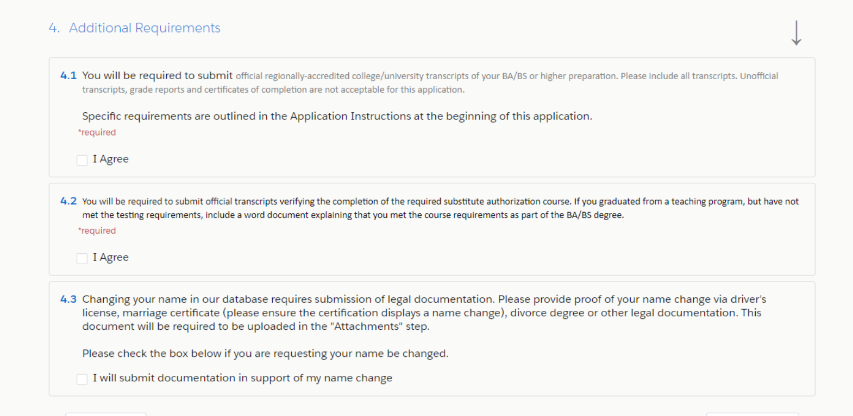
Additional Requirements. 1. BA OR HIGHER 2. SUB AUTH TRANSCIPTS DO NOT USE IF YOU HAVE PARA AND NO BA “Withdraw application and apply to add a Concentration to your Para Certification”

Slide 22
Once you complete the checklist, you will click on the “Required Attachments” to include your Official BA Transcripts and your Official Substitute Authorization Transcripts. (please note we do not accept certificate of completions)

Slide 23
Click on the “Upload file” to include the verification. Click “done” when complete. (do not use the add more button for any required documents). “You may use “Add More” if you have more than one document to upload for a section (e.g. Official Transcripts)”

Slide 24
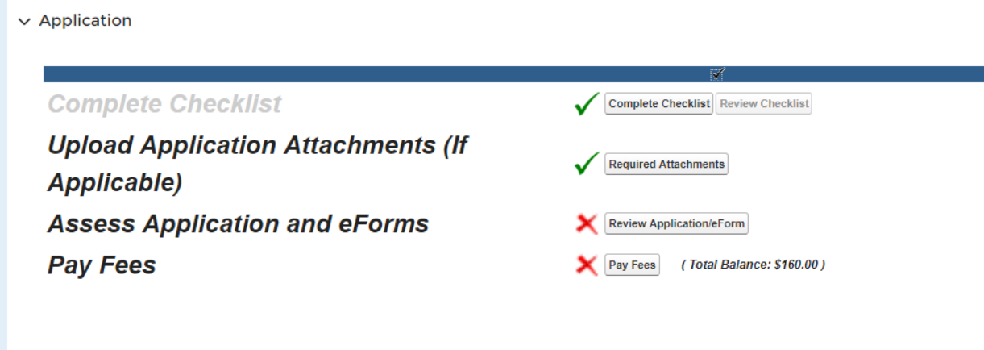
The “Review Application” area is where the system will check to make sure you have all the required boxes checked, and documents if needed. In addition you will send out any electronic verification forms you need. Note: the red x will not change until you pay the fee.

Slide 25
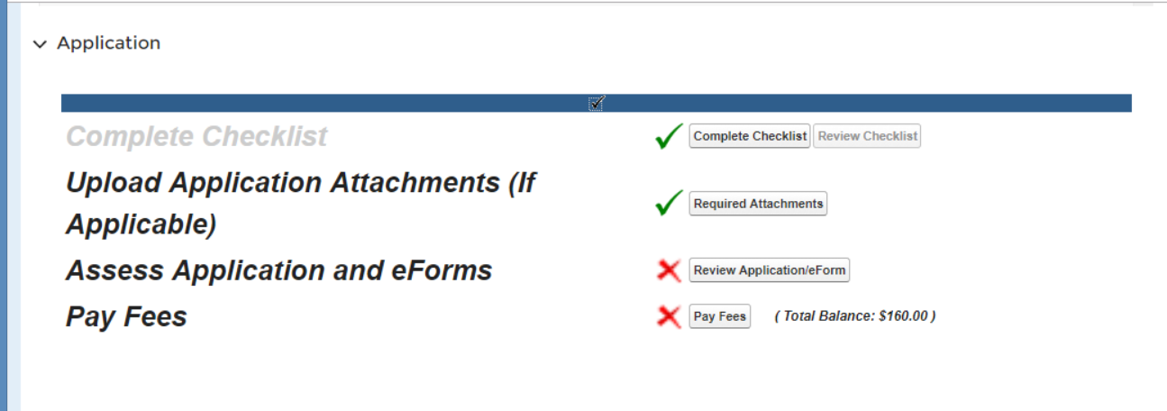
You are now ready to pay fees and submit your application.

Slide 26
Choose the fees you are wanting to pay. All fees for a specific application must be paid for the application to be submitted. You may pay with credits card online now, or select the option to print an invoice and mail in a check.

Slide 27
On the Home page of your account, under the “my applications tab” you can also see your folder number

Slide 28
When the status has changed to “Pending – Internal Review” your application is complete and submitted. This only happens when all required documents, payment has been made and you have reviewed your application.

Slide 29
--License issuance will not occur until a complete background check has cleared (if required) --Processing time is 4-6 weeks depending on the background check. --Coming to our office for the background check will expedite the background process.

Slide 30
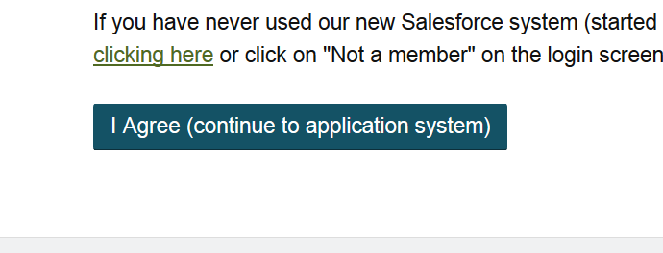
Returning to your application.
If you start your application, but do not complete it all in one sitting, you may leave an come back.
Go to the BoEE website and locate the same “ I Agree” button

Slide 31
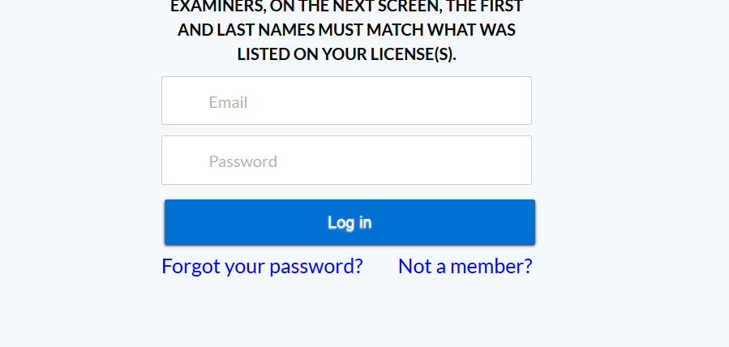
Type the same email and password from your original registration, and click “Log In”

Slide 32
Click on the “My Applications” tab at the top of the page

Slide 33
Select your application (note, this number will be specific to your application)

Slide 34
You may pickup where you left off, and complete your application.

