Slide 1
Unpacking the Recipe for Promoting Student Social, Emotional, and Behavioral Wellbeing as the Foundation for School and Life Success
Clay Cook, PhD, LP
Professor
John W. and Nancy E. Peyton Fellow in Child and Adolescent Wellbeing
College of Education & Human Development
University of Minnesota
Core Faculty
Institute for Translation Research in Children’s Mental Health
University of Minnesota
crcook@umn.edu
@ClayCook_PhD

Slide 2
My Plan
Why integrate social, emotional, and behavioral supports…
What & How does it look like to implement a robust a continuum of social, emotional, and behavioral supports…

Slide 3
The Why:

Slide 4
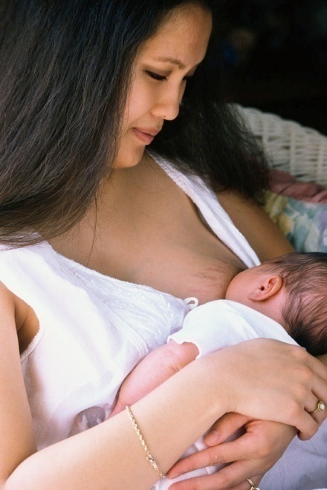
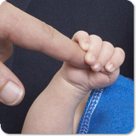
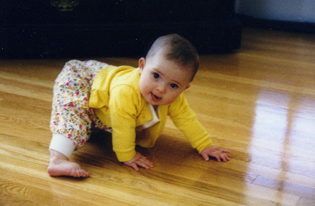
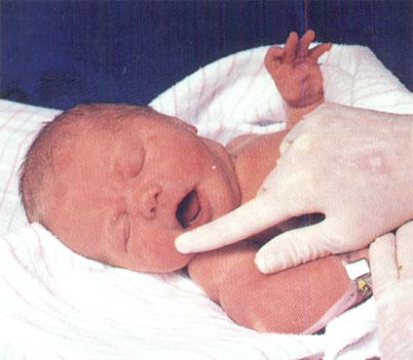
Big Question?
What can babies do when they are born?

Slide 5
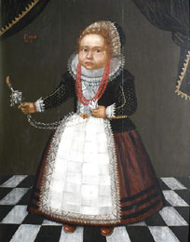
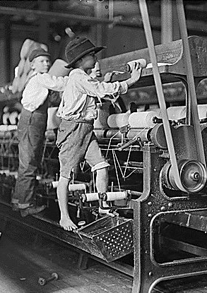
Are children and adolescents just miniature adults? Yes or No?
Notes:
Concept of children as miniature adults held until the 18th Century. Wasn’t until then that society began to accept that childhood was a stage in life. No child labor laws
Why do you think, Cognitive behavior therapy, which relies on talking with children to dispute faulty thoughts, works better for adolescents than young children.

Slide 6
Does knowing how to be successful in one setting mean you know how to be successful in another?
Would we crack open a beer in church?

Slide 7
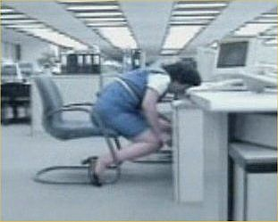
Does knowing how to be successful in one setting mean you know how to be successful in another?
Do we behave the same at work as we do at home with our family?

Slide 8
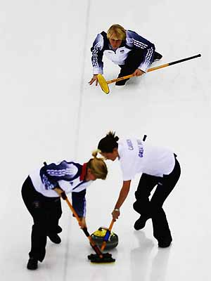
Does knowing how to be successful in one setting mean you know how to be successful in another?
Curling anyone?

Slide 9
Whole-Child Perspective
Academic, social/emotional/behavioral, and physical functioning are all interconnected
ACADEMICS
PHYSICAL HEALTH
SOCIAL, BEHAVIOR & EMOTION

Slide 10
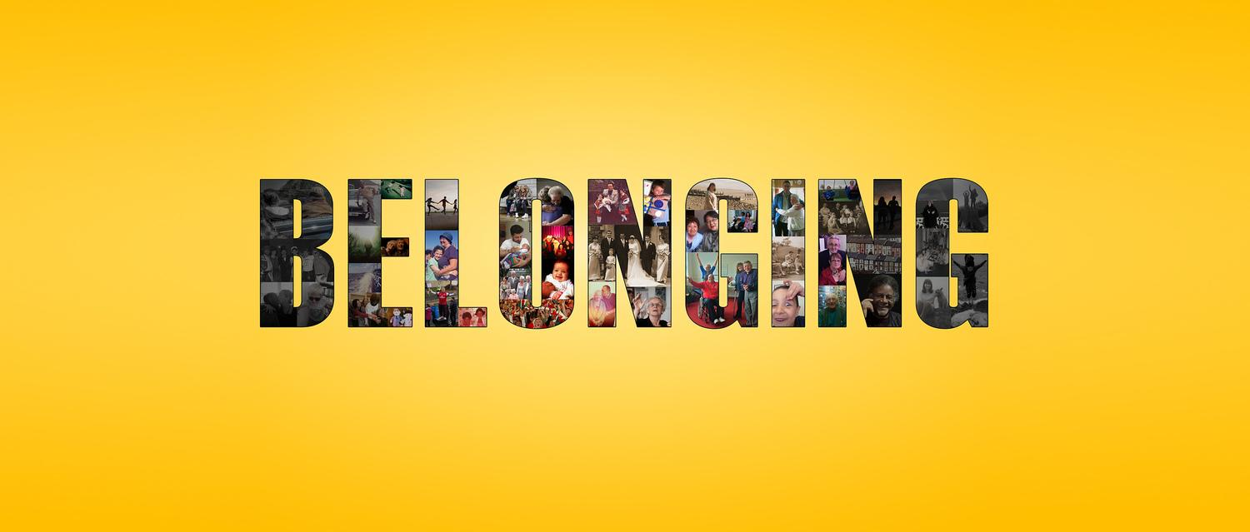
Sense of Belonging as a Core Human Need
Notes:
Provide information:
Social psychology, health psychology, educational psychology, clinical psychology, neuroscience, and developmental psychology all indicate that social belonging is a core human need.
A sense of belonging to authority figures establishes the context for engagement and motivation and greater prosocial interactions.
(3) NIJ study indicates that virtually no incidents of school violence have occurred by individuals who feel valued, respected, and a sense of belonging. Thus, lack of belonging is considered a root cause for problems that young people experience.

Slide 11
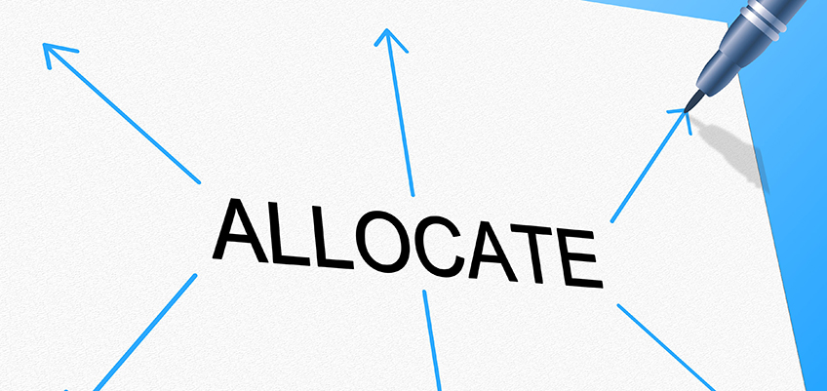
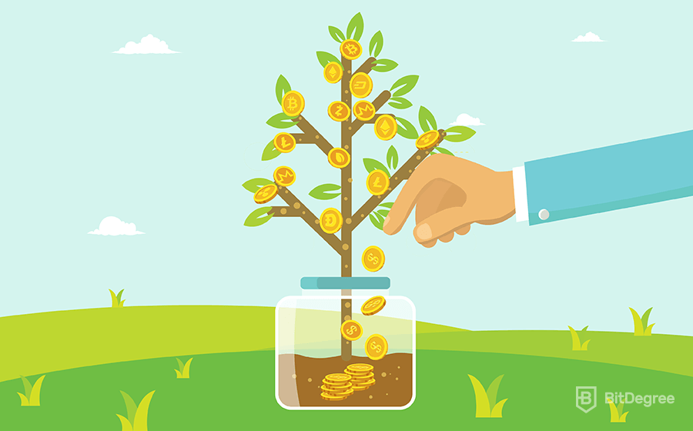
Notes:
On the social, emotional, and behavioral side we see a treatment heavy, reactive approach. How many of you believe in the importance of prevention. Why is a focus on prevention needed?

Slide 12
“If a child doesn’t know how to read, we teach.”
“If a child doesn’t know how to swim, we teach.”
“If a child doesn’t know how to multiply, we teach.”
“If a child doesn’t know how to drive, we teach.”
“If a child doesn’t know how to behave, we… …teach? …punish?”
(Herner, 1998)

Slide 13
Capitalize on the opportunities or miss opportunities?
7 x 180 = 1260

Slide 14
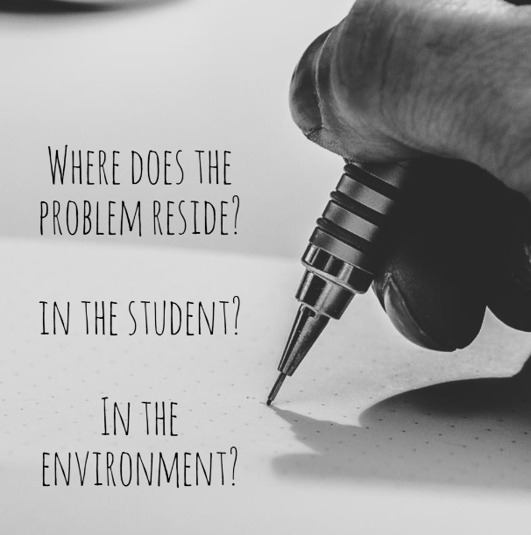

Slide 15
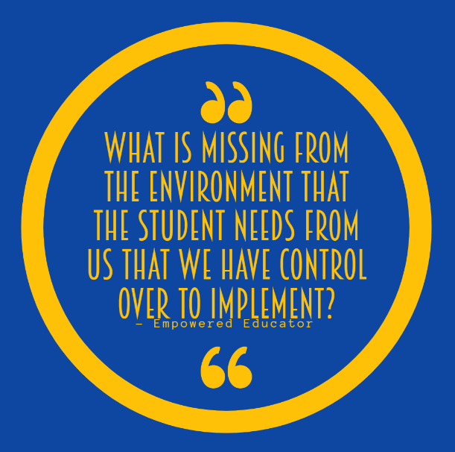

Slide 16
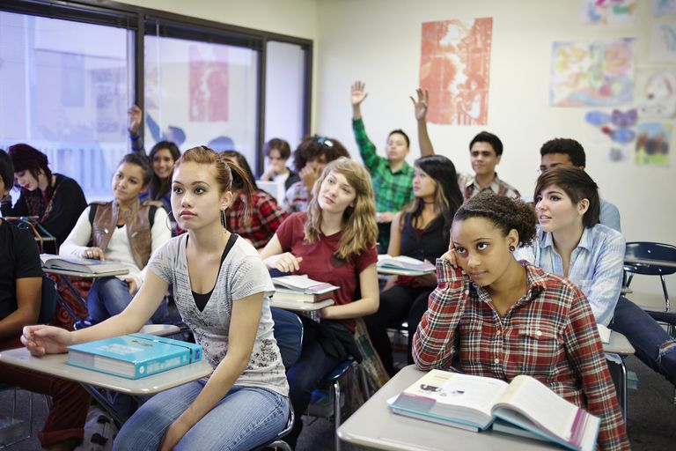
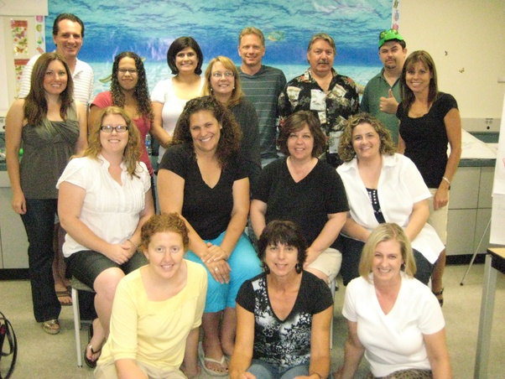
For student outcomes to change, who must change?
OR
Students
Educators

Slide 17
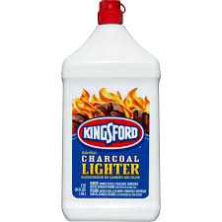
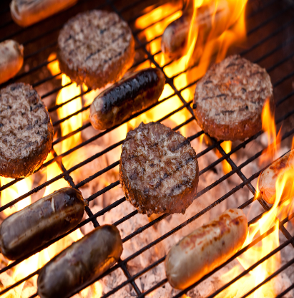
The Science of Human Behavior
Lack of sleep, tired
Told to do something they do
Refuse to do it
Avoid unwanted academic work
Setting Events
An event that increases the likelihood that the trigger will provoke the behavior
Triggering
Antecedents
The main
behavior of
concern
Problem
Behavior
The purpose or
reason why
the problem
behavior occurs
(i.e., function)
Maintaining
Consequences
The immediate event that provokes the behavior
Notes:
17

Slide 18
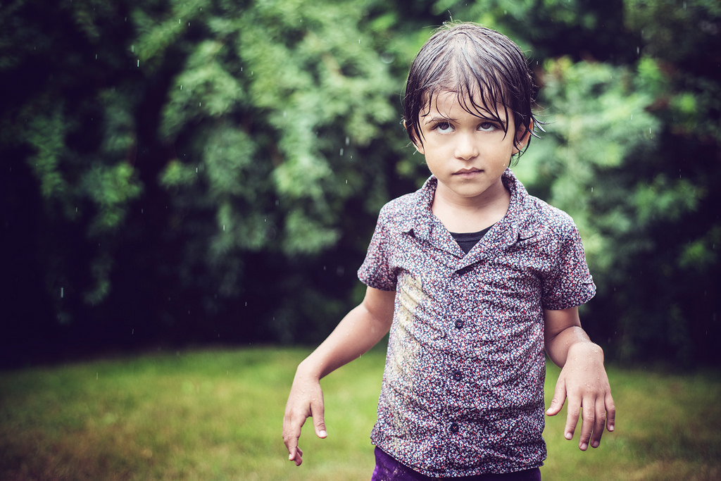
Setting Events
Factors outside the immediate situation that increases the probability that a given situation will provoke a behavior
TRAUMA!!!

Slide 19
Prevention/Proactive Supports
Reactive Strategies
Teaching Skills
Setting Events
An event that increases the likelihood that the trigger will provoke the behavior
Triggering
Antecedents
The main
behavior(s) of
concern
Maintaining
Consequences
Problem
Behavior
The purpose or
reason why
the problem
behavior occurs
(i.e., function)
The immediate event that provokes the behavior
Notes:
19
Breaking down the science of behavior

Slide 20
Gathering and Using Student-Specific Information to Facilitate Proactive Programming
Setting Events
(increases the
likelihood the
trigger will
provoke
behavior)
Triggering
Antecedents
(what happens
right before
the behavior
occurs that
provokes it)
Problem
Behavior
(main behaviors
of concern that
are maintained
by the same
consequence)
Maintaining
Consequences
(the function or
purpose of the
problem behavior)
Categories of Information
Student-Specific Information
On days when….
Specific situations that provoke behavior are..
The behavior problem involves….
The outcome/experience keeping the behavior going is..
Proactive programming
The neutralizing routines we will use when setting event is present…
The antecedent strategies we will use to prevent behavior problem
The replacement behaviors and skills we will teach…
The motivators we will use to increase likelihood of desired or replacement behavior

Slide 21
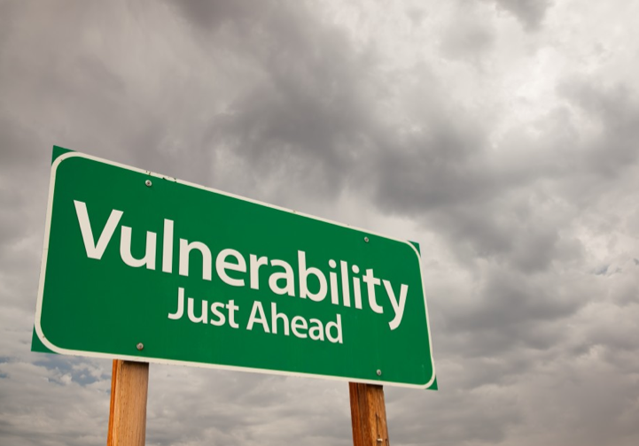
Examining Our Own Vulnerabilities
Specific situations in we are more vulnerable to engage in unskillful behaviors in response to certain situations
Examples:
Tired/fatigued (lack of sleep)
Stress due to external factors
Feeling overwhelmed because juggling multiple responsibilities

Slide 22
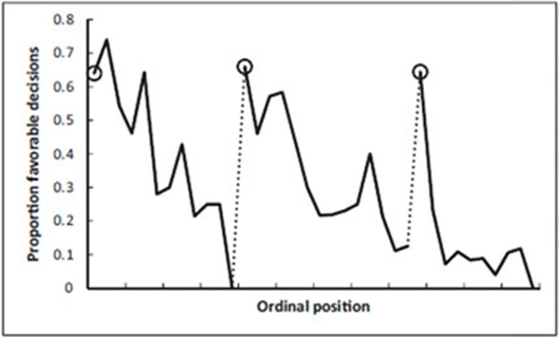
Resource Depletion in Action
Outcomes of parole hearings (Danziger et al., 2011)
Judges’
Snack Break
Judges’
Lunch Break

Slide 23
Adult Self-Regulation
Anticipatory stress
Fatigue
Unwanted student behavior
Unskillful reprimands
Relief / end to the unwanted behavior
2. Triggering
Antecedents
1. Problem
Behavior
4. Maintaining
Consequences
3. Setting Events
An event that increases the likelihood that the trigger will provoke the behavior
The main
behavior(s) of
concern
The purpose or
reason why
the problem
behavior occurs
(i.e., function)
The immediate event that provokes the behavior
Educator Behavior
Notes:
23

Slide 24
Reflecting on our own vulnerabilities and matches
When is your decision making more vulnerable to engage in unskillful behaviors in response to student behavior?
What student behaviors represent your matches that increase the likelihood of unskillful reactions?
Are your matches more likely to come from particular students?
How can I proactively be more successful to interact with particular students?

Slide 25
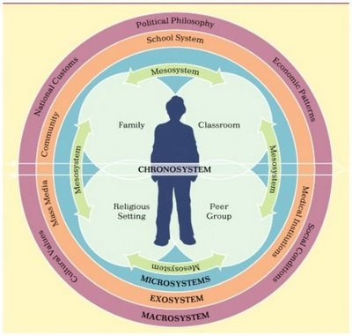
Promoting Student Social, Emotional, and Behavioral Wellbeing
Social-emotional wellbeing as a function of Supportive, Healthy Environments
Create the context for engagement and learning to occur
SEL competencies as Enablers to Life Success
Knowledge and skill acquisition

Slide 26
Positive Climates Provide the Context in Which ALL Humans Thrive
Critical
Misjudged, mistrust
Attention to negative
Reactive, punitive
Unstructured
Can’t you do better
“You’re not doing it right!”
“What’s wrong with you!”
Compassionate
Connected
Attention to positive
Proactive, supportive
Structured, organized
Encouraging
“Way to put in effort!”
“I believe in you!”
Notes:
In which environment would you rather work and learn? Where would you flourish and perform best?
Who is responsible for designing your work environment? Who is responsible for designing the classroom environment?
How do we design a positive classroom environment?

Slide 27
Capitalize on the opportunities or miss opportunities?
7 x 180 = 1260

Slide 28
THE PLATE

Slide 29
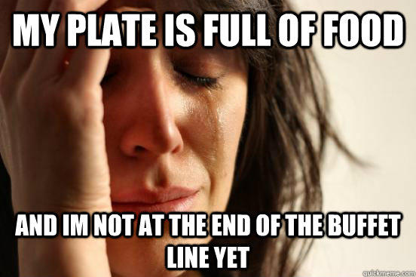

Slide 30
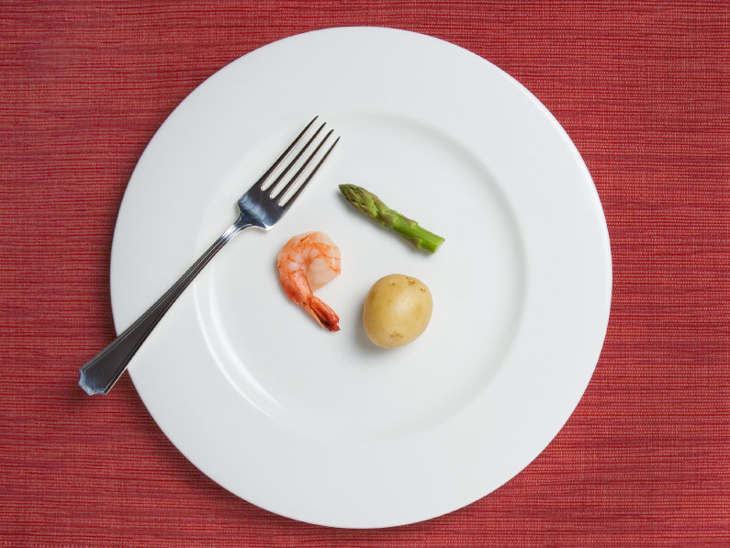

Slide 31
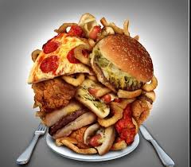

Slide 32
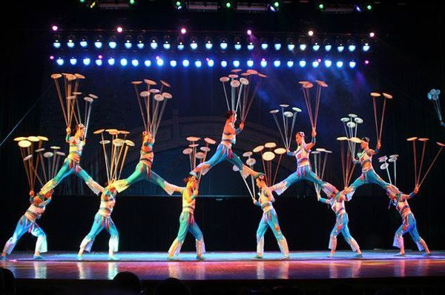
Forest Lake Educators

Slide 33
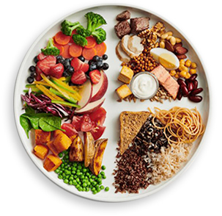
What should go on educators’ plates?

Slide 34
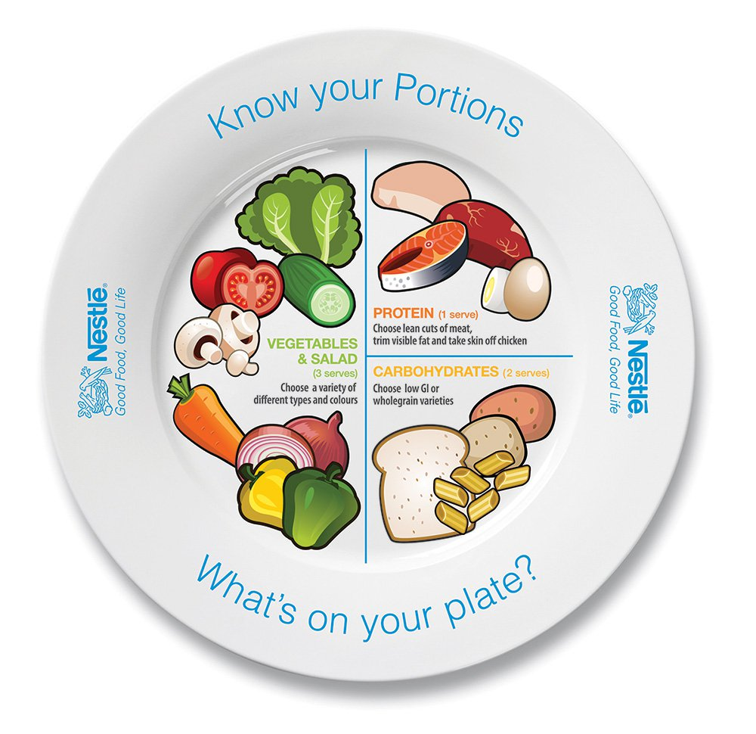
What should go on educators’ plates?
Portion control
Making sure the right stuff is on the plate
Notes:
Lopsided focus on academics

Slide 35
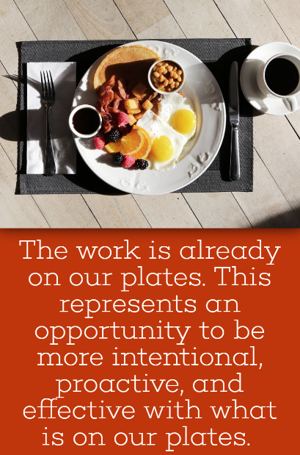
Interacting with students
Managing student behavior
Responding to student needs

Slide 36
The What:

Slide 37
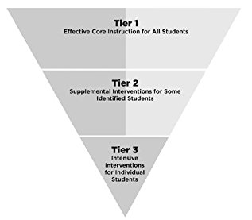
Purpose of Tier 1
Tier 1 Purposes:
Prevent problems from emerging
Promote/enhance/optimize success
Provide a solid foundation that enable interventions to work better
ALL Students Receive Exposure to Prevent and Promote

Slide 38
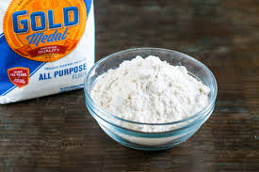
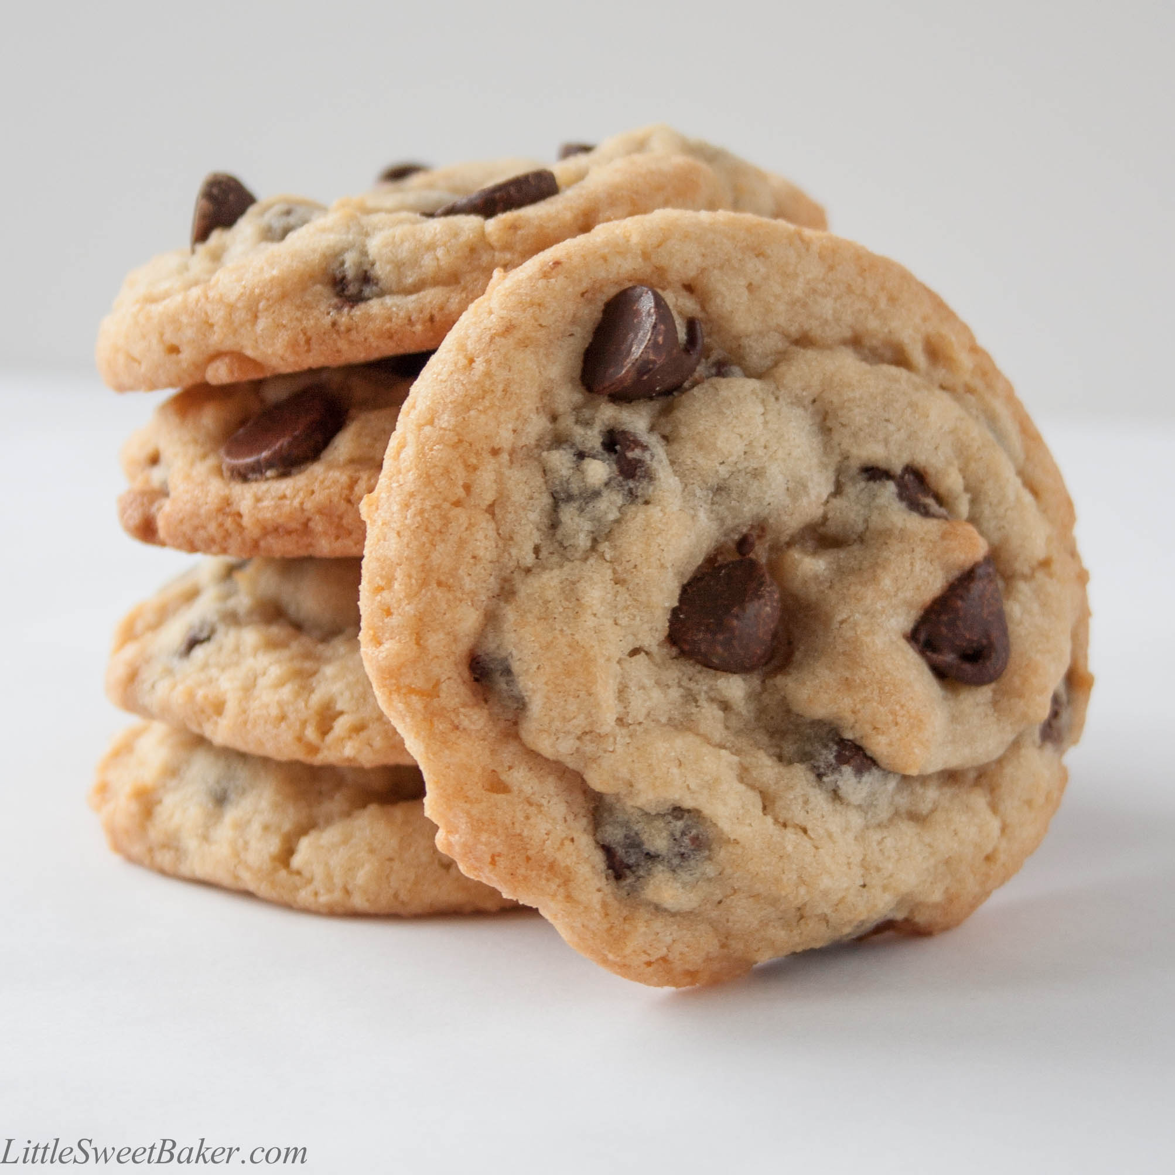
Metaphor Tier 1 as a Baking Recipe
Providing high quality school experiences that serve as a platform for life success is like a good cooking recipe that involves the integration of core active ingredients
An active ingredient is a component of a recipe that helps achieve its desired outcome
Single ingredients represent necessary features of the recipe, but insufficient alone to produce the desired outcome
=
Notes:
(ELICIT, PROVIDE, ELICIT)

Slide 39
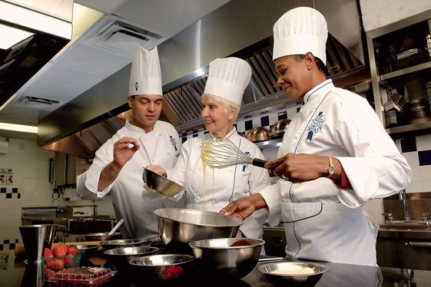
The Recipe for Creating a Robust Tier 1
What are the ingredients?
Notes:
An ingredient is something that will never become a bad idea for schools to invest

Slide 40
Evidence-Informed Practice Ingredients
Environment – adults in charge create a safe, predictable, and reinforcing/positive environment
Relationships – everyone (staff and students) feels a sense of belonging and connection
Knowledge, skills, & mindsets – rigorous instruction to teach students the social, emotional, and academic knowledge, skills, and mindsets necessary to meet the demands of home, work, & civic life
Differentiated supports – students with needs are able to access differentiated supports as part of core instruction / classroom environment

Slide 41
Linking Ingredients to Implementation
RECIPE INGREDIENTS
SELECTION TO IMPLEMENT
SW-PBIS & Proactive Classroom Management
Environment: positive, safe, structured, predictable
Positive relationships for ALL
Establish, Maintain, Restore or Restorative Practices
Knowledge, skills, & mindsets
Instructional framework/practices along with quality core academic & SEL curricula
Differentiated supports
Prevent, Teach, & React approach used in PLCs to facilitate teacher problem-solving

Slide 42
Social, emotional, behavioral side to MTSS
Progress monitoring
Tier 3 Menu of Individual Supports for a FEW:
Intensive academic interventions
Individualized behavioral and mental health services
Wraparound supports
Medical intervention
Targeted/
Intensive
(FEW High-risk students)
Individual Interventions
(3-5%)
Tier 2 Menu of Default Supports for SOME:
Academic interventions
Social, emotional, and behavioral
interventions
Selected
(SOME At-risk Students)
Small Group &
Individual Strategies
(10-25% of students)
Screening
Tier I Menu of Supports for ALL:
Core academic and social-emotional
curriculum/instruction
School-wide PBIS
+ Relationships w/ ALL Students
Rested, nourished, & physically well
Differentiated supports for struggling
students
Universal
(ALL Students)
School-wide, Culturally-responsive
Systems of Support
(75-90% of students)

Slide 43
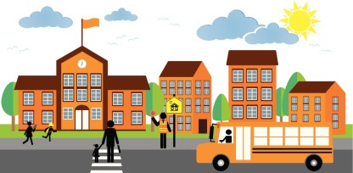
What are the ingredients?
Environmental ingredient
A safe, nurturing, predictable, and reinforcing environment

Slide 44
School-wide PBIS: Teaching, Modeling, Cueing and Reinforcing Common Behavioral Expectations to Create a Healthy, Supportive Environment

Slide 45
Big Ideas of SW-PBIS
Consistency and predictability through adults getting on the same page
Shared understanding of behavior between adults and students
Helps students code-switch
Provides ongoing feedback to students about their behavior
Turns behavioral mistakes into learning opportunities

Slide 46
Teaching Matrix |  | SETTING
 |  | All Settings | Hallways | Playgrounds | Cafeteria | Library/ Computer Lab | Assembly | Bus
 | Respect Ourselves | Be on task. Give your best effort. Be prepared. | Walk. | Have a plan. | Eat all your food. Select healthy foods. | Study, read, compute. | Sit in one spot. | Watch for your stop.
 | Respect Others | Be kind. Hands/feet to self. Help/share with others. | Use normal voice volume. Walk to right. | Play safe. Include others. Share equipment. | Practice good table manners | Whisper. Return books. | Listen/watch. Use appropriate applause. | Use a quiet voice. Stay in your seat.
 | Respect Property | Recycle. Clean up after self. | Pick up litter. Maintain physical space. | Use equipment properly. Put litter in garbage can. | Replace trays & utensils. Clean up eating area. | Push in chairs. Treat books carefully. | Pick up. Treat chairs appropriately. | Wipe your feet. Sit appropriately.
1. SOCIAL SKILL
2. NATURAL CONTEXT
Expectations
3. BEHAVIOR EXAMPLES

Slide 47
How Do We Teach Behavior?
Introductory Learning Experiences
School-wide assemblies
Videos that demonstrate example & non-example
Rotational teaching
Students receive instruction on behavioral expectations by the adults who are responsible for each and every setting (office, cafeteria, bus drivers, media/library, etc.)
On-going teaching of expectations
Classroom lessons throughout the year
Referencing in other curriculum and multiple contexts

Slide 48
Key Terms
Acknowledgement
Recognition
Appreciation

Slide 49
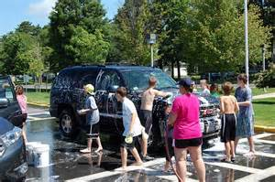
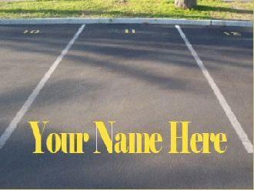
Staff Acknowledgement & Recognition to Show Appreciation
Covering class to provide gift of time
Favorite food delivered
Surprise car wash
Favorite caffeine waiting for you in the morning
Best parking spot reserved

Slide 50
Rationale-What Does 5 Positives to 1 Negative Mean?
Students should experience predominately positive interactions (ratio of 5 positives for every negative) in all locations of school.
Positive Interactions =
Behaviorally specific feedback as to what the student did right (contingent)
Smile, nod, wink, greeting, attention, hand shake, high five (non-contingent)
Greetings and farewells
Negative Interactions=
Reprimands
Sarcasm
Non-specific behavioral corrections
Ignoring student behavior (appropriate or inappropriate)

Slide 51
Gottman Research
Predicted whether 700 newlywed couples would stay together or divorce by scoring their positive and negative interactions in one 15-minute conversation between husband and wife.
Ten years later, the follow-up revealed that they had predicted divorces with 94% accuracy.
Marriages that last: o 5.1 to 1 for speech acts and 4.7 to 1 for observed emotions
Marriages likely to end in divorce: o 1 positive to 1.5 negative ratio likely to end up in divorce

Slide 52
Research on 5 to 1 Ratio
Marriages:
Successful marriages = 5.1 positives to 1 negatives
Struggling marriages = 1 positives to 1.5 negatives
Business Teams:
High Performance = 5.6 positives to 1negative
Medium Performance = 1.9 positives to 1 negative
Low Performance = 1 positive to 2.7 negatives Losada, 1999; Losada & Heaphy, 2004
Educators
Teachers with strong relationships/low behavior problems = 4.5 positives to 1 negatives
Teachers with weaker relationships/higher behavior problems = 1 positives to 10 negatives

Slide 53
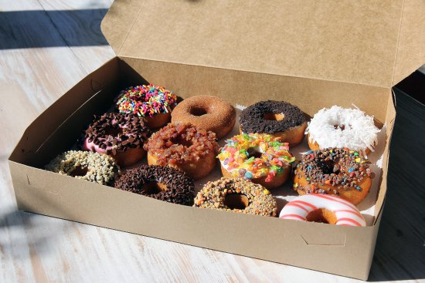
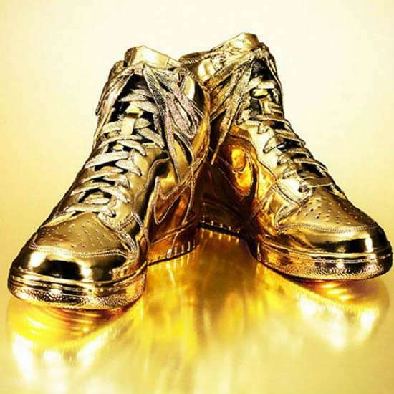
Recognizing and Acknowledging Behavior in Specific Settings
Cafeteria
Being in class on time
Hallway behavior: Walking and staying to the right

Slide 54
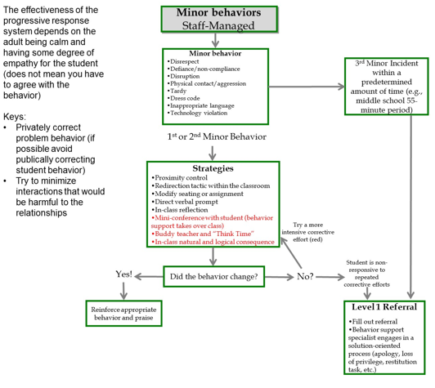
School-Wide PBIS:
Creating a progressive discipline system

Slide 55
Responding to Problem Behavior
Progressive Response
Proximity control
Redirection strategy
Ongoing Monitoring
Prompt expected behavior
Teaching interaction
#1 warning of consequence with “Think Time’
Reconnect, Repair, & Restore Relationship
#2 delivery in-class disciplinary consequence
#3 request for office support process

Slide 56
Proactive Classroom Management: Prevention-oriented strategies to promote academic engagement and decrease problem behaviors

Slide 57
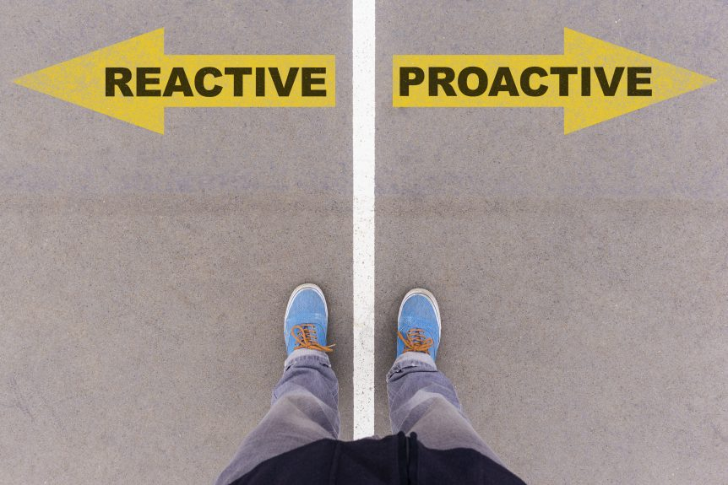
I’m going to invest time, where do I to invest it?

Slide 58
Structured Environments Proactive Classroom Management
Relationship Strategies
Procedural Strategies
5 to 1 ratio of positive to negative interactions (Magic ratio)
Behavior specific praise
Smiling and being nice
Positive greetings and farewells on a daily basis
Communicating competently w/ students
Wise Feedback
Non-contingent reinforcement
Precorrection
Organizing a productive classroom (effortless to pay attention, flow, limit distractions, seating)
Providing numerous opportunities to respond
Providing student choice
Ongoing teaching, modeling, and recognition of behavioral expectations
Transitions are managed well
Independent seatwork is managed and used when needed
Teacher proximity and mobility
Class-wide motivation system to motivate behavior
Goal setting and performance feedback
Visual schedule of classroom activities
Effective cueing systems to release and regain attention

Slide 59
What is a Precorrection?
Antecedent
Behavior
Consequence
Prevent
Teach
Respond
A form of errorless learning
Reminding/prompting students how to be successful before they even begin the activity, assignment or task
Not assuming that students are ready or are thinking about how to be successful
Rather, providing them with the behavioral answers to be successful in class
Notes:
Managing behavior with precorrections:
An antecedent-based strategy: anticipate what activities may cause inappropriate behaviors
Identifies predictable contexts that often result in problem behavior and provides students with supports, prompts, and reinforcement for engaging in appropriate behavior
A shift from controlling behavior with consequence alone

Slide 60
What is a Precorrection?
Precorrection
Correction
Proactive teaching methodology that does not assume students know and ready for what is next
Anticipating behavior that could occur and getting on the front end of it
Increasing the likelihood that you wont see particular behaviors that interfere with learning
Waiting for behavior to occur then reacting to it
Unintentionally escalating behavior by how behavior is addressed
Assuming students are thinking about what to do next
vs.

Slide 61
What is a classroom motivation system?
Antecedent
Behavior
Consequence
Prevent
Teach
Respond
System that grants students contingent access to wanted experiences based on exhibiting desired behavior
Notes:
Managing behavior with precorrections:
An antecedent-based strategy: anticipate what activities may cause inappropriate behaviors
Identifies predictable contexts that often result in problem behavior and provides students with supports, prompts, and reinforcement for engaging in appropriate behavior
A shift from controlling behavior with consequence alone

Slide 62
Motivation System
Types of group-based motivation systems:
ALL for one (visible publically)
ONE for all
To each his/her own (privately managed)

Slide 63
What is a Positive Greetings at the Door?
A
B
C
Antecedent Behavior Consequence
Goal is to get the class off to a good start and pull students “into relationship” with the teacher before transitioning into the room
Aim is for each student to feel welcomed and wanted as they enter the classroom
Notes:
Managing behavior with precorrections:
An antecedent-based strategy: anticipate what activities may cause inappropriate behaviors
Identifies predictable contexts that often result in problem behavior and provides students with supports, prompts, and reinforcement for engaging in appropriate behavior
A shift from controlling behavior with consequence alone

Slide 64
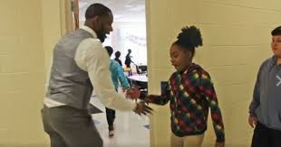
Steps to Implement PGD
Steps
Have an activity ready as students transition into the classroom
Greet each student individually using their name, a gesture, or special handshake
Periodically prompt/remind of the activity
Be intentional about connecting with students who may have struggled behaviorally the previous day

Slide 65
What are the ingredients?
Relationship ingredient
All students and staff feel welcomed, valued and a sense of belonging and connection to others in school

Slide 66
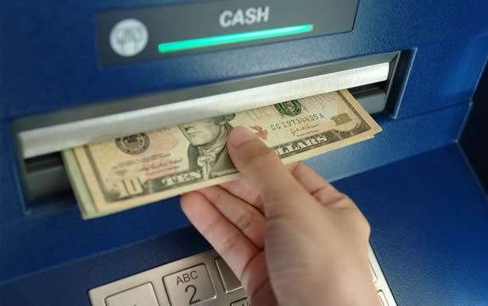
Banking Metaphor
Relationships are transactional, like banking:
One cannot withdraw from a relationship until deposits have been made
Notes:
MD: some teachers at Washington had a little bit of a reaction to this metaphor. Can you preface with something that acknowledges that?
LN: Maybe reframing it along the lines of “if your interactions (deposits) aren’t demonstrating care in a way that builds up (banking interest) the student’s respect for you, you cannot expect the student to take in what you’re saying because you haven’t built the respect from the student to be able to do so (cannot afford the withdrawal)”

Slide 67
Banking Metaphor
Withdraws educators make from students:
Correcting student behavior
Motivating a student to do unwanted work
Reminding students to show up to class on time
Getting students to be okay with failure
Encouraging students to try their hardest

Slide 68
Equity/Triage Tree Exercise: Identifying Who Needs it the Most
Apples represent the students in your class.
Where a student is located depends on the relationship you have with the student.
Step 1:
Select the class you are struggling with the most

Slide 69
Equity/Triage Tree Exercise: Identifying Who Needs it the Most
Step 2:
Separate the tree into thirds
Bottom = low hanging fruit (easy to build relationship)
Middle = those who require more effort but you have a relationship with
Top = difficult to reach students who need you to extend a relationship latter

Slide 70
Equity/Triage Tree Exercise: Identifying Who Needs it the Most
Step 3:
Exploring inequities
Is gender equally distributed across the tree?
Is race/ethnicity equally distributed across the tree?
Is socioeconomic status equally distributed across the tree?

Slide 71
Equity/Triage Tree Exercise: Identifying Who Needs it the Most
Step 4:
Equity
Action plan: Identify Establish or Restore strategies that you can use with the students in the top third of the tree who are in most need of you to intentionally build a relationship with them.

Slide 72
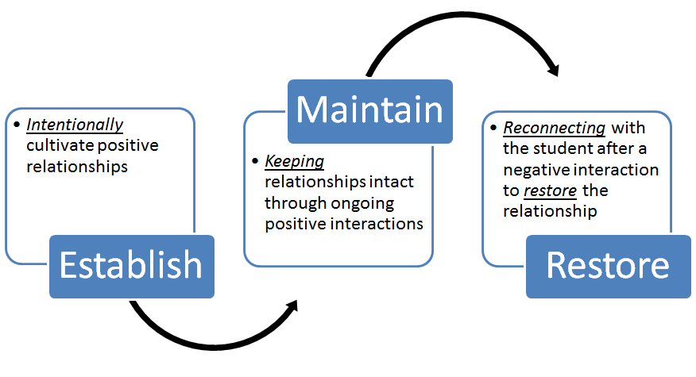
Establish-Maintain-Restore
Provides staff with concrete relationship practices
Embedded within professional learning communities as a continuous improvement process
Notes:
MD: don’t think you need both this and the graphic on the previous slide. I like the previous graphic better.

Slide 73
Establish Practice Categories:
Goal is to intentionally capitalize on existing time to establish positive relationships with students, especially those who need and can benefit from it the most
Devote time to get to know students
Banking time
Gather, track, and acknowledge
Communicating high expectations and high support
High expectation, high belief feedback
Proactively & reactively offering help
Providing opportunities for voice and choice
Gathering feedback & acting on it
Interspersing opportunities for choice
Intentional acknowledgements to show care
Positive greetings & farewells
Recognizing something positive through other adults

Slide 74
Maintain Practice Categories:
Goal is maintain positive relationships that have been established by striving for a 5 to 1 ratio of positive to negative interactions
Preventing Negative Interactions
Respond progressively
Responding to problem behavior with empathy
Positive Interactions
Greetings & farewells
Opportunities for fun & laughter
Checking in on how things are going inside & outside of school
Recognizing & acknowledging specific behavior
Recognizing & acknowledging effort, failure, & persistence
Non-contingent positive interactions (i.e., not-based on previous behavior or something the student said or did)
Contingent positive interactions (i.e., based on something the student said, did, achieved, or put effort into doing)

Slide 75
Restore Practice Categories:
Goal is reconnect with the student to skillfully communicate to repair and restore the relationship
Letting Go Conversation
For whom: student who thinks the adult will hold a grudge
Taking ownership
For whom: student who thinks the adults think
Empathy and mutual problem-solving
Statement of care by separating deed from the doer
For whom: student who thinks adult does not care or want them in class
For whom: student who wants perspective understood
Notes:
Empathy statements are critical

Slide 76
What are the ingredients?
Knowledge and skills ingredient (i.e., teaching and learning)
Teach the knowledge and skills that enable students to meet the demands of civic, work, and private aspects of life

Slide 77
Social-Emotional Learning: Adopting a curriculum that supports students to learn self-regulation and decision-making skills that lead to increased resilience and school and life success

Slide 78
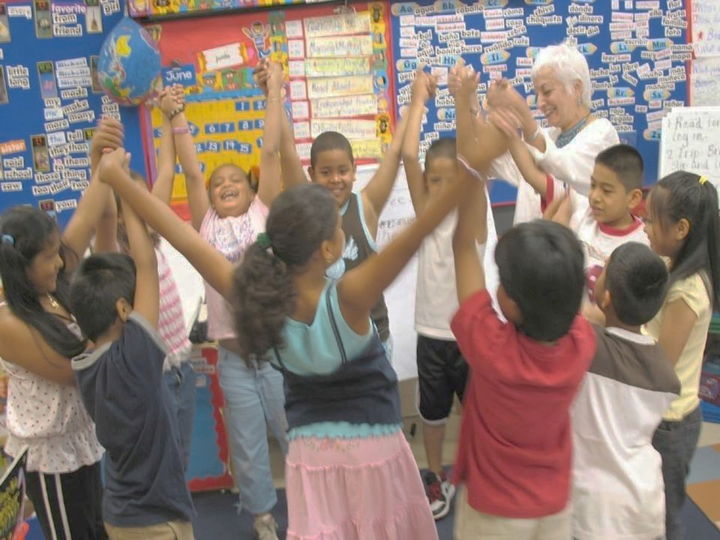
SEL is…
The process through which children and adults acquire and effectively apply the knowledge, attitudes, and skills necessary to understand and manage emotions, set and achieve positive goals, feel and show empathy for others, establish and maintain positive relationships, and make responsible decisions.

Slide 79
Social and Emotional Learning
SEL
Impulse control
Stress management
Self-discipline
Self-motivation
Perseverance
Goal-setting
Organizational skills
Identifying emotions
Self-perception/Identity
Recognizing strengths
Sense of self-confidence
Self-efficacy
SELF-AWARENESS
SELF-MANAGEMENT
Perspective-taking
Empathy
Appreciating diversity
Respect for others
Social and
Emotional
Learning
(SEL)
SOCIAL AWARENESS
RESPONSIBLE DECISION-MAKING
RELATIONSHIP SKILLS
Identifying problems
Analyzing situations
Solving problems
Evaluating
Reflecting
Ethical responsibility
Communication
Social engagement
Building relationships
Working cooperatively
Resolving conflicts
Helping/Seeking help
Notes:
How we understand ourselves, how do we work well with others, and how do we make good decisions
So everything from resilience, managing anger, how you deal with conflict, how you deal with others – is what underlies everything. And we know if you are intentional

Slide 80
SEL works: Compelling national evidence
Science Links SEL to Student Gains:
Better social-emotional skills
Improved attitudes about self, others, and school
Positive classroom behavior
11 percentile-point gain on standardized achievement tests
Fewer conduct problems
Less emotional stress
Lower drug use
…and adults benefit too
Teachers who possess social and emotional competencies are more likely to stay in the classroom longer because they’re able to work more effectively with challenging students —one of the main causes of burnout.
Statistically significant associations between measured social-emotional skills in kindergarten and key young adult outcomes across multiple domains of education, employment, criminal activity, substance use, and mental health.
Notes:
80
80
An overview slide for those who want only one slide, with research highlights.
It combines findings from several studies on one slide. Note that the citations are not on the actual slide, but they are here in case you are asked:
Meta-analysis source (top section): Durlak, J.A., Weissberg, R.P., Dymnicki, A.B., Taylor, R.D., & Schellinger, K. (2011). The impact of enhancing students’ social and emotional learning: A meta-analysis of school-based universal interventions. Child Development: 82 (1), 405-432.
Teacher burnout (bottom left): Jennings, P.A. & Greenberg, M.T. (2009). The prosocial classroom: Teacher social and emotional competence in relation to student and classroom outcomes. American Educational Research Association.
Adult outcomes (bottom right): Jones, D.E., Greenberg, M., & Crowley, M. (2015) Early social-emotional functioning and public health: The relationship between kindergarten social competence and future wellness. American Journal of Public Health 105 (11), 2283-2290.

Slide 81
Implementing an SEL Curriculum
Delivery
What?
Selecting a high quality curriculum
When and where?
Time and day of the week
Homeroom, advisory period, health class, other classroom setting
Who?
General education teacher, health teacher
Master scheduling issue

