Slide 1

Intervention Programming from Beginning to End: Matching, Mapping, Monitoring, and Meeting
Clayton R. Cook, PhD
Associate Professor
School Psychology
College of Education & Human Development
University of Minnesota
Core Faculty
Institute for Translational Research in Children’s Mental Health
University of Minnesota
im4education.com

Slide 2
What makes a behavior a problem?

Slide 3

What is the definition of a problem/need?
Between what is expected for someone to be able to do and what the individual is currently doing

Slide 4
What indicates a social, emotional, or behavioral need for intervention?
It is having a negative impact on the learning environment, others, or self
What dimension of ‘IT’ is creating the need?
  Frequency
  Duration
  Intensity

Slide 5

Welcome to IM4, a problem-solving system that coordinates intervention programming from beginning to end for students with social, emotional, and behavioral needs.
Notes:
IM4 is somewhat similar to Turbotax. How many of you have used Turbotax to file your taxes?
Turbotax is a system that enables someone to perform like an expert accountant due to embedded algorithms and sequenced process. As a user, you need to prepared with specific information that it will prompt you to input into the system so you too can file you taxes in a way where you get maximum benefit and don’t violate IRS.
If you input the right information into the system, it will guide

Slide 6
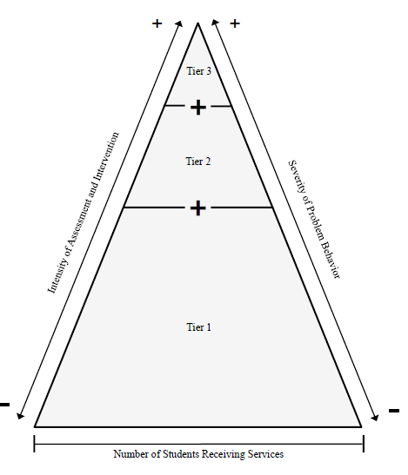
What is Tier 2?
For 10 to 20% of all students who exhibit social, emotional and/or behavioral needs that warrant intervention above Tier 1 alone
Implemented in addition to Tier 1
Quick and efficient
    Limited assessment data and minimal expertise needed to select and implement an appropriate intervention for the student

Slide 7
Tier 2 is a process not just an intervention
Tier 2 and 3 is a coordinated problem-solving process that we wrap around a child not just an intervention
  Proactively detecting students who need intervention
  Matching students to intervention
  Gathering baseline data
  Implementing the intervention
  Monitoring progress
  Meeting

Slide 8
How does a student go from Tier 1 to Tier 2?
Proactive detection of students who may be in need of intervention
Use of existing data capturing warning indicators (“kitchen sink”)
Universal and/or targeted screening
Structured Teacher Nomination

Slide 9
Existing Social, Emotional, and Behavior Screening Tools
Free screening tools
  Student Risk Screening Scale (Externalizing & Internalizing)
  Brief Externalizing and Internalizing Screener for Youth (BEISY)
  Youth Internalizing & Externalizing Problem Screeners (YIPS & YEP)
  Strengths and Difficulties Questionnaire (SDQ)
Commercially available screening tools
  Review360 (Student internalizing behavior screener & Student externalizing behavior screener)
  Social, Academic, Emotional Behavior Risk Screener (SAEBRS; FBL)
  Systematic Screener for Behavioral Disorders (SSBD)
  Behavior and Emotional Screening Scale (BASC)
  Social Skills Improvement System – Screener (SSIS-S)
  DESSA-Mini

Slide 10
The ‘What’
Structured problem-solving process
Step 1: Identify and define the main problem/concern/need
What intervention does the student need to address the hypothesized root cause underlying the problem?
Step 4: Evaluate whether the plan worked
Step 2: Determine why the problem is happening to generate solutions
Step 3: Develop and implement a plan

Slide 11
The ‘What’ in IM4 Language
Match, Map, Monitor and Meet
Match
  Problem Identification & Problem Analysis
  Matching the student to the most precise and appropriate intervention
Map
  Plan Development and Implementation
  Core components of the intervention to increase the fidelity with which the intervention is implemented
Monitor
  Plan Evaluation
  Gather baseline data and begin monitoring student response to the intervention and intervention fidelity
Meet
  Plan Evaluation
  Meet as a team to review data and make a data-driven decision

Slide 12


Slide 13
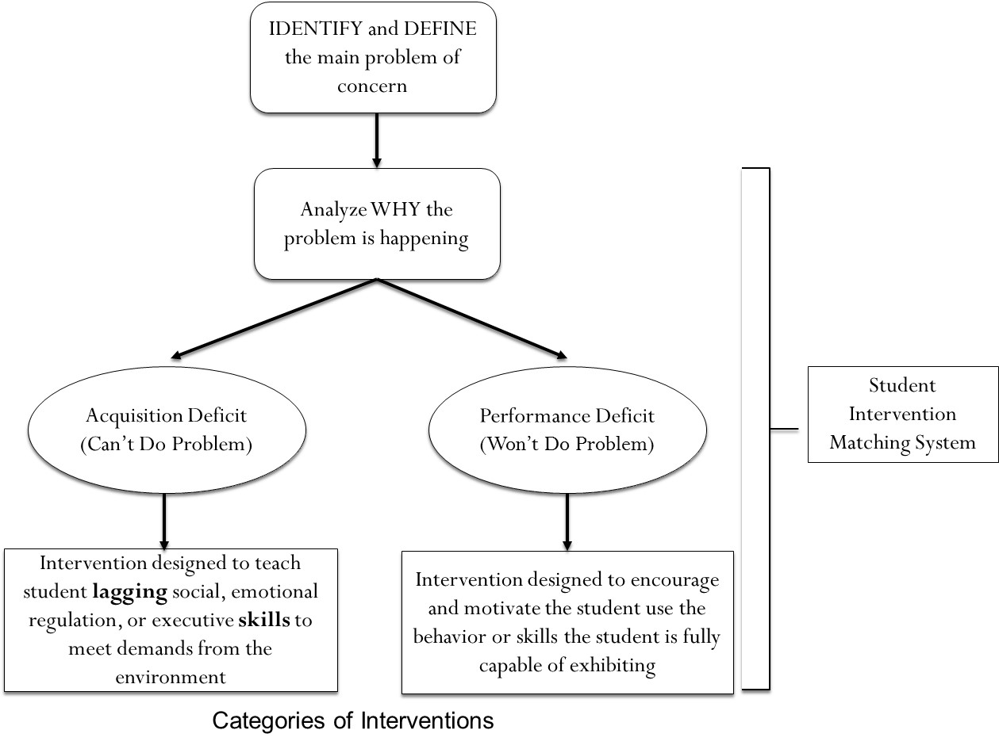
Match
  Match the student to the most precise and appropriate intervention

Slide 14
Problem-Solving Process
Step 1: Identify & define the problem
Step 2: Determine why the problem is happening (i.e., root cause analysis)
Step 3: Select an intervention to address the problem
Step 4: Implement the intervention with fidelity and determine whether it was effective
Student Intervention
Matching System

Slide 15



Root Cause Analysis
Theoretically-informed, data-driven approach to determine the hypothesized root cause that explains why the problem is happening
Linking root cause to intervention
  root cause must be amenable to intervention (malleable/alterable) so it can be linked to a precise intervention that educators have ability/control over to implement

Slide 16

Why a menu of evidence-based interventions?
Students with social, emotional and behavioral problems are a heterogeneous group of students
One-size-fits-all approach to intervention results in lackluster outcomes
Matching students to the most precise intervention requires having a menu of options to select from

Slide 17
Tier 2 Root Cause Analysis to Determine Why the Problem is Happening

Slide 18

Acquisition-Performance Deficit Paradigm
A problem or difficulty will always be observed when
(1) a person lacks or does not possess a skill or given set of behaviors
ACQUISITION DEFICIT
(Can’t do)
(2) A person is not properly supported or motivated to exhibit the skills or behaviors they do possess
PERFORMANCE DEFICIT
(Won’t do)
OR
to meet the demands and expectations of a given performance setting (e.g., classroom).

Slide 19
Acquisition vs. Performance
Descriptor | Acquisition Deficit | Performance Deficit
Explanation of the problem | Problem occurs because the student does not possess the requisite skills/behaviors to meet the demands or expectations of the environment | Problem occurs because the student is insufficiently supported or motivated by the environment to exhibit the skills/behaviors they possess
Student deficit | Student lacks a skill/behavior that is necessary to meet the social or academic demands of the environment | Student is not properly motivated and/or supported to utilize skills/behaviors they already possess
Type of problem | Can’t Do Problem | Won’t Do Problem
Focus of the intervention | Instructional intervention that focuses on teaching the student lagging skills or behaviors to effectively meet the demands from the environment | Intervention that is embedded in the environment that prompts, encourages, and motivates student to use skills/behaviors he or she already possesses
Notes:
Students who are in the middle need more practice; to build their fluency
For behavior kids, treat kids who need fluency as kids who need acquisition→ gives opportunities for practice
Academically, it is easier to contrive practice situations
Performance deficit interventions need to be firmly embedded in the environment

Slide 20
Categories of Interventions
IDENTIFY and DEFINE the main problem of concern
Analyze WHY the problem is happening
Acquisition Deficit
(Can’t Do Problem)
Performance Deficit
(Won’t Do Problem)
Student Intervention Matching System
Intervention designed to teach student lagging social, emotional regulation, or executive skills to meet demands from the environment
Intervention designed to encourage and motivate the student use the behavior or skills the student is fully capable of exhibiting

Slide 21
Student Intervention Matching - Form

Slide 22

Tier 2 Menu of Supports
Tier 2 Menu:
Performance-based Interventions
  Behavioral contract
  Self monitoring
  School-home note system
  Structured, mentor-based program
  Class Pass Intervention
  Goal setting with problem solving
Acquisition-based Interventions
  Small group social-emotional skills
    Social skills
    Executive functioning
    Emotion regulation
Targeted/
Intensive
(A FEW
students)
Individual
Interventions
(3-5%)
Tier 2 Menu:
Performance-based Interventions
  Behavioral contract
  Self monitoring
  School-home note system
  Structured, mentor-based program
  Class Pass Intervention
  Goal setting with problem solving
Acquisition-based Interventions
  Small group social-emotional skills
    Behavior regulation
      Social skills
      Executive functioning
    Emotion regulation
      Anger
      Anxiety/depression
      Trauma
Selected
(SOME Students)
Small Group or
Individual Strategies
(10-25% of students)
Universal
(ALL Students)
School/classwide, Culturally Relevant
Systems of Support
(75-90% of students)

Slide 23
Tier 2 Menu of Supports
Tier 2 Menu:
Performance-based Interventions
  Behavioral contract
  Self monitoring
  School-home note system
  Structured, mentor-based program
  Class Pass Intervention
  Goal setting with problem solving
Acquisition-based Interventions
  Small group social-emotional skills
    Social skills
    Executive functioning
    Emotion regulation
Targeted/
Intensive
(A FEW
students)
Individual
Interventions
(3-5%)
Tier 2 Menu:
Performance-based Interventions
  Behavioral contract
  Self monitoring
  School-home note system
  Structured, mentor-based program
  Class Pass Intervention
  Goal setting with problem solving
Acquisition-based Interventions
  Small group social-emotional skills
    Social skills
    Executive functioning
    Emotion regulation
Selected
(SOME Students)
Small Group or
Individual Strategies
(10-25% of students)
Universal
(ALL Students)
School/classwide, Culturally Relevant
Systems of Support
(75-90% of students)

Slide 24


Performance-Based Intervention
Behavior Contract
Process of negotiating an agreement between staff and a student so each party receives some benefit or payoff
  Teacher benefits by improved student behavior
  Student benefits by earning something based on good behavior
Components of behavioral contract:
  Description of the desired behaviors
  Goal statement specifying by when, what behavior, and under what conditions pay-off will be earned
  Identification of the privileges, rewards, or desired social experiences to be earned
  (i.e., The Pay-Off)
  Signatures from all parties involved
  Teacher precorrects and prompts student on daily basis using the behavior contract

Slide 25

Behavior Contract:
Student Characteristics
Designed for students who respond well to school-based incentives or contingent access
  Eager to earn rewards, special privileges, and/or recognition from others
Students who dislike particular academic subjects and could benefit from receiving extrinsic reinforcement (i.e., pay-off)
Students who could benefit from receiving precorrection and prompting

Slide 26

Behavior Contract:
Active Ingredients
Negotiated agreement or brokered deal to increase student buy-in
Focus on positive behaviors teachers want to see in the classroom (i.e., those behaviors that are incompatible with problem behavior)
Positive reinforcement for meeting goal
Teacher follows up with daily pre-correction and prompting
  Pulling out the contract and reminding the student of the behavior and reward to be earned
  At the first warning signs of problem behavior, prompting the student

Slide 27
Difference Between Effective and Ineffective Behavior Contracts
Negotiated agreement
Describes what the student should do
Provides a goal statement
Outlines what the student will earn as a reward for meeting goal
Teacher uses contract to precorrect and prompt behavior
Non-negotiated
Describes what the student is doing wrong
Provides no goal statement
Outlines how the student will be punished if problem behavior continues
No other adult follow through with the contract
EFFECTIVE BEHAVIOR CONTRACT
INEFFECTIVE BEHAVIOR CONTRACT

Slide 28
Performance-Based Intervention
Class Pass Intervention
CLASS PASS
Name: ________________
Time: __________
Where to?: ___________________
Initial: __________
Intervention designed for students who escaped-motivated disruptive classroom behavior
Students are given class passes and taught how to appropriately request a break by issuing a class pass
Students can choose to hold on to the class passes to exchange them for a more preferred item, activity, or privilege
It works because students:
  Exercise choice by requesting a break with class pass
  Dual motivational contingencies (break from work and contingent access to preferred experience)

Slide 29
CPI Implementation Steps
Meet with the student to teach them the CPI and how to appropriately request a break using the class pass
Identify a spot where the student can break and engage in a preferred activity for 3 – 7 minutes (this depends on how long staff are willing to accept)
Determine the rewards and/or privileges that can be earned by saving the class passes (make it such that the more passes means the better the reward and/or privilege)
Give the student a predetermined amount of class passes (anywhere from 3 to 5)
When implementing the CPI, provide prompts to the student to use the class pass if you see him beginning to engage in problem behavior
Monitor and track the effectiveness of the intervention
Give the student feedback about how he is doing

Slide 30
Class Pass Intervention:
Student Characteristics
Students who engage in classroom behavior problems only when presented with academic work
Students whose classroom behavior is hypothesized to be escape-motivated
Students who have a low tolerance for engaging in academic work
Students who are more likely to remain on-task when provided with choice

Slide 31
Class Pass Intervention:
Active Ingredients
Develop the actual class passes to be used
Determine the number of class passes and length of time the student can break for
Identify the location for the break (desk, in the classroom, outside of the classroom)
Identify the items, privileges, or activities that can be earned and the number of class passes needed for each one

Slide 32
Example of a Class Pass
FRONT
BACK
Guidelines for Class Pass:
If you use the pass…
1. Choose a time when you need to step out of the class.
2. Fill out one of your passes.
3. Show pass to teacher.
4. Walk to ____________________.
5. Have adult where you walked initial pass on your way back to class.
6. Enter class quietly.
7. Join classroom activity.
If you save the pass…
Earn a reward!!!!!!!
CLASS PASS
# ______
Name: ________________
Time: __________
Where to?: ___________________
Initial: __________
Reward for a saved pass:
___________________________

Slide 33
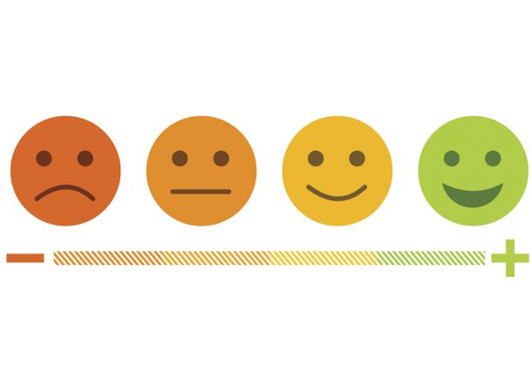

Acquisition-Based Interventions
EMOTIONAL REGULATION/COPING
  Anger
  Anxiety
  Trauma
  Stress/Depression
BEHAVIORAL REGULATION
  Social Skills
  Executive Functioning

Slide 34
Example evidence-based curriculum
EMOTIONAL REGULATION
  Anger
    Anger replacement training; Coping Power
  Anxiety
    FRIENDS, Coping Cat, Coping with Stress
  Trauma
    Bounce Back, Cognitive Behavior Intervention for Trauma in Schools
  Stress/Depression
    Coping with Depression, Penn Resilience Program, Teaching Kids to Cope
BEHAVIORAL REGULATION
  Social Skills
    Skillstreaming, Social Skills Improvement System
  Executive Functioning
    Homework, Organization, and Planning Skills

Slide 35


Slide 36
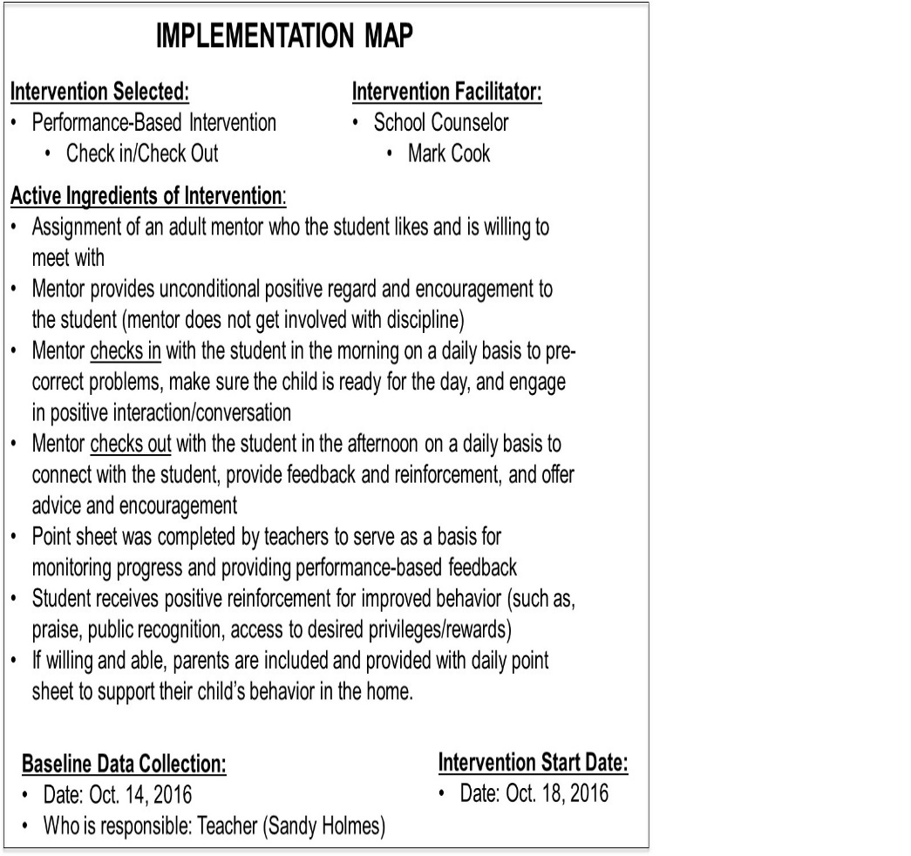
Map
Map out who is implementing core components of the intervention to increase the fidelity with which the intervention is implemented

Slide 37




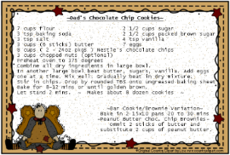

Mapping out a Plan (MAP)
Focusing on the Active Ingredients
Delivering an effective intervention is like a good cooking recipe that involves combining multiple ingredients to produce a yummy product
  An ingredient is a component of a product that helps achieve its desired outcome
  Single ingredients are necessary but insufficient alone to produce the desired outcome
=

Slide 38
IMPLEMENTATION MAP
Intervention Selected:
Performance-Based Intervention
  Check in/Check Out
Intervention Facilitator:
School Counselor
  Mark Cook
Who’s Responsible?
Active Ingredients of Intervention:
Assignment of an adult mentor who the student likes and is willing to meet with
Mentor provides unconditional positive regard and encouragement to the student (mentor does not get involved with discipline)
Mentor checks in with the student in the morning on a daily basis to pre-correct problems, make sure the child is ready for the day, and engage in positive interaction/conversation
Mentor checks out with the student in the afternoon on a daily basis to connect with the student, provide feedback and reinforcement, and offer advice and encouragement
Point sheet was completed by teachers to serve as a basis for monitoring progress and providing performance-based feedback
Student receives positive reinforcement for improved behavior (such as, praise, public recognition, access to desired privileges/rewards)
If willing and able, parents are included and provided with daily point sheet to support their child’s behavior in the home.
Initials:_______
Initials:_______
Initials:_______
Initials:_______
Initials:_______
Initials:_______
Initials:_______
Dates:
Baseline Data Collection:
Date: Oct. 14, 2016
Who’s responsible: Teacher (Sandy Holmes)
Intervention Start Date:
Date: Oct. 18, 2016
Meeting to Review Data Date:
Date: Nov. 2, 2016

Slide 39


Slide 40
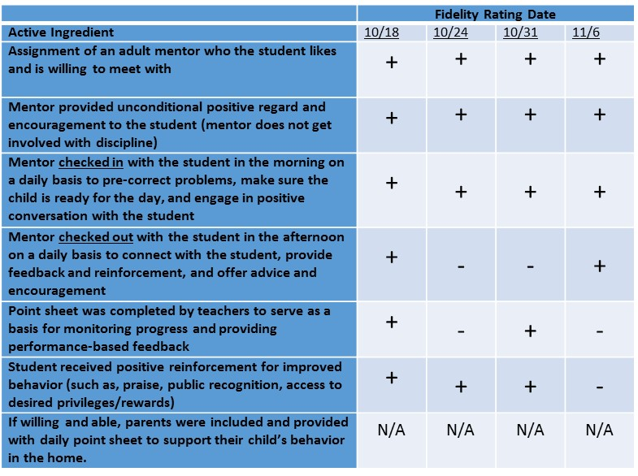
Monitor
  Gather baseline data and begin monitoring student response to the intervention and fidelity of implementation

Slide 41
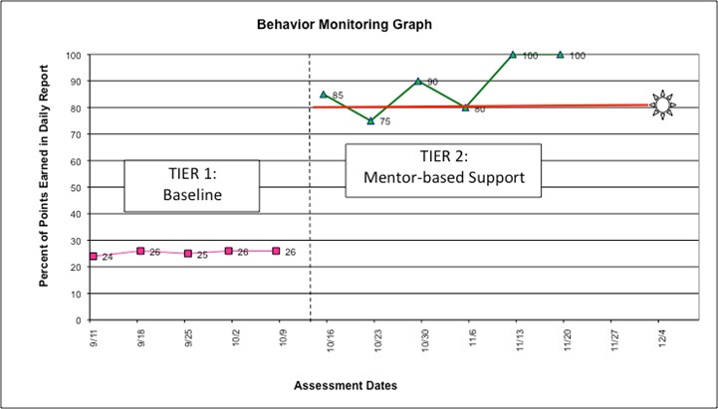

Slide 42
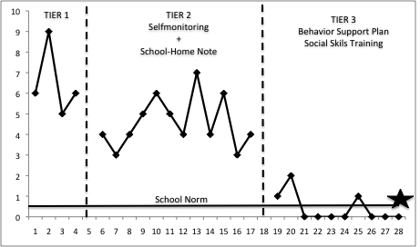

Slide 43
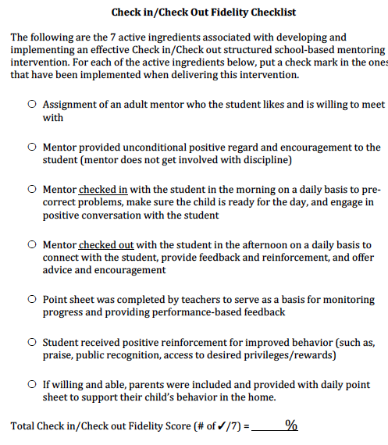
Monitoring Intervention Fidelity

Slide 44
 | Fidelity Rating Date
Active Ingredient | 10/18 | 10/24 | 10/31 | 11/6
Assignment of an adult mentor who the student likes and is willing to meet with | + | + | + | +
Mentor provided unconditional positive regard and encouragement to the student (mentor does not get involved with discipline) | + | + | + | -
Mentor checked in with the student in the morning on a daily basis to pre-correct problems, make sure the child is ready for the day, and engage in positive conversation with the student | + | + | + | -
Mentor checked out with the student in the afternoon on a daily basis to connect with the student, provide feedback and reinforcement, and offer advice and encouragement | + | - | - | -
Point sheet was completed by teachers to serve as a basis for monitoring progress and providing performance-based feedback | + | - | + | -
Student received positive reinforcement for improved behavior (such as, praise, public recognition, access to desired privileges/rewards) | + | + | + | -
If willing and able, parents were included and provided with daily point sheet to support their child’s behavior in the home. | N/A | N/A | N/A | N/A

Slide 45


Slide 46
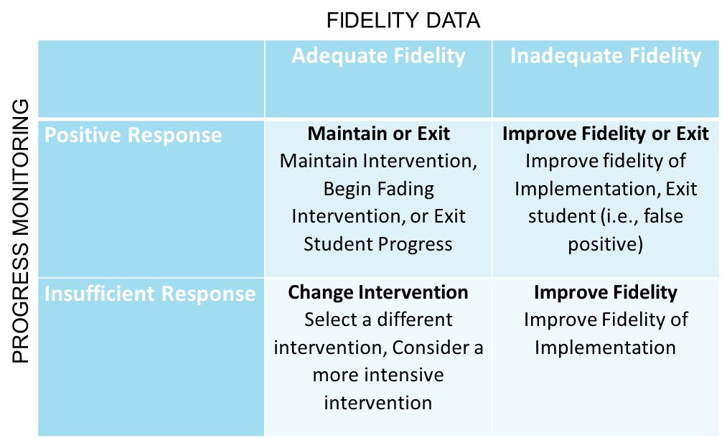
Meet
  Meet as a team to review data (graphed progress monitoring depicting student response and estimates of fidelity of implementation) and make timely and relevant data-driven decisions

Slide 47
Meeting to Make a Data-Driven
FIDELITY DATA
 | Adequate Fidelity | Inadequate Fidelity
Positive Response | Maintain or Exit Maintain Intervention, Begin Fading Intervention, or Exit Student Progress | Improve Fidelity or Exit Improve fidelity of Implementation, Exit student (i.e., false positive)
Insufficient Response | Change Intervention Select a different intervention, Consider a more intensive intervention | Improve Fidelity Improve Fidelity of Implementation
PROGRESS MONITORING

Slide 48



http://itr.umn.edu/
im4education.com
crcook@umn.edu
@ClayCook_PhD

