Slide 1
Iowa Statewide Assessment of Student Progress
Iowa Statewide Assessment System Advisory Committee meeting
April 25, 2019

Slide 2
Agenda
2019 Administration update
Standard Setting activities and planning
Reporting
Questions and Discussion

Slide 3
Administration Update

Slide 4
Administration Update (as of 4/24/19)
Tests we expect to administer: ~1 million (by specific grade/ subject, e.g. Gr 5 Math)
Online Tests Administered: 685,000
Paper processing is underway

Slide 5
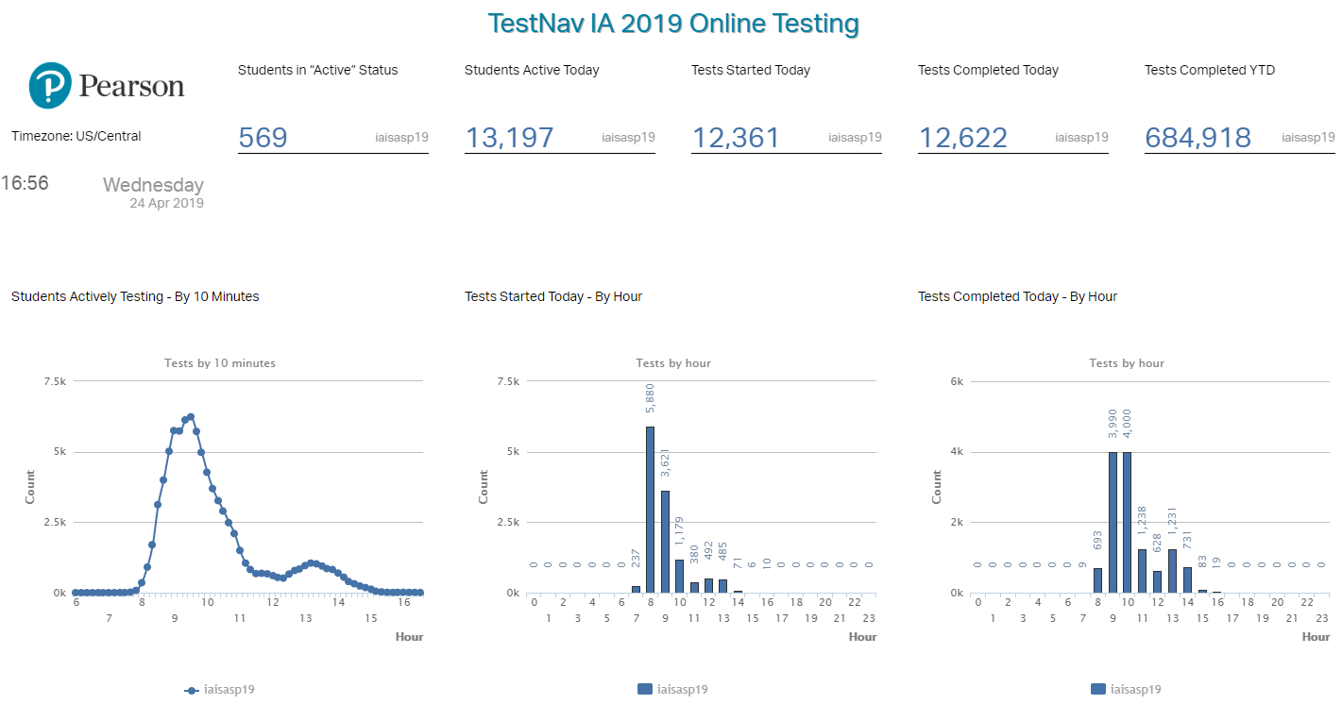
Administration Update (as of 4/24/19)

Slide 6
Administration Update (as of 4/24/19)
Rangefinding finishing this week
Separate panels for Reading, Writing, Math and Science
Panelists recruited from across Iowa
Identifying exemplars at each score point
Results will be used to create training and validation materials for scoring (human-scored and machine-scored)

Slide 7
Performance Level Descriptors and Standard Setting

Slide 8
Three-stage Process from: Iowa Core to: Thresholds for Student Performance
Iowa Core
PLDs
Standard Setting

Slide 9
PLD timelines leading to Standard Setting
Draft PLDs released for Public Comment: April 3 http://iowa.pearsonaccessnext.com/performance-levels/
PLD Educator panels convene to review public comment: April 27 English Language Arts--https://uiowa.qualtrics.com/jfe/form/SV_d5QLncmyzMUMqYl Mathematics-- https://uiowa.qualtrics.com/jfe/form/SV_bNoRdxwwNUB3xAh Science-- https://uiowa.qualtrics.com/jfe/form/SV_egFfw9AptGA4I1T
Iowa Department of Education input: Ongoing – June
PLDs ready for use in Standard Setting: July 1

Slide 10
Standard Setting Method (Lead by Pearson)
Extended Modified (Yes/No) Angoff Method
(Davis & Moyer, 2015; Plake, Ferdous, Impara, & Buckendahl, 2005)
Test-centered criterion based method
Content-based judgments from experienced educators
Flexible method for working with different item types and scores and multiple performance levels
Consistent judgment question for items of different point values
Items and stimuli are presented in administration order
Successfully used for recommending standards for multiple assessment programs
PARCC
MCAS

Slide 11
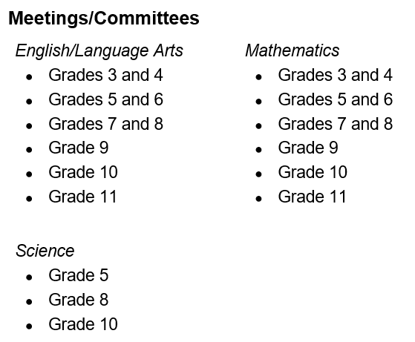
Standard Setting Panelists

Slide 12
Standard Setting Schedule

Slide 13
Reporting

Slide 14
Reporting Timeline
Standard Setting concludes July 26
Process and results summarized: August
Review Materials submitted to the State Board of Education: Sept. 4
State Board Approval of Standard Setting Results: September 12
Pearson Releases Reports: mid-October

Slide 15
Reporting Metrics
Will be determined after the standard setting in the summer of 2019. Will be established on the scale score metric.
Will be determined after the Spring 2020 administration after two consecutive years of testing.
Growth
Proficiency

Slide 16
Reporting
Test Component | ESSA
Reading (Grades 3 to 11) | English Language Arts
Language/Writing (Grades 3 to 11)
Mathematics (Grades 3 to 11) | Mathematics
Science (Grades 5, 8 and 10) | Science

Slide 17
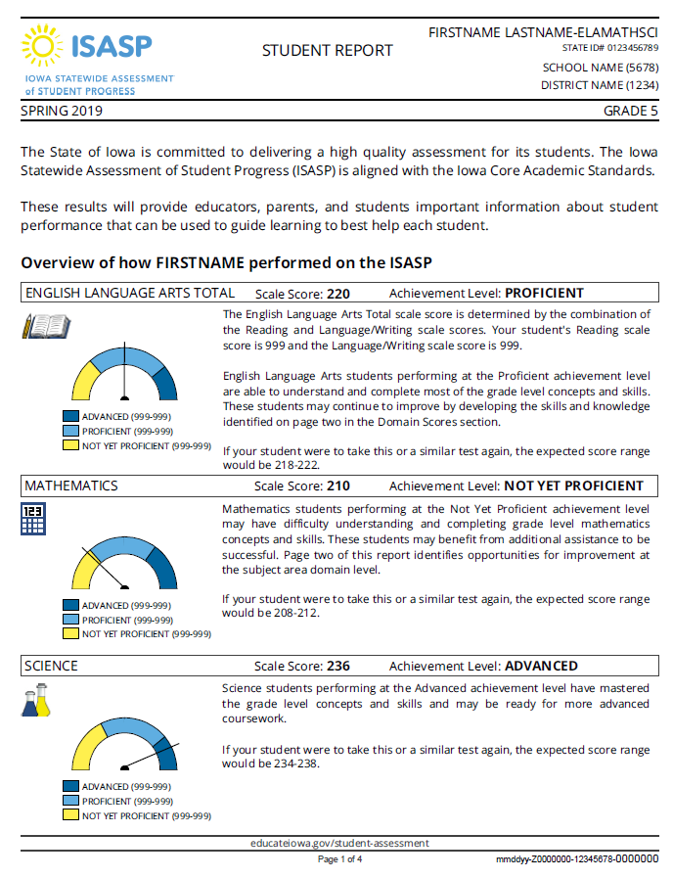
Reporting at the ESSA level— Student
ELA, Math and Science
Scale score
Cutscores for proficient
Vertical scale
DRAFT

Slide 18
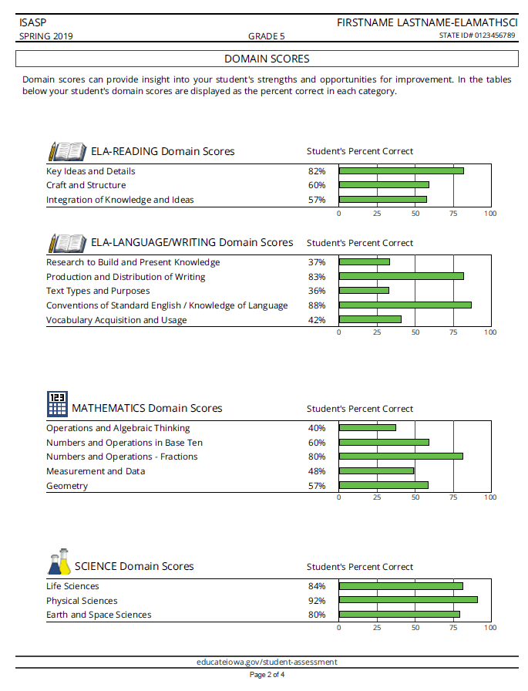
Student Reporting at the Domain level
DRAFT
Percent Correct By Domain

Slide 19
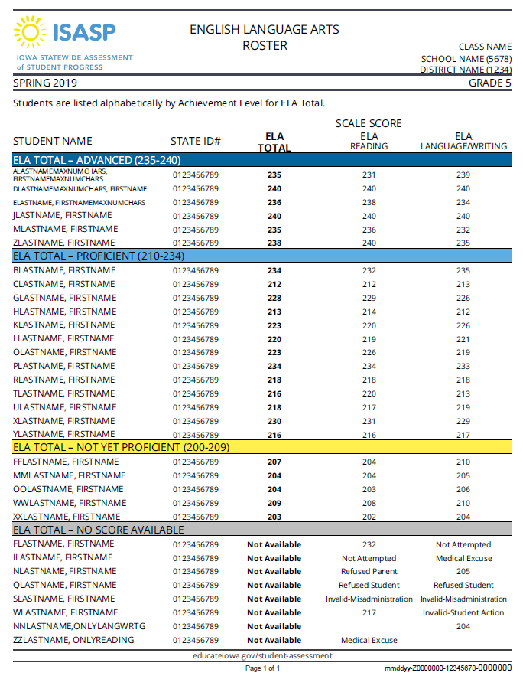
Reporting at the ESSA level— Student Roster
ELA (with Reading and Language/ Writing)
Math
Science
Grouped by Proficiency
Scale Scores
DRAFT

Slide 20
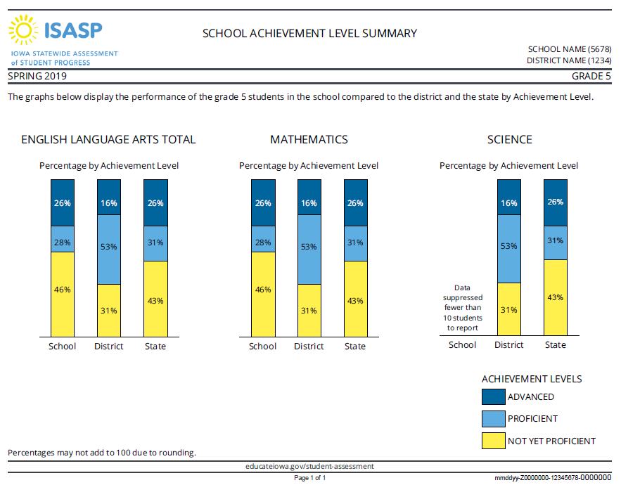
Group-Level Achievement Summary
Percent of students in each proficiency category
By School, District and State
DRAFT

Slide 21
Questions and Discussion

Slide 22
Thank you
David-Henkhaus@uiowa.edu

