Slide 1
Transforming School Culture
How to Overcome Staff Division (2nd Edition Update)
Anthony Muhammad, PhD

Slide 2
Call to Arms
“When a school or district functions as a PLC, educators within the organization embrace high levels of learning for ALL students
as both the reason the organization exists and the fundamental responsibility of those who work within it.”
—DuFour, DuFour, Eaker, Many & Mattos, Learning by Doing:
A Handbook for Professional Learning Communities at Work (2016), pg. 11

Slide 3
A Major Shift in Paradigm
Invitation
(Meritocracy)
Guarantee
(Egalitarianism)

Slide 4
Two Forms of Change
Technical
Cultural

Slide 5
Healthy School Culture
“Educators have an unwavering belief in the ability of all of their students to achieve success, and they pass that belief on to others in overt and covert ways.
“Educators create policies and procedures and adopt practices that support their belief in the ability of every student.”
—Kent D. Peterson in Cromwell, “Is Your School Culture Toxic
or Positive?” Education World (2002)

Slide 6
Toxic School Culture
“Educators believe that student success is based on students’ level of concern, attentiveness, prior knowledge, and willingness to comply with the demands of the school, and they articulate that belief in overt and covert ways.
“Educators create policies and procedures and adopt practices that support their belief in the impossibility of universal achievement.”
—Kent D. Peterson in Cromwell, “Is Your School Culture Toxic or Positive?” Education World (2002)

Slide 7
The Real Difference
Healthy
Toxic
Reflective
Prescriptive
Descriptive
Deflective

Slide 8
Real Objective
School culture is about creating
an environment that improves productivity!

Slide 9
Theoretical Framework
“Theories are formulated to explain, predict, and understand phenomena and, in many cases, to challenge and extend existing knowledge within the limits of critical bounding assumptions. The theoretical framework is the structure that can hold or support a theory of a research study.”
Abend, Gabriel. "The Meaning of Theory." Sociological Theory 26 (June 2008): 173–199; Swanson, Richard A. Theory Building in Applied Disciplines. San Francisco, CA: Berrett-Koehler Publishers 2013.

Slide 10
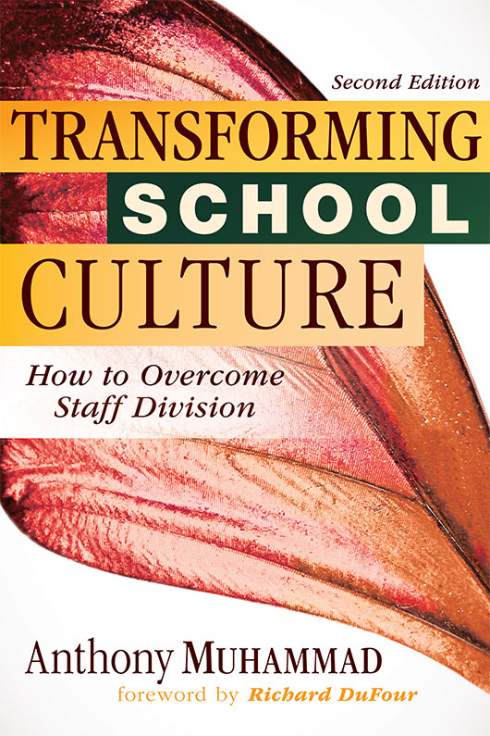

Slide 11
Adult Drama
Dysfunctional social interactions between adult professionals within a school environment that interfere with the proper implementation of important policies, practices, and procedures that support the proper education of students.

Slide 12

The Quandary
Tweeners
Believers
Survivors
Fundamentalists
Muhammad, Transforming School Culture 2nd Edition, (2018)

Slide 13
Believers
Objective:
Success for All Students

Slide 14
The Believers
Are very intrinsically motivated
Are flexible with students (academically
and behaviorally)
Are mission driven or connection to school
or community
Are willing to confront negative talk and attitudes toward children, but only under extreme circumstances
Have varied levels of pedagogical and professional skill

Slide 15
Pause to Think!
Is your school culture focused on success for students or the likes/dislikes of the adults?
Are your Believers politically active or docile?
Are your Believers active in the informal culture?

Slide 16
Tweeners
Objective:
To Find Comfort Zone
Within the Organization

Slide 17
The Tweeners
Are loosely coupled with the school mission
Are enthusiastic about the idealistic nature of school, but have not quite hit the tipping point
Stay out of school and district politics.
Follow instructions as given by administration, creating a wall of silence (considered “good” teachers).
One extreme experience (moment of truth) can swing them to be believers or fundamentalists.

Slide 18
Pause to Think!
Do you have a significant amount of turnover among your Tweeners? If so, why? If not, what do you do to support and retain them?
Who supports your Tweeners when they have their moment of truth?

Slide 19
Survivors
Objective:
Survival

Slide 20
Survivors
Overwhelming nature of the job or life has caused clinical depression (burnout).
They have no political or organizational aspirations.
They create subcontracts with students to broker a ceasefire agreement.
Little to no professional practice is evident.
All members of the organization agree that they do not belong in the profession.
Removal and treatment is the only possible remedy.

Slide 21
Pause to Think!
Do you have colleagues that may be Survivors or in the process of becoming a Survivor?
If so, have you reached out to him or her?
Has administration addressed the issue?
How have your Survivors impacted students?

Slide 22
Fundamentalists
Objective:
Maintain Status Quo
(Leave Me Alone!)

Slide 23
The Fundamentalists
Believe not all children can learn (social Darwinists).
Believe that school reform is a waste of time.
Believe in autonomy and academic freedom.
Organize to resist threats to status quo.
Believe that gaps in learning are due to outside forces (students, parents, administration).
Have varied levels of pedagogical skills.

Slide 24
Methods: The Three D’s
Defame
Disrupt
Distract

Slide 25
Pause to Think!
Do you have an active group of Fundamentalists at your school? If so, how have they affected the culture?
Do your Believers challenge your Fundamentalists?
Have you witnessed any of the three D’s?
If so, how has it affected your school?

Slide 26
The Real Difference
Believers
Fundamentalists
Goal: success for every student
Accept that change
(the right change) is necessary to improve student performance.
Student interest is more important that personal interest (public servant).
Goal: Maintain status quo.
Reject any substantive change if it clashes with personal agenda.
Self-interest is more important than student interest (self-servant).

Slide 27
The Current State of School Reform
The Clash
Fundamentalists
(need for stability or predictability)
School Improvement
(need to change to meet organizational goals)
Stalemate

Slide 28
New 2nd Edition Insights
NCLB and other external drivers made culture worse over the last nine years.
Tweener turnover dropped, but burnout (Survivors) increased.
Research has increasingly identified culture as the top driver of school improvement.
Good leadership and school culture development cannot be separated.

