Slide 1
Iowa Statewide Assessment of Student Progress
Curriculum Network Meeting
January 4, 2019
Notes:
Jan. 4 2019
David Henkhaus
Here is the email address for David Henkhaus: david-henkhaus@uiowa.edu

Slide 2
Agenda
Portal Updates (Training and Documentation)
Professional Development
Preparing for Testing
Questions and Discussion

Slide 3
ISASP Portal
Iowa Statewide Assessment of Student Progress (ISASP) portal
http://iowa.pearsonaccessnext.com/

Slide 4
Updates to the Portal

Slide 5
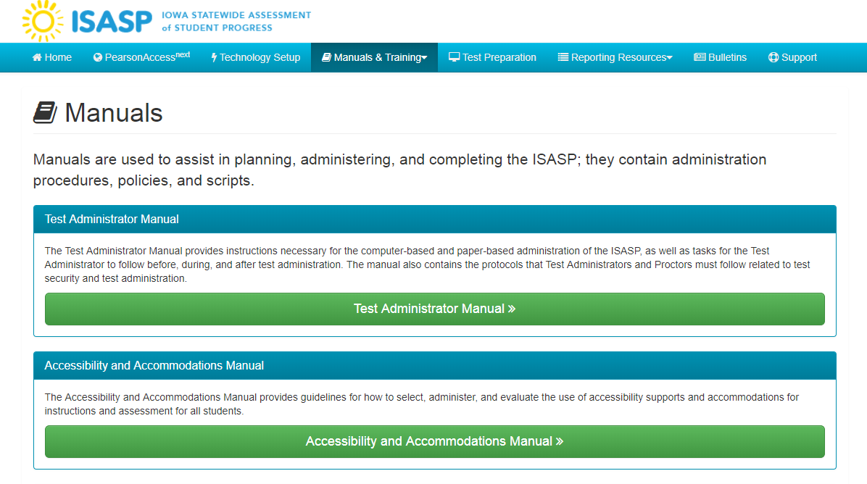
Notes:
These are new manuals inserted on the portal. These are two of the primary documents available now

Slide 6
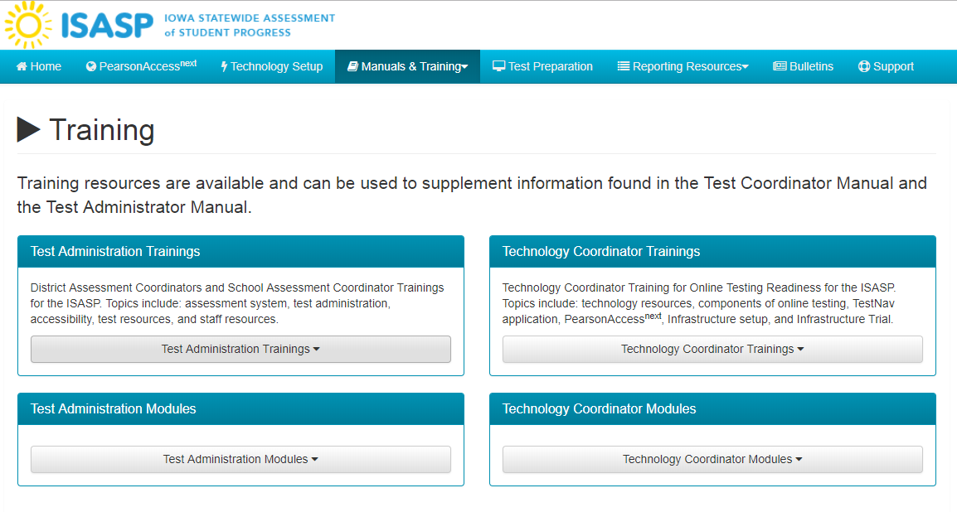
Notes:
Test coordinator training is also on this site, as a refresher for those who attended the training
Technology coordinator training also has new information

Slide 7
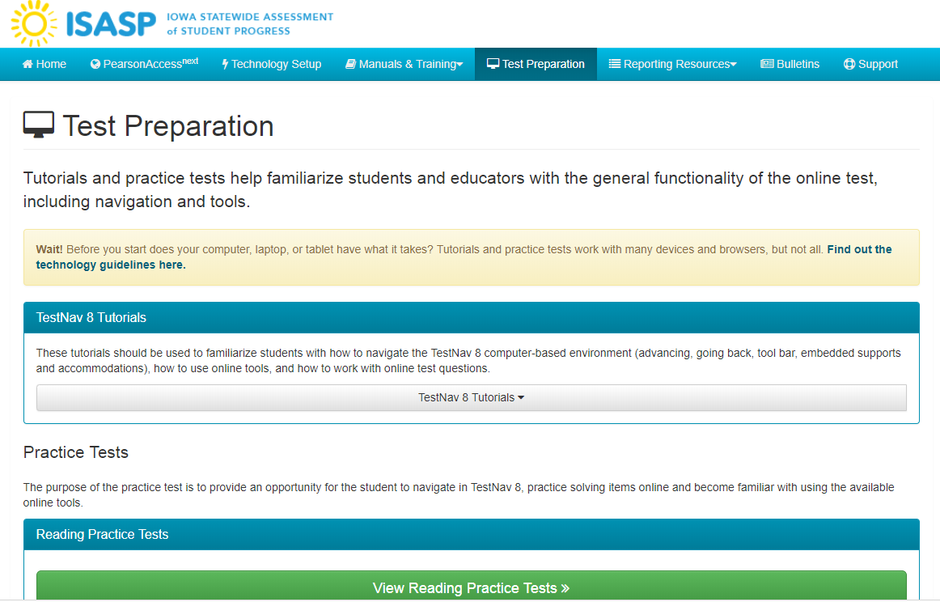
Notes:
Test preparation

Slide 8
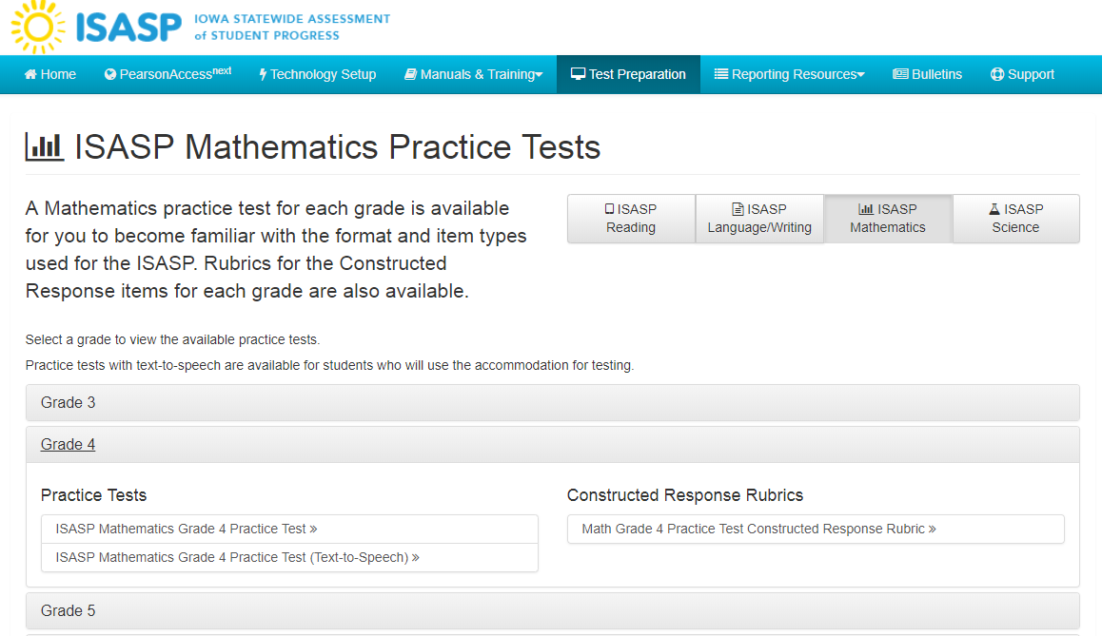
Notes:
Click on the subject area . It will bring up a full page of practice items across grade levels
Text to speech directions….
These are not live items just practice items used with students so that they get comfortable navigating the computer system
These practice tests are ½ of the length of a compete test. These practice tests a representative of each of the item types across subject areas

Slide 9
Practice Test Opportunities
Practice Tests
TestNav 8
Reading, Language and Writing, Mathematics, and Science
Covers all grades of ISASP
Include rubrics for the constructed-response items
Text-to-speech, giving students for whom the technology is warranted an opportunity to become familiar with the process
Tutorials
Familiarize students and staff with mechanics of the online testing platform
Another opportunity to confirm tech infrastructure readiness/ suitability

Slide 10
Professional Development

Slide 11
Future Trainings
Module | Dates | Focus
Assessment System Modules | January 11 | Modules that provide an overview of the administration platform, processes for paper and online testing, the delivery platform, reporting and test security.
Accessibility and Accommodations | January 28 | Introduces the Accessibility and Accommodations Manual and offer opportunities to train educators on system tools, features and accommodations.
Test Overview | January 28 | Reviews test specifications, item types, practice items, formula sheets.
Test Administration | January 30 | Focuses on preparing for test administration and managing and monitoring live testing. Topics will include creating and managing user accounts, creating student files, creating and managing test sessions.
Test Security | January 30 | Policies and procedures to ensure the security and integrity of the testing program. Will have guidance for administrators, teachers, and students.
Score Reports | August 2019 | Will include an overview of the state’s results, student reports, metrics.
Notes:
Modules of mechanics of testing administration, adding new users, new proctors….
How to start and stop a testing session.
Also an introduction
Jan 28, session accessibility and accommodations, and a test overview with test specifications

Slide 12
Preparing for Testing

Slide 13
 | Preparing for Testing
January | Attend/review training sessions Update student registrations Enter testing window into PearsonAccess ^{next} (prior to January 18) Assign students to online or paper/ pencil tests (prior to January 18) Full Local Infrastructure Trial (begins January 28—for Online testing)
February | Tech Infrastructure Remediation (if needed)
Before local testing window | Prepare students for online testing (using practice tests) Become familiar with the administration directions Work with technology staff to ensure testing devices are ready For online testing, create test sessions and add students to test sessions in PearsonAccess ^{next}, confirm accommodations

Slide 14
Establish Testing Window (March 4–May 31)
Specific testing schedule is established by the district.
Interests of students should be prioritized when setting the local testing schedule. Administering the entire ISASP on one day may work well for scheduling, but it is likely very demanding for some students. Although the ISASP tests are not timed, students should be allowed to continue working on a test as long as they are making progress.
Test security should be maintained. Administering one test on the same day in a school before administering the next subject may help minimize exposure and maximize security.

Slide 15
Iowa Statewide Assessment of Student Progress
ISASP Portal
Iowa Statewide Assessment of Student Progress (ISASP) portal
URL: http://iowa.pearsonaccessnext.com/

Slide 16
Iowa Statewide Assessment of Student Progress
Thank you!
David-Henkhaus@uiowa.edu

