Slide 1

Bringing the 4 PLC Questions to Life!: Ensuring the Systemic Implementation of the PLC Process
Anthony Muhammad, PhD
Notes:
Welcome and Overview – Cass
Logistics: facility, bathrooms, etc.
Purpose & Expectations
Process (modeling / adding tools)
Context of this Orientation in line of becoming an associate
Intros to the team (Janet, Jeff, Cass) as modeling to their intros
Check-in / Introductions – Janet
2 Truths and a Lie
Sign ‘non-compete’ forms?

Slide 2
Focus
Essential standards
Common assessments
Academic interventions
Action orientation and experimentation
Teach and
Collaborate
Assess
Analyze Data
Intervene
Plan

Slide 3
Four Corollary PLC Questions
What do we want student to know and be able to do?
How do we know if students have learned?
How do we respond when students don’t learn?
How de we respond when students have learned?

Slide 4

Professional Learning Communities
Targets
Evidence
Action
Q1. What do we want students to know and be able to do?
Q2. How will we know if they get it or can do it?
Q3.How will we respond when they don’t learn?
Q4. How will we respond when they do learn, or already know it?
A World Leader in Education Cultivating Exceptional Thinkers Prepared for the Future

Slide 5

PLC Question #1
Robert Marzano (2001) found that…
  On average - 200 broad standards; 3093 benchmarks (www.mcrel.org)
  Given # of days/hours/minute, necessary to change from K – 12 to K - 22 prior to university
  Increase time or
  decrease standards!

Slide 6
Power STandards
“Prioritized standards that are derived from a systematic and balanced approach to distinguishing which standards are absolutely essential for student success from those that are nice to know.”
-Ainsworth, Power Standards: Identifying the Standards that Matter Most, 2004

Slide 7
Power Standards
LESS is more!
Leverage
Endurance
Success in School (readiness)
Notes:
As emphasized in Simplifying Response to Intervention

Slide 8

What Do We Want
Students to Know and Be Able to Do?
Identify essential standards and outcomes.
Pace them per quarter.
Identify instructional material to ensure student mastery of standards.

Slide 9
Unpack learning targets
Understands and analyzes how cultures and cultural groups have contributed to history.

Slide 10
Unpack learning targets
Understands and analyzes how cultures and cultural groups have contributed to history.
Underline the content
Circle the cognitive behavior

Slide 11
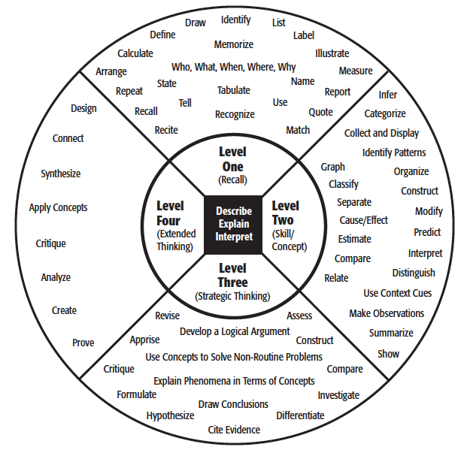
Webb’s DOK
High Cognitive Demand
Low Cognitive Demand

Slide 12
Reflection
How do you currently address the first PLC question: What do we want students to learn?
Do teachers get an opportunity to gain a common understanding of the standards?

Slide 13
Traditional Assessment Model
Pretest
Teach
Teach
Teach
Teach
Post-test
Assign grades

Slide 14
Formative
Summative
occurs during the course of a unit of study
determines a student’s knowledge and skills, including learning gaps
    used to inform instruction and guide learning
    includes assessment as and for learning
made at the end of a unit of study
determines the degree to which a student has met a learning target
used to evaluate or judge student achievement
includes assessment of learning
Notes:
Define first with elbow partner…

Slide 15




Assessment Literacy
OF
FOR
AS
Summative
Formative
Notes:
There is a wide spectrum of classroom assessments ranging from formative to summative.

Slide 16

How Do We Know
If Students Have Learned?
Develop common assessments.
Assessments measure if students can perform identified tasks.
Students should receive assessments at least each quarter per core subject matter.
Assessments should not exceed 25 questions.
Teachers who teach the content should develop assessments.
Assessment questions should be more challenging than the modality used on state assessment.

Slide 17
Reflection
How do you currently address the second PLC question: How do we know if students have learned?
What do you do with assessment results?

Slide 18
Pyramid of Intervention
Intensive Support
For students who have not responded to first two levels
Track student progress weekly
Intensive
Supplemental Instruction and Support
Identify students with common assessment data, grades, and environment data
Supplemental
Base Program
Base Program—
For all students
Daily best practice
Should address the needs of at least 75% of your students.

Slide 19
Pyramid of Interventions
How do we respond when students do not learn?
Homework lunch
In-school tutors
Student support specialist
After-school tutoring
Student success plan
Title 1 Summer Institute

Slide 20
Reflection
How do you address the third and fourth PLC questions?
  How do we respond when students do not learn?
  How do we respond when students have learned?
Do you need to address these questions again systemically?

