Slide 1

Retention and Recertification Elections Presentation-
Central Rivers Area Education Agency
Mike Cormack, Board Chair
Public Employment Relations Board

Slide 2

Retention and Recertification Elections – New Elections resulting from H.F. 291
Employees (eligible voters) in represented bargaining units will vote to KEEP (retain) or REMOVE (decertify) their current certified bargaining representative.

Slide 3

Effect of retention and recertification elections
If more than 50% of eligible voters vote “yes” to retain the representative, the employee organization will be retained and recertified and continue to represent the unit.

Slide 4

Effect of Retention and Recertification Elections
If 50% or more of eligible voters either vote “no” or do not vote, the employee organization will be decertified and will no longer represent the unit.

Slide 5
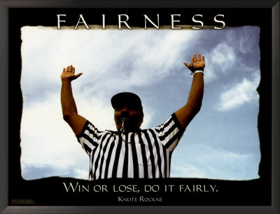
PERB’s Role
Conduct election as required
Ensure a fair election process for all participants
Provide accurate tally of the results

Slide 6

When will PERB conduct recertification elections?
Election is triggered by the expiration date of the applicable collective bargaining agreement (CBA) between employer and certified representative.
Iowa Code 20.15(2) requires PERB to hold the election approximately 10 months prior to the expiration date of the CBA.

Slide 7

Bargaining units voting this fall
September
October
For contracts expiring between July 1- August 31, 2018.
Two week voting period from September 12-26, 2017.
For contracts expiring June 30, 2018.
Two week voting period from October 10-24, 2017.

Slide 8

Bargaining units voting this fall:
September
October
Mail ballots
13 bargaining units with 1,291 voters
All 13 bargaining units voted to retain and recertify their Association
Paperless voting system -- Phone and online voting
Experienced vendor provides voting services -- Everyone Counts
468 bargaining units with 35,000 potential voters

Slide 9

At-a-Glance:
Steps in a Recertification Election
Identified representatives received an email “alert” that a filing was submitted to that specific unit.
PERB determines a recertification election must be conducted based on expiration date of CBA.
PERB electronically files a Notice of Intent to Conduct a Recertification Election and a Notice to Employees.
Employer provides requested voter list by deadline.
If voter list timely received, certified representative pays election fee by deadline.

Slide 10



At-a-Glance:
Steps in a Recertification Election, cont.
If election fee was timely received, PERB electronically filed a Direction of Election which includes a Notice of Election
    Employer must post/distribute these notices as directed
Identified representatives received an email “alert” that a filing was submitted to that specific unit
From perbefile@mail-relay.iowa.gov

Slide 11

At-a-Glance:
Steps in a Recertification Election, cont.
Eligible voters cast their vote during set voting period.
PERB tabulates votes and electronically files tally.
10-days objection period from filing of tally. If no objections received, PERB files appropriate order (order of recertification OR order of decertification).

Slide 12


Direction of Election
Identified representatives received an email “alert” that a filing was submitted to that specific unit.
PERB eFiled the DIRECTION OF ELECTION, NOTICE of ELECTION AND SAMPLE BALLOT QUESTION.
  All one document
  eFiled on September 20th.
Direction of Election contained:
  Bargaining unit description
  Order that a retention and recertification election be conducted
  Order that if the employee list previously provided has changed, changes need to be submitted to PERB.

Slide 13
Challenges to Voter Lists
Eligible voters are employees who were employed in the bargaining unit during the payroll period immediately preceding direction of election (September 20) and are employed in the bargaining unit on the last date of the election (October 24).
This is the same eligibility requirement from PERB’s previous rules and is not changed.
Parties may alter the eligible voter list by mutual agreement.
Certified bargaining representatives can challenge the eligibility of an employee on the list. Normally, this can be worked out by the parties.

Slide 14


Notice of Election
NOTICE OF TELEPHONIC AND WEB-BASED RETENTION AND RECERTICIATION ELECTION that the employer must post/distribute to eligible voters.
Contains the voting information for the employees.
  Includes the voting schedule (October 10, 2017 beginning at 8:00 a.m. and ending October 24, 2017 ending at 1:00 p.m.)
  Includes the phone number: 1-855-976-9349 and online address: www.iowaperb.everyonecounts.com
Contains the ballot questions and options
Contains the voting instructions

Slide 15

Ballot Question
Do you want
[ Employee Organization]
TO BE RETAINED AND RECERTIFIED AND CONTINUE TO BE YOUR EXCLUSIVE BARGAINING REPRESENTATIVE?
Yes, I want [Employee Organization] to continue to represent me.
No, I do not want [Employee Organization] to continue to represent me.

Slide 16

Voting Instructions – By Phone
1. Call 1-855-976-9349 toll-free.
2. Be prepared to provide your birth date (MM/DD/YYYY) and the last four digits of your Social Security number.
3. Follow the instructions provided to you on the phone.
4. You will be asked, “Do you want [Employee Organization] to be retained and recertified and continue to be your exclusive bargaining representative?
5. After you vote, you will be asked to confirm your choice for your vote to be counted. You MUST CONFIRM your choice for your vote to be counted.

Slide 17

Voting Instructions – By Internet
1. Go to www.iowaperb.everyonecounts.com.
2. Be prepared to provide your birth date (MM/DD/YYYY) and the last four digits of your Social Security number.
3. Follow the instructions provided to you.
4. You will be asked, “Do you want [Employee Organization] to be retained and recertified and continue to be your exclusive bargaining representative? Select either:
“Yes, I want [Employee Organization] to continue to represent me.”
“No, I do not want [Employee Organization] to continue to represent me.”
5. After you vote “yes” or “no,” you will be asked to confirm your choice for your vote to be counted. You MUST CONFIRM your choice for your vote to be counted.

Slide 18

Who do I ask?
If voter experiences any problems with the voting system or need special assistance in voting
Who is eligible to vote, has process questions or gets a prompt saying they have voted and have not voted
Everyone Counts
Public Employment Relations Board

Slide 19

PERB can disclose who is eligible to vote. However, PERB cannot disclose if an individual voter has voted and must keep that information confidential.

Slide 20
Election results
PERB will e-file “tally of ballots” & post on website
If the majority of the bargaining unit employees VOTE YES, the collective bargaining agreement remains intact and the certified representative continues to represent the employees in the unit.
If a tie or the majority of the employees in the unit DO NOT VOTE YES (no and nonvotes are majority) PERB will issue and order of decertification immediately after the objection period to the election has run and the certified representative no longer represents the unit.

Slide 21
Objectionable Conduct During Election Campaign
Either party can object to the conduct of the election within 10 days of the filing of the ballots (same as before)
PERB can invalidate an election if
  Objectionable activity took place during the election; AND
  it could have affected the results of the election
This is the same objection process as in PERB’s previous rules and has not been changed.

Slide 22
What could invalidate an election?
Misuse of PERB documents, including an indication that PERB endorses any particular choice on the ballot
Misstatements of material facts by any party to the election or its representative without sufficient time for the adversely affected party to adequately respond
Commission of a prohibited practice

Slide 23
What could invalidate an election? Cont.,
Campaign speeches, by mgt, to assembled groups of employees during working hours within the 24-hour period before the election
Any polling of employees by a public employer which relates to the employees’ preference for or against a bargaining representative
Any other misconduct or other circumstance which prevents employees from freely expressing their preferences in the election

Slide 24
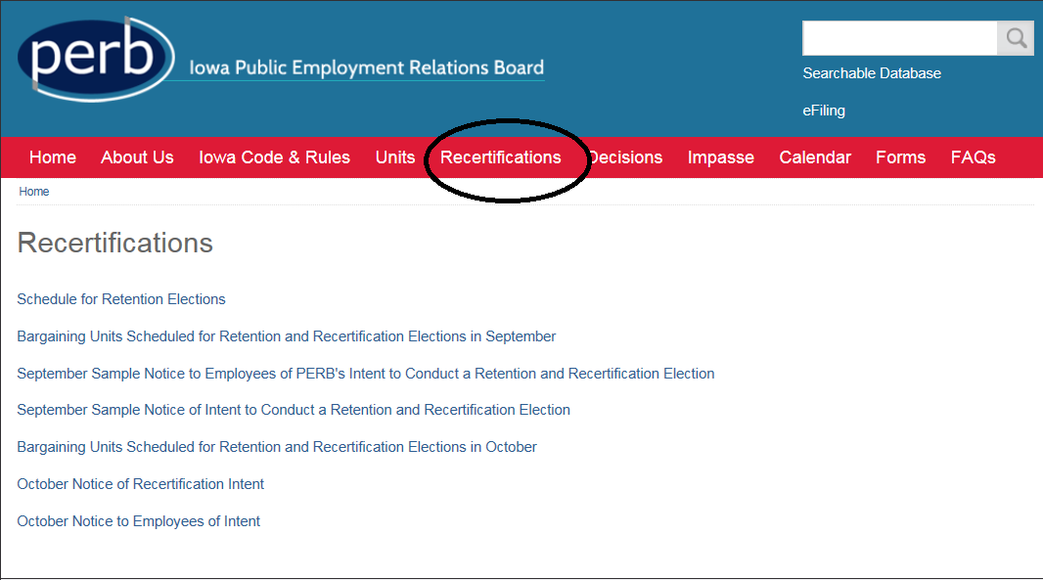
www.iowaperb.iowa.gov

Slide 26
For specific election questions, contact Amber DeSmet at amber.desmet@iowa.gov

Slide 27

Thank you!
Any questions?
PERB Contact Information-
Website:
iowaperb.iowa.gov
Telephone:
515-281-4414

