Slide 1
Notes:
https://docs.google.com/document/d/11hZt0KC4hdZNUj9ZIUTl57GaeVA_83JO6GFw7JO_1o8/edit?usp=sharing
Proposed Flow of the Supt Meeting:
· 9-10:30 Manny Scott shares message importance of one and empathy and resilience (ties to our theme of Empathic Learning Environment, Youth engagement in School and Community)
· 10:45 to 11:15 Liz shares WHY MTSS for community and schools is important and tees up the importance of universal tier and the 5 foundational themes (through problem solution format) (Ties to access to resources through partnerships, and youth engagement in school and community)
o Refer to slides and one pager with MTSS framework
o We hand out our One pager and tie it to where schools might be right now:
§ Slide with table of barriers.
· 11:15- 11:25 AEA person introduces our one pager refers back to Liz and leads into our MTSS one pager roll out and how we vetted what schools need to have in place universally and How to implement (back side) whomever holds the one pager (cross references to the five foundational themes)
o Refer to Slides and handout one pager
§ Slide with the MTSS framework
§ Slide with the Leadership and implementation guidance
· 11:25-11:35 talk about the five foundational themes that surfaces for a strong multi-tiered system of support for social, emotional, behavioral, and mental health. These five themes help us determine what to offer for support (Systems and Individual)
o Refer to slides (one at a time and their cards so they can see this is also how they can determine what they are doing is working. So it is a way to measure progress.
§ Slide Leadership
§ Slide Data
§ Slide Learn Environment
§ Slide Youth Engage
§ Slide Access to Resources
o So we showed you some systems pieces, now we will show individual supports from our support teams. And talk about our agency offering support teams for individual support.
§ Slide on support team access
· 11:35 to 11:45 Now we want you to talk at your tables and determine what resonates and give us some feedback
o Please answer this quick google form and as you are talking at your tables we will collect and show your data.
§ Slide with the google form link
· 11:45 to 11:55 We will take this data and use it to help us put together some options for supports in conversation, learning and action planning to help move your towards your vision of your desired state.
· Share the data on the screen
o Also talk to your RA
Share Cards you do we do
Slides: What will happen between now and November
· To come in November: We will share some ways we will collaborate; What you need to do and what we can do as a collaborative partner.
· We also want you to talk to your RA and give us feedback on what you see, what you have questions about, what might be missing

Slide 2
TODAY’S MEET
For
Questions and Comments

Slide 3
Liz Cox
Executive Director
Prevent Child Abuse Iowa

Slide 4
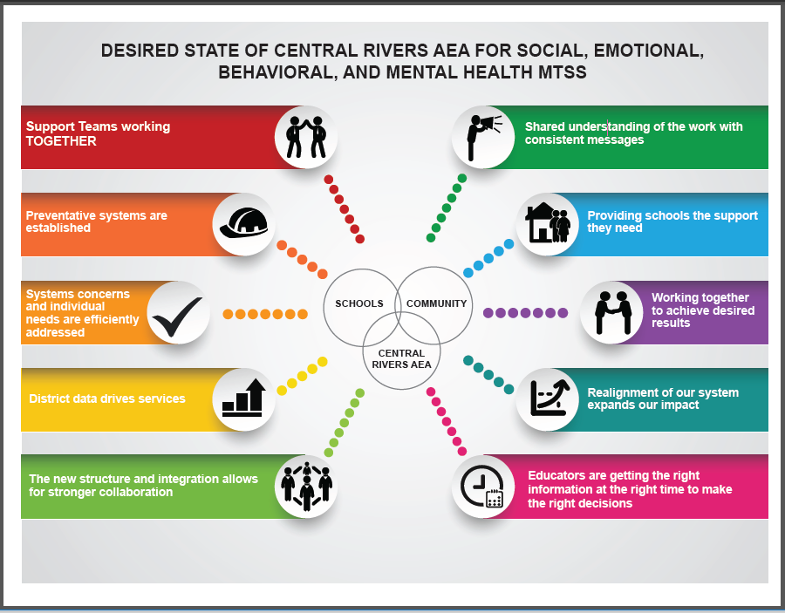
Notes:
A multi-tiered system of integrated supports for social, emotional, behavioral, and mental health is available to build the capacity of districts to address the needs of children and youth from birth to 21 years of age. All stakeholders are knowledgeable about the integrated supports available through Central Rivers and access supports as needed.
Desired State of Central Rivers AEA for Social Emotional Behavioral and Mental Health MTSS
Support Teams working TOGETHER
Shared understanding of the work with consistent messages
Providing schools the support they need
Working together to achieve desired results
Realignment of our system expands our impact
Educators are getting the right information at the right time to do the right work
The new structure and integration allows for stronger collaboration
District data drives services
We efficiently address systems concerns and individual needs
Preventative systems are established

Slide 5
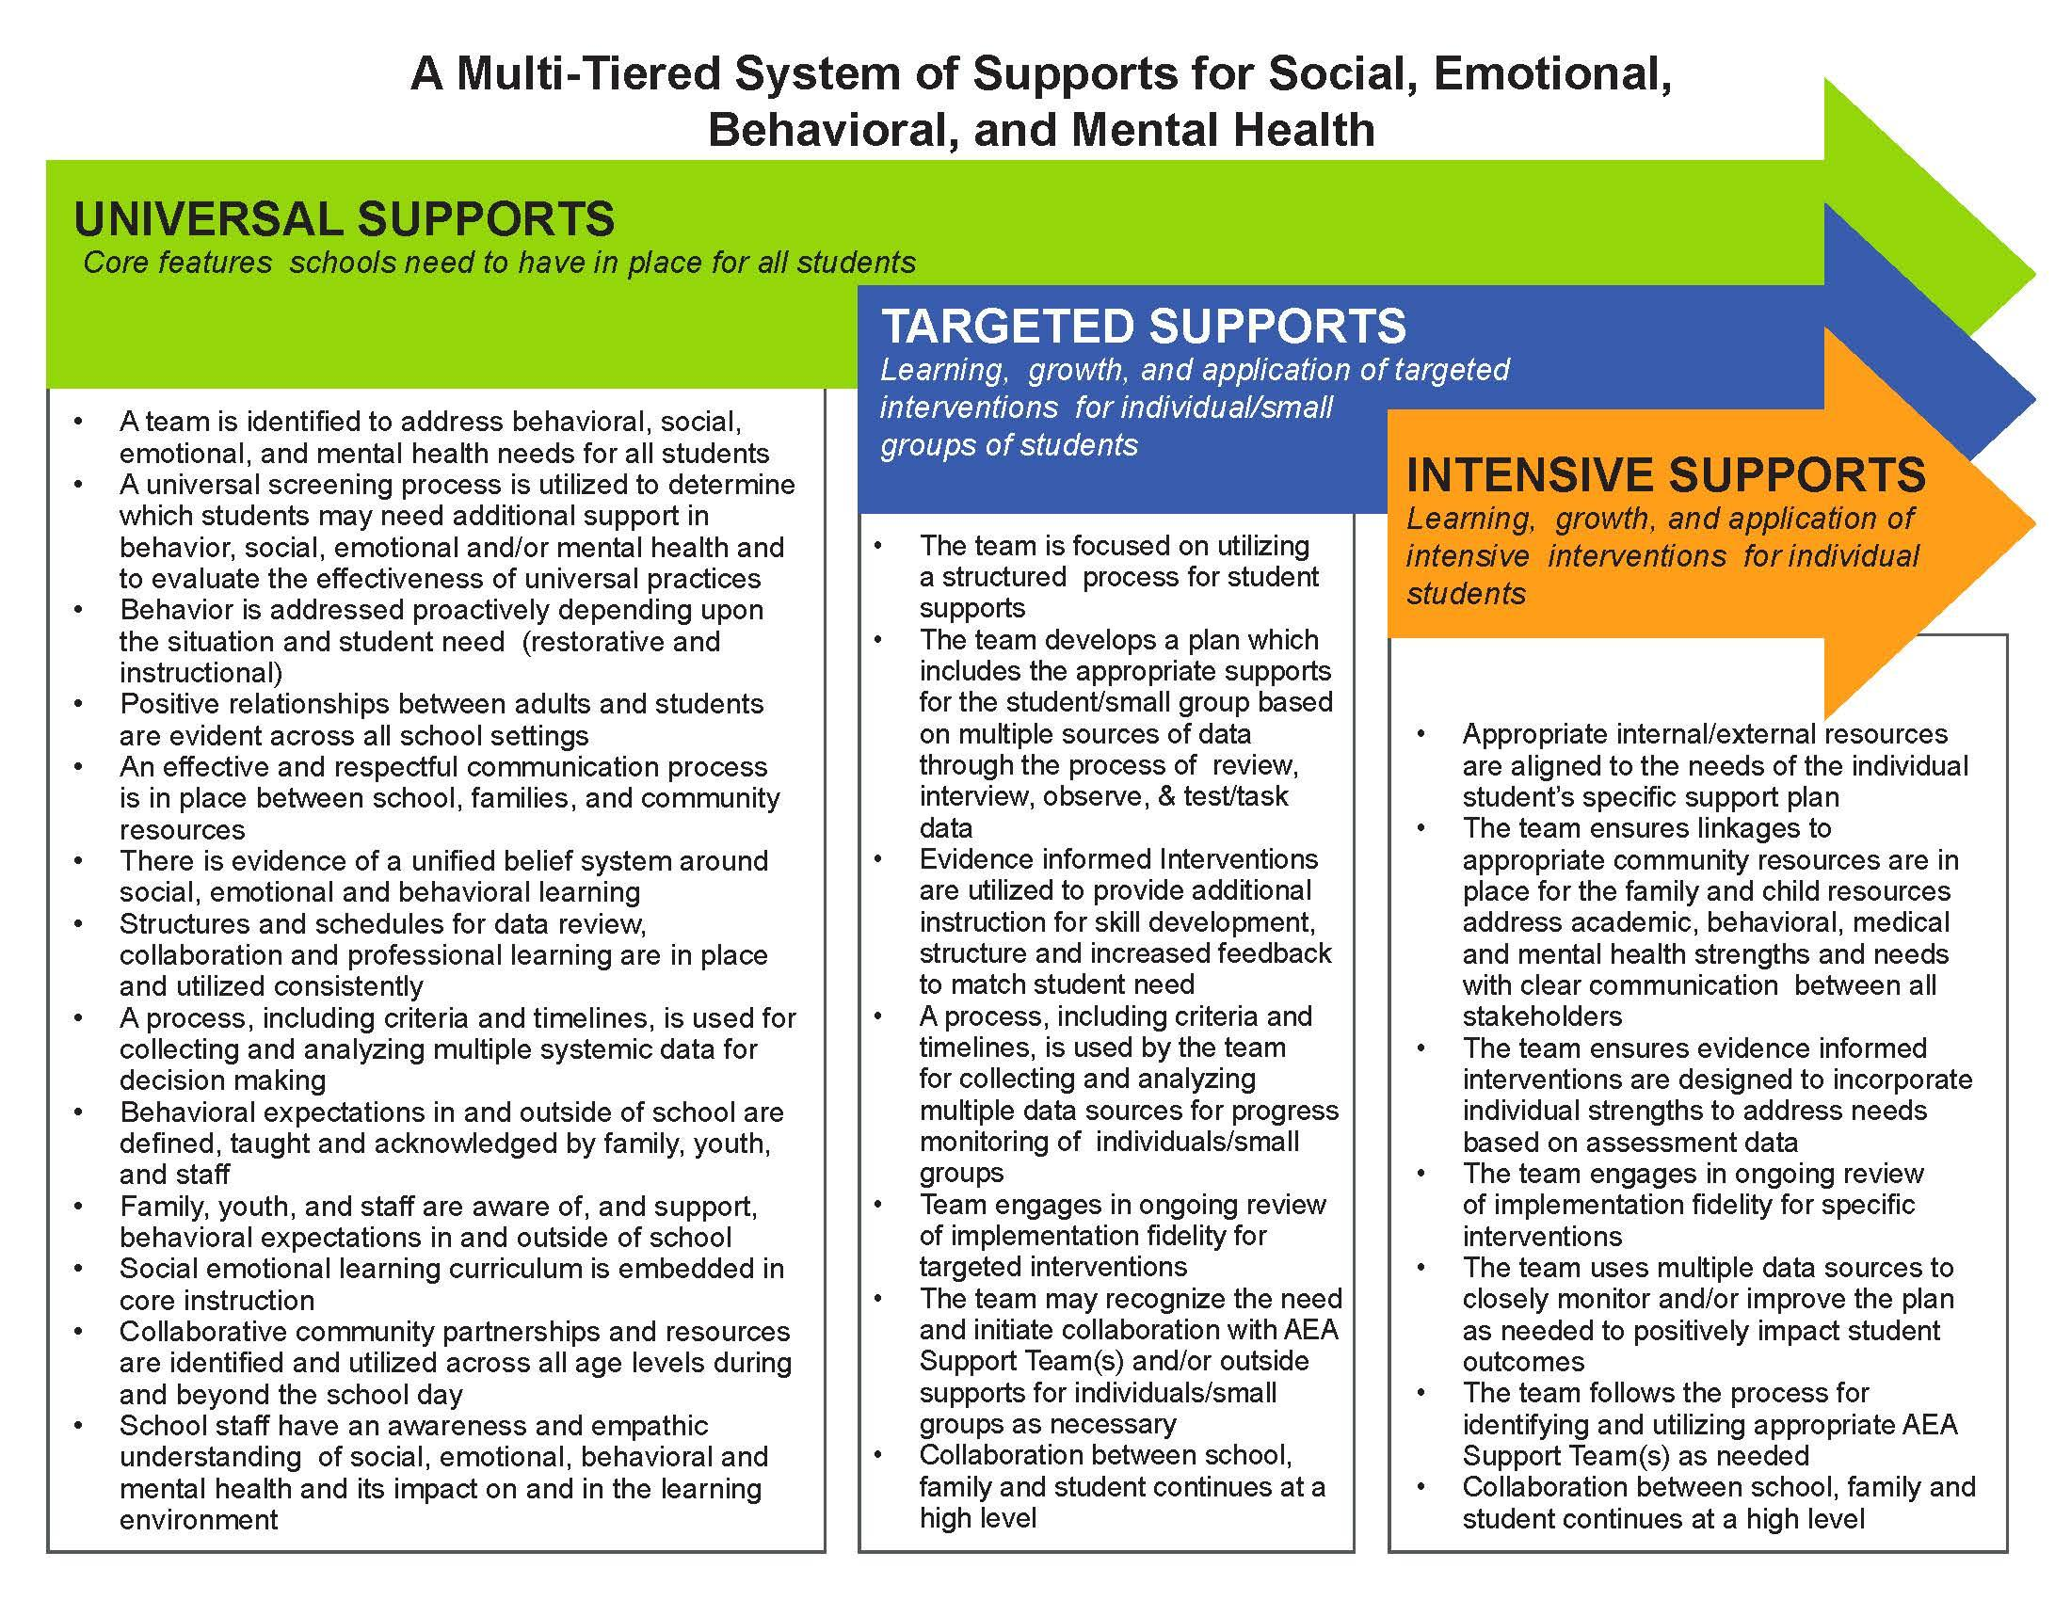
Notes:
THIS SLIDE PICTURE NEEDS UPDATING FROM LINDSAY
This graphic provides guidance, grounded in school improvement processes, for launching MTSS for social, emotional, behavioral, and mental health
(Text heavy)
Talking Points:
This is a big picture overview of the framework (school system) -
2. Overlap of arrows Universal (all) - Targeted (Some) - Intensive (Few)
3. Components aren’t in a hierarchical order. Equal significance.
4. Components were developed through discussion - PBIS, mental health, Leader in Me, what we know about EBP in SEL,
This is a lot to think about. So, the question is… how will Central Rivers AEA support you?
Read for clarity and comprehensiveness - put questions/comments on the Google Doc -
Put our MTSS doc/visual here. The big idea here is that many schools jump to targeted and intensive...but need to really get strong in universal (Prevention) (MTSS IOWA SYSTEM)

Slide 6
Notes:
THIS SLIDE NEEDS TO BE UPDATED WITH LINDSAY
What if it is determined a school doesn’t have the right things in place.
How do we go about making the change and sustaining it?
Where do we start?
How do we know what steps to take?

Slide 7
Feedback & Questions
Partnering with Districts to Support Social, Emotional, Behavioral, and Mental Health

Slide 8
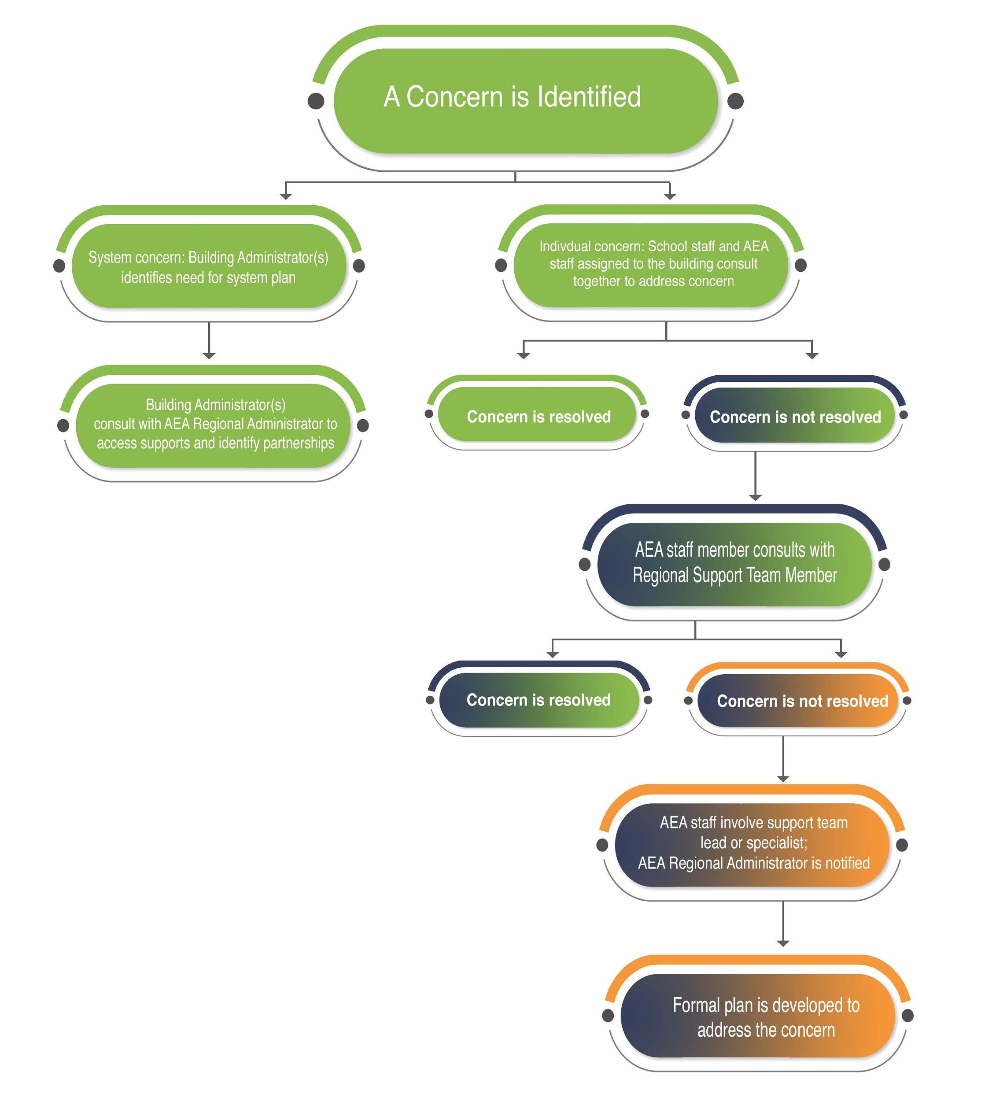
Notes:
Flow Chart of accessing support team members

Slide 9
Central Rivers AEA
Support Team Structure
Assistive Tech MTSS Structure
Autism MTSS Structure
Challenging Behavior MTSS Structure
Mental Health MTSS Structure

Slide 10
Next Steps
Follow up dialogue with RAs
Introduce the Social, Academic, and Emotional Behavioral Risk Screener (SAEBRS)
Follow up sessions for implementation of MTSS for Social, Emotional, Behavioral, and Mental Health
November 27th, Clear Lake Conference Center
November 30th, Marshalltown Conference Center
December 12, Cedar Falls Conference Center
Register for Course # 15725
Notes:
Screener

Slide 11
UNIVERSAL SUPPORTS
Core features schools need to have in place for all students
LEA Leadership commitment…
Develop a clear VISION
Follow a structured framework with fidelity encompassing…
An assigned team
Screening process
Proactive actions
Positive relationships
Communication
Unified beliefs
Proactive structures and schedules
Collaboration and professional learning
Process for reviewing, analyzing and acting on multiple data points
expectations
All stakeholders supporting expectations
Social emotional learning curriculum
Partnerships (Community, School, AEA)
Learning
Central Rivers AEA commitment …
RA and regional team
Partner in data review
Support the use of a screener
Partner in prevention of the knowing and doing gap
Provide guidance in implementation fidelity of a structured framework
Serve as a connector and advocate of multiple and diverse partnerships
Provide professional learning and follow up
Notes:
These things that need to be solid in schools
A team is identified to address behavioral, social, emotional, and mental health needs for all students
A universal screening process is utilized to determine which students may need additional support in behavior, social, emotional and/or mental health and to evaluate the effectiveness of universal practices
Behavior is addressed proactively
Positive relationships between adults and students are evident across all school settings
An effective and respectful communication process is in place
There is evidence of a unified belief system
Structures and schedules for data review, collaboration and professional learning are in place and utilized consistently
A process, including criteria and timelines, is used for collecting and analyzing multiple systemic data for decision making
Behavioral expectations in and outside of school are defined, taught and acknowledged
Family, youth, and staff are aware of, and support, behavioral expectations
Social emotional learning curriculum is embedded in core instruction
Community partnerships and resources are identified and utilized across all age levels during and beyond the school day
School staff have an awareness and empathetic understanding of social, emotional, behavioral and mental health and its impact on and in the learning environment
LEA Commitment
Choose and follow a structure for MTSS that has these minimum criteria, and follow it with fidelity
It can be a program if that will help
It can be organic to your own vision that follows a change structure through implementation science. (Central Rivers offers CBAM)
Central Rivers Commitment
Support your structure if you have one in place
Give you information on different options for structures for change
Provide support if you choose an authentic approach (CBAM)
Partner in using data to prioritize steps
Connect you to the right resources to accomplish the desired state
Bottom line: If the leaders don’t get universal right, you will waste time energy and money and burn out
If Leaders get universal right then you will gain time, energy, momemtum trust,
It all comes down to the leader. Are you, as a leader willing to do what it takes? If you are willing, do you have the skill it takes? If you have the will and skill then it will happen. If you only have the will but not the skill we can help you. If you have the skill and will we can help you…if you don’t have the will, then we are not in a position to help you. And that is on you.

Slide 12
TARGETED SUPPORTS
Learning, growth, and application of targeted interventions for individual/small groups of students
LEA Leadership commitment
Continue following a structured framework with fidelity for a strong universal system
Assign a school team(s) for identified individuals/small groups to..
Central Rivers AEA commitment …
RA and regional team
Partner in data review
Support the use of a screener
Partner in prevention of the knowing and doing gap
Provide guidance in implementation fidelity of a structured framework
Serve as a connector and advocate of multiple and diverse partnerships
Provide professional learning and follow up
May assign an appropriate Support Team
dig deeper in data and supports
develop plan(s)
use evidence based interventions
provide additional instruction
provide structure and increased feedback
progress monitor plans
engage in ongoing review of implementation fidelity for targeted interventions
possibly collaborate with more partners
model strong collaboration between all stakeholders
Notes:
Targeted Supports
The team is focused on utilizing a structured process for student supports
The team develops a plan which includes the appropriate supports for the student/small group based on multiple sources of data through the process of Review, Interview, Observe, & Test/Task data
Evidence based Interventions are utilized to provide additional instruction for skill development, structure and increased feedback to match student need
A process, including criteria and timelines, is used by the team for collecting and analyzing multiple data sources for progress monitoring of individuals/small groups
Team engages in ongoing review of implementation fidelity for targeted interventions
The team may recognize the need and initiate collaboration with AEA Support Team(s) and/or outside supports for individuals/small groups as necessary
Collaboration between school, family and student continues at a high level
A team is identified to address behavioral, social, emotional, and mental health needs for all students
A universal screening process is utilized to determine which students may need additional support in behavior, social, emotional and/or mental health and to evaluate the effectiveness of universal practices
Behavior is addressed proactively
Positive relationships between adults and students are evident across all school settings
An effective and respectful communication process is in place
There is evidence of a unified belief system
Structures and schedules for data review, collaboration and professional learning are in place and utilized consistently
A process, including criteria and timelines, is used for collecting and analyzing multiple systemic data for decision making
Behavioral expectations in and outside of school are defined, taught and acknowledged
Family, youth, and staff are aware of, and support, behavioral expectations
Social emotional learning curriculum is embedded in core instruction
Community partnerships and resources are identified and utilized across all age levels during and beyond the school day
School staff have an awareness and empathetic understanding of social, emotional, behavioral and mental health and its impact on and in the learning environment
LEA Commitment
Choose and follow a structure for MTSS that has these minimum criteria, and follow it with fidelity
It can be a program if that will help
It can be organic to your own vision that follows a change structure through implementation science. (Central Rivers offers CBAM)
Central Rivers Commitment
Support your structure if you have one in place
Give you information on different options for structures for change
Provide support if you choose an authentic approach (CBAM)
Partner in using data to prioritize steps
Connect you to the right resources to accomplish the desired state
Bottom line: If the leaders don’t get universal right, you will waste time energy and money and burn out
If Leaders get universal right then you will gain time, energy, momemtum trust,
It all comes down to the leader. Are you, as a leader willing to do what it takes? If you are willing, do you have the skill it takes? If you have the will and skill then it will happen. If you only have the will but not the skill we can help you. If you have the skill and will we can help you…if you don’t have the will, then we are not in a position to help you. And that is on you.

Slide 13
INTENSIVE SUPPORTS
Learning, growth, and application of intensive interventions for individual students
LEA Leadership commitment
Continue following a structured framework with fidelity for a strong universal system
Identified school team(s) continue collaborative efforts for targeted supports with identified individuals/small groups and..
Central Rivers AEA commitment …
RA and regional team
Partner in data review
Support the use of a screener
Partner in prevention of the knowing and doing gap
Provide guidance in implementation fidelity of a structured framework
Serve as a connector and advocate of multiple and diverse partnerships
Provide professional learning and follow up
May assign an appropriate Support Team
Collaborate in linking new partners if needed
may reach out to more internal/external resources
may spend more intensive time and resources dedicated to individual student needs
Notes:
may reach out to more internal/external resources
may spend more intensive time and resources dedicated to individual student needs
Intensive Supports
Appropriate internal/external resources are aligned to the needs of the individual student’s specific support plan
The team ensures linkages to appropriate community resources are in place for the family and child Resources address academic, behavioral, medical and mental health strengths and needs with clear communication between all stakeholders
The team ensures evidence-based interventions are designed to incorporate individual strengths to address needs based on assessment data
The team engages in ongoing review of implementation fidelity for specific interventions
The team uses multiple data sources to closely monitor and/or improve the plan as needed to positively impact student outcomes
The team follows the process for identifying and utilizing appropriate AEA Support Team(s) as needed
Collaboration between school, family and student continues at a high level
If you are encountering problems with behavior in your school then you need to re examine your core beliefs, and structure for addressing behavior..but more importantly…as the leader…address yourself… do you model what you want to have happen. Do you have non-negotiables? Have you examined your beliefs and mental models? (do youhave schedules and structures in place)

Slide 14
Feedback & Questions
Partnering with Districts to Support Social, Emotional, Behavioral, and Mental Health

