Slide 1
Supporting Our Schools in Promoting Healthy Learning Environments
Notes:
1:00
Copies for the group
Link to PPT in agenda
Copies of the 3 arrows doc (Brochure for Aug)
Copies of Theory of action (Brochure for Aug)
4 sections of this presentation 1 What is the issue *current reality 2 All possible causes to issue No plan, not sticking to plan, 3 Some Solutions 3 approaches to a plan 4 Best Solution vision leadership and implementation and partnerships
4 sections of this presentation 1 What is the issue 2 All possible causes to issue 3 Some Solutions 4 Best Solution

Slide 2
Notes:
https://docs.google.com/document/d/11hZt0KC4hdZNUj9ZIUTl57GaeVA_83JO6GFw7JO_1o8/edit?usp=sharing
Proposed Flow of the Supt Meeting:
· 9-10:30 Manny Scott shares message importance of one and empathy and resilience (ties to our theme of Empathic Learning Environment, Youth engagement in School and Community)
· 10:45 to 11:15 Liz shares WHY MTSS for community and schools is important and tees up the importance of universal tier and the 5 foundational themes (through problem solution format) (Ties to access to resources through partnerships, and youth engagement in school and community)
o Refer to slides and one pager with MTSS framework
o We hand out our One pager and tie it to where schools might be right now:
§ Slide with table of barriers.
· 11:15- 11:25 AEA person introduces our one pager refers back to Liz and leads into our MTSS one pager roll out and how we vetted what schools need to have in place universally and How to implement (back side) whomever holds the one pager (cross references to the five foundational themes)
o Refer to Slides and handout one pager
§ Slide with the MTSS framework
§ Slide with the Leadership and implementation guidance
· 11:25-11:35 talk about the five foundational themes that surfaces for a strong multi-tiered system of support for social, emotional, behavioral, and mental health. These five themes help us determine what to offer for support (Systems and Individual)
o Refer to slides (one at a time and their cards so they can see this is also how they can determine what they are doing is working. So it is a way to measure progress.
§ Slide Leadership
§ Slide Data
§ Slide Learn Environment
§ Slide Youth Engage
§ Slide Access to Resources
o So we showed you some systems pieces, now we will show individual supports from our support teams. And talk about our agency offering support teams for individual support.
§ Slide on support team access
· 11:35 to 11:45 Now we want you to talk at your tables and determine what resonates and give us some feedback
o Please answer this quick google form and as you are talking at your tables we will collect and show your data.
§ Slide with the google form link
· 11:45 to 11:55 We will take this data and use it to help us put together some options for supports in conversation, learning and action planning to help move your towards your vision of your desired state.
· Share the data on the screen
o Also talk to your RA
Share Cards you do we do
Slides: What will happen between now and November
· To come in November: We will share some ways we will collaborate; What you need to do and what we can do as a collaborative partner.
· We also want you to talk to your RA and give us feedback on what you see, what you have questions about, what might be missing

Slide 3
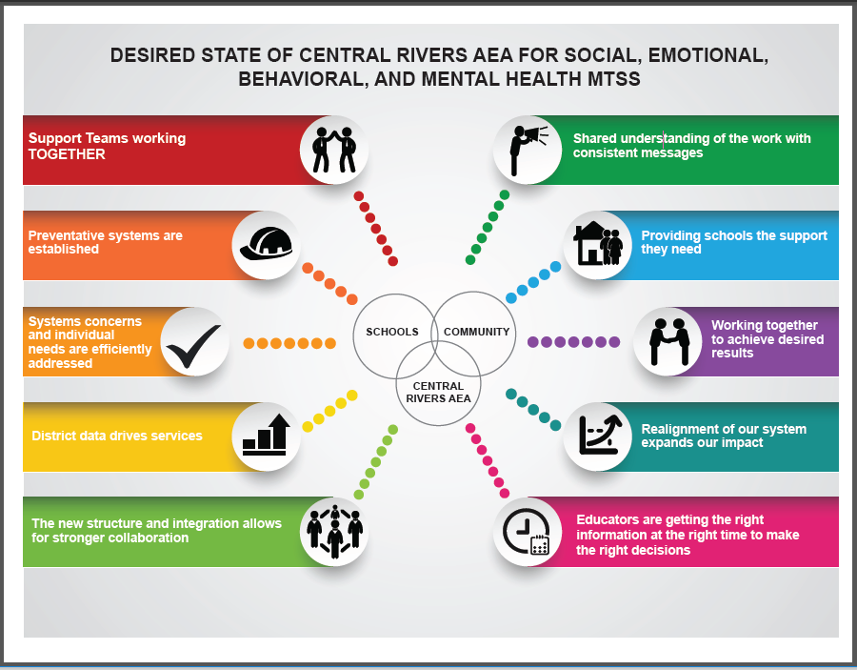
Notes:
A multi-tiered system of integrated supports for social, emotional, behavioral, and mental health is available to build the capacity of districts to address the needs of children and youth from birth to 21 years of age. All stakeholders are knowledgeable about the integrated supports available through Central Rivers and access supports as needed.
Desired State of Central Rivers AEA for Social Emotional Behavioral and Mental Health MTSS
Support Teams working TOGETHER
Shared understanding of the work with consistent messages
Providing schools the support they need
Working together to achieve desired results
Realignment of our system expands our impact
Educators are getting the right information at the right time to do the right work
The new structure and integration allows for stronger collaboration
District data drives services
We efficiently address systems concerns and individual needs
Preventative systems are established

Slide 4
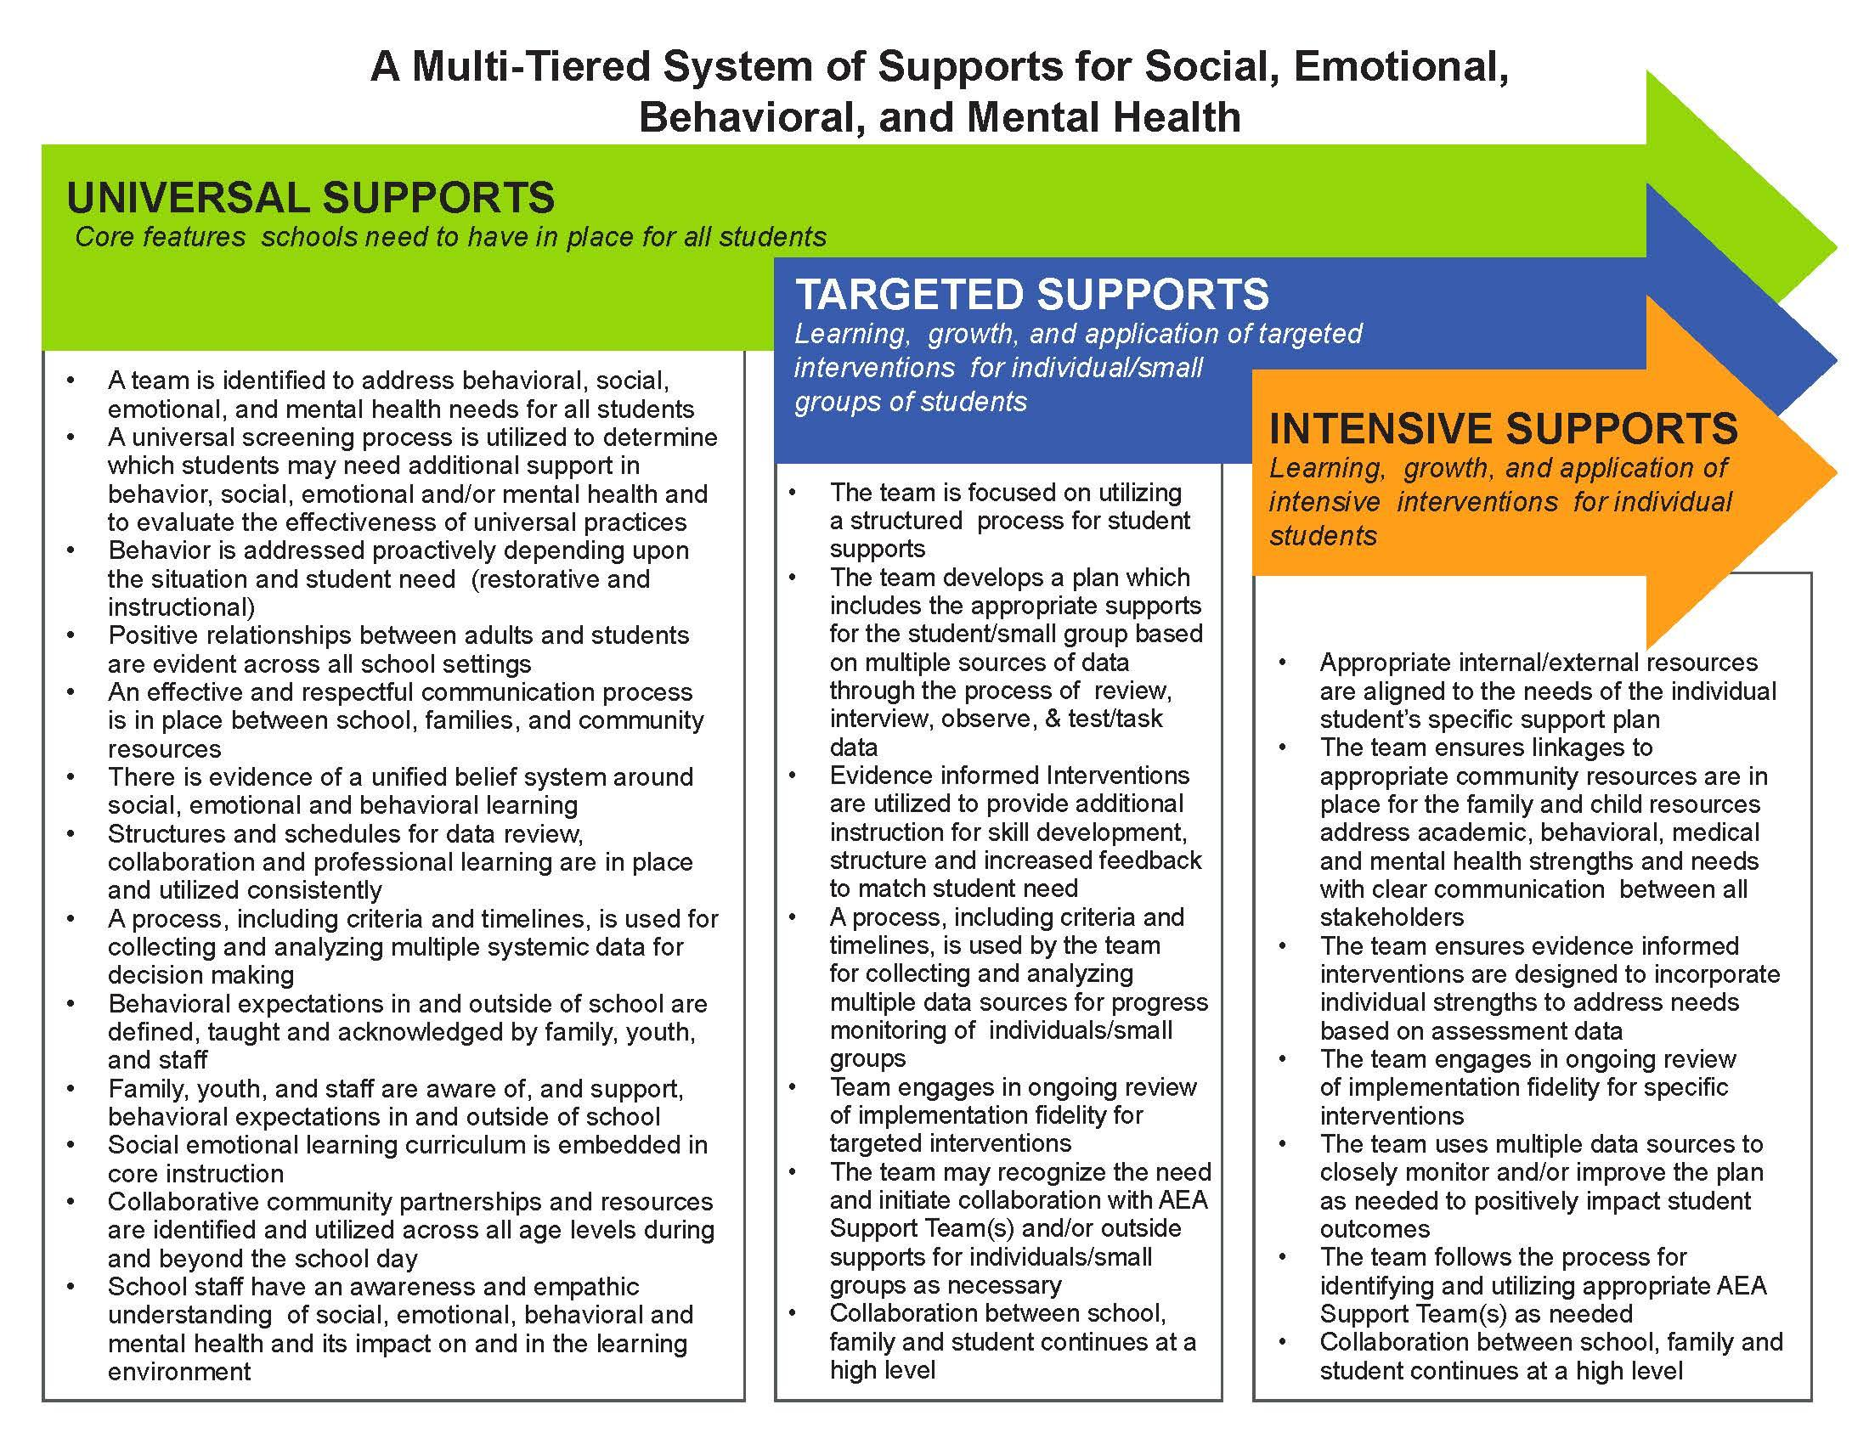
Notes:
THIS SLIDE PICTURE NEEDS UPDATING FROM LINDSAY
This graphic provides guidance, grounded in school improvement processes, for launching MTSS for social, emotional, behavioral, and mental health
(Text heavy)
Talking Points:
This is a big picture overview of the framework (school system) -
2. Overlap of arrows Universal (all) - Targeted (Some) - Intensive (Few)
3. Components aren’t in a hierarchical order. Equal significance.
4. Components were developed through discussion - PBIS, mental health, Leader in Me, what we know about EBP in SEL,
This is a lot to think about. So, the question is… how will Central Rivers AEA support you?
Read for clarity and comprehensiveness - put questions/comments on the Google Doc -
Put our MTSS doc/visual here. The big idea here is that many schools jump to targeted and intensive...but need to really get strong in universal (Prevention) (MTSS IOWA SYSTEM)

Slide 5
Notes:
THIS SLIDE NEEDS TO BE UPDATED WITH LINDSAY
What if it is determined a school doesn’t have the right things in place.
How do we go about making the change and sustaining it?
Where do we start?
How do we know what steps to take?

Slide 6
Next Steps
Follow up sessions for implementation of MTSS for Social, Emotional, Behavioral, and Mental Health
November 27th, Clear Lake Conference Center
November 30th, Marshalltown Conference Center
December 12, Cedar Falls Conference Center
Register for Course # 15725 Multi-tiered Systems of Support for Social, Emotional, Behavioral and Mental Health kick-off
Introduce the Social, Academic, & Emotional Behavioral Risk Screener (SAEBRS)
Notes:
Screener

Slide 7
Purpose for the Day:
Provide Information and Obtain
feedback on district needs
OUTCOMES: What do we want audience to know and be able to do as a result of the day
1. Identify beliefs around social emotional learning, mental health and behavior
2. Understand social emotional learning, mental health and behavior and why they are important
3. Learn about the impact of trauma on the brain and learning
4. Determine current practices within your school context

Slide 8
Outcomes Continued
5. Review of AEA MTSS for SEBMH Framework and make connections to their own context
6. Overview the five themes of the framework for professional learning and identify some areas to fill in gaps (Empathic Environments, Engagement, Leadership, Data, Access to Resources)
7. Introduction to Risk Screener (SAEBRS)
8. Next steps and action planning

Slide 9
Team Members
LEA Building Administrator
Counselor
At-Risk Coordinator
PBIS Internal Coach(es)
Instructional Coach(es)
Behavior Interventionist(s)
AEA Team Representative(s)
School Improvement Consultant
Mental Health Support Team
Behavior Support Team
PBIS Team

Slide 10
Course Instructors
Dr. Dana Miller
and
Rusti Sparks

Slide 11
Social, Academic, & Emotional Behavior Risk Screener (SAEBRS)
What is it?
and
What does it tell us?

Slide 12
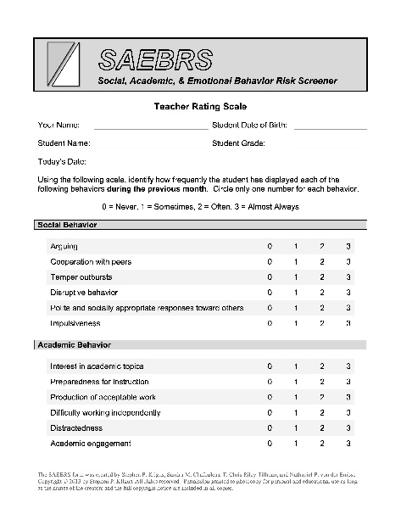
Social, Academic, & Emotional Behavior Risk Screener (SAEBRS)
(Kilgus, Chafouleas, Riley-Tillman, & von der Embse, 2013)
The SAEBRS form was created by Stephen P. Kilgus, Sandra M. Chafouleas, T. Chris Riley-Tillman, and Nathaniel P. von der Embse Copyright © 2013 by Stephen P. Kilgus. All rights reserved. Permission granted to photocopy for personal and educational use as long as the names of the creators and the full copyright notice are included in all copies

Slide 13
Social, Academic, & Emotional Behavior Risk Screener (Kilgus, Chafouleas, Riley-Tillman, & von der Embse, 2013)
SAEBRS: Universal screening for behavioral and emotional risk
Measures across domains in academic and behavior Success
Total behavior
Social Behavior
Academic Behavior
Emotional Behavior
For use in K-12 settings
1-3 min to rate a single student
19 items are divided between 3 scales:
Social Behavior (6 items)
Academic Behavior (6 items)
Emotional Behavior (7 items)
Adapted from: Riley-Tillman, C. (2014). EBA Brief for Social, Academic, and Emotional Behavior Risk Screener (SAEBRS). Retrieved from: http://ebi.missouri.edu/?p=1116

Slide 14
Social, Academic, & Emotional Behavior Risk Screener (Kilgus, Chafouleas, Riley-Tillman, & von der Embse, 2013)
Raters identify how frequently the student has displayed behaviors during the previous month using the following 4-point Likert-type scale:
0 = Never, 1 = Sometimes, 2 = Often, 3 = Almost Always
Negatively worded items are reversed scored.
Social Behavior | Academic Behavior | Emotional Behavior
Arguing | Interest in academic topics | Sadness
Cooperation with peers | Preparedness for instruction | Fearfulness
Temper outbursts | Production of acceptable work | Adaptable to change
Disruptive behavior | Difficulty working independently | Positive attitude
Polite and socially appropriate responses toward others | Distractedness | Worry
Impulsiveness | Academic engagement | Difficulty rebounding from setbacks
 |  | Withdrawal
Adapted from: Riley-Tillman, C. (2014). EBA Brief for Social, Academic, and Emotional Behavior Risk Screener (SAEBRS). Retrieved from: http://ebi.missouri.edu/?p=1116

Slide 15
Social, Academic, & Emotional Behavior Risk Screener (Kilgus, Chafouleas, Riley-Tillman, & von der Embse, 2013)
SCORING | Social Behavior | Never | Sometimes | Often | Almost Always
 | Arguing | 3 | 2 | 1 | 0
 | Cooperation with peers | 0 | 1 | 2 | 3
 | Temper outbursts | 3 | 2 | 1 | 0
 | Disruptive behavior | 3 | 2 | 1 | 0
 | Polite and socially appropriate responses toward others | 0 | 1 | 2 | 3
 | Impulsiveness | 3 | 2 | 1 | 0
 | Interest in academic topics | 0 | 1 | 2 | 3
 | Preparedness for instruction | 0 | 1 | 2 | 3
 | Production of acceptable work | 0 | 1 | 2 | 3
 | Difficulty working independently | 3 | 2 | 1 | 0
 | Distractedness | 3 | 2 | 1 | 0
 | Academic engagement | 0 | 1 | 2 | 3
 | Sadness | 3 | 2 | 1 | 0
 | Fearfulness | 3 | 2 | 1 | 0
 | Adaptable to change | 0 | 1 | 2 | 3
 | Positive attitude | 0 | 1 | 2 | 3
 | Worry | 3 | 2 | 1 | 0
 | Difficulty rebounding from setbacks | 3 | 2 | 1 | 0
 | Withdrawal | 3 | 2 | 1 | 0
Reverse scoring on some items
Adapted from: Riley-Tillman, C. (2014). EBA Brief for Social, Academic, and Emotional Behavior Risk Screener (SAEBRS). Retrieved from: http://ebi.missouri.edu/?p=1116

Slide 16
Social, Academic, & Emotional Behavior Risk Screener (Kilgus, Chafouleas, Riley-Tillman, & von der Embse, 2013)
Interpretation
Higher scores are indicative of more appropriate behavior and functioning
Subscale and total scores can be dichotomized in terms of risk category as at-risk and not at-risk
 | At-risk | Not at-risk
Social Behavior | 0-12 | 13-18
Academic Behavior | 0-9 | 10-18
Emotional Behavior | 0-16* | 17*-21
Total Behavior | 0-36 | 37-57
(Kilgus, Chafouleas, & Riley-Tillman; 2013; Kilgus, Sims, von der Embse, & Riley-Tillman, 2015; Kilgus, Eklund, von der Embse, Taylor, & Sims, 2016) *2016 revised risk range.
Adapted from: Riley-Tillman, C. (2014). EBA Brief for Social, Academic, and Emotional Behavior Risk Screener (SAEBRS). Retrieved from: http://ebi.missouri.edu/?p=1116

Slide 17
Next Steps for SAEBRS
Identify what supports are needed at the building/district level and implement these supports
Identify AEA level supports and design services in order to partner with LEAs
Identify and implement supports for parents

Slide 18
Feedback & Questions
Partnering with Districts to Support Social, Emotional, Behavioral, and Mental Health

