Slide 1

How many can think of students who are having a tough time?
Think of some of the problems in your school or your students that you worry about.
Notes:
SPEAKER NOTES
How many can think of students who are having a tough time?
Think of some of the problems in your school or your students that you worry about.
Now think of colleagues who are having a tough time.
We all have problems at different times. (consider putting this into the slide, not just the notes.
These are call-out questions to get the audience involved without putting anyone on the spot to answer or share their response.
We want people to “connect” with this presentation by helping them recognize that we are all affected in some way by the challenges individuals face.

Slide 2

Ever wonder what you could do to help?
Science is showing us that the little things we do to connect make a big difference!
Notes:
SPEAKER NOTES
It starts with understanding the developing brain and continues with seeing how relationships build healthy brains and a thriving community.
The bottom-line is that “CONNECTIONS MATTER!” This presentation will show you how and why the little things we can do to connect with one another and build relationships are important for everyone. What emphasis does your school place on building relationships?

Slide 3
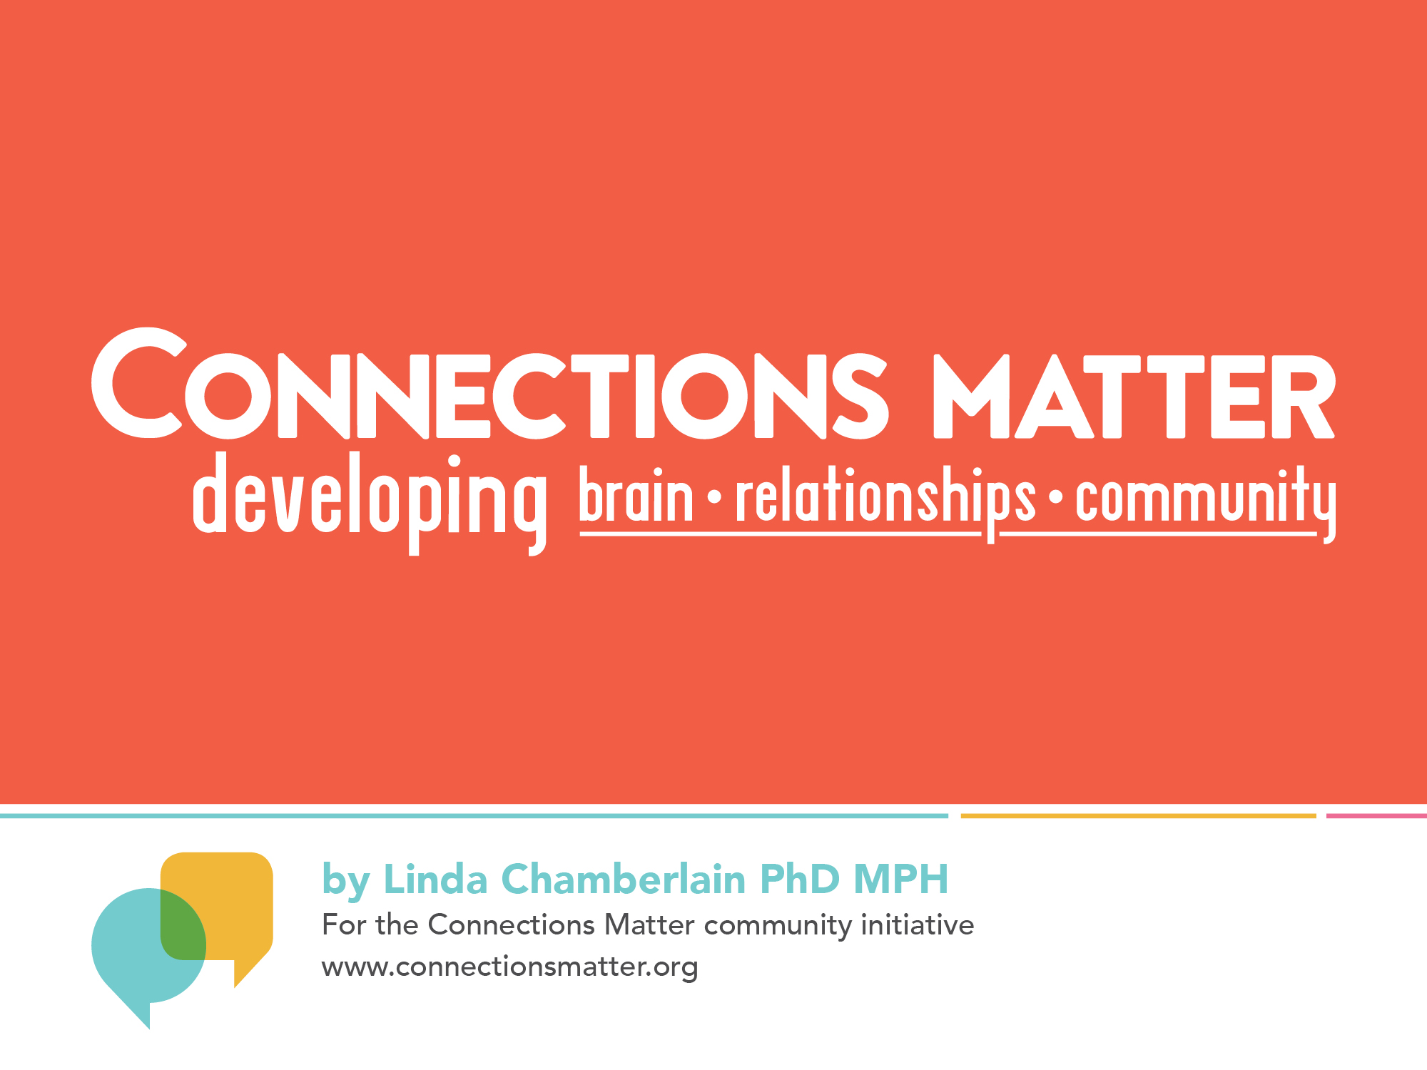
Notes:
SPEAKER NOTES
This PowerPoint presentation has slides and additional information for you in the “Notes” section of many of the slides. This presentation is designed to be approximately 50 minutes in length, but the length will vary depending on whether you show the two videos and the time you spend doing exercises.
If you need to deliver a shorter presentation, we have provided a 20-minute version that you can adapt as needed.
RESOURCES NEEDED
Internet Access
If you plan to show the two videos (which are available on-line); or you may choose to download the videos ahead of time.
Playfoam
A children’s toy, available in some toy stores and on-line, if you want to demonstrate the plasticity of the brain.
Post-Its (we recommend 2 inches by 2 inches or larger)
Important for the closing exercise called “What’s My Connection?” Also, while not essential, it would be useful to have a larger sheet of paper, poster board, or some designated surface for participants to post their ideas.

Slide 4
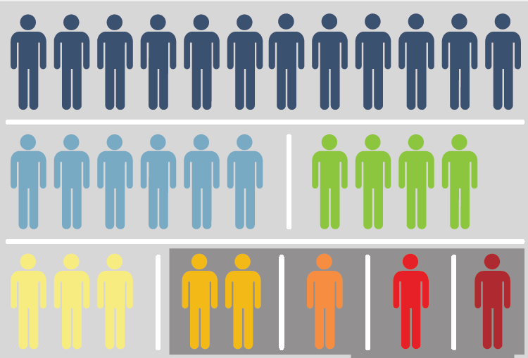
5 out of 30
students live with a parent who has experienced significant childhood trauma
Notes:
Set the stage for talking about ACES:
Original study in California
We’ve been studying the impact of ACEs on Iowa’s adult population for three years
1/6 people have four or more ACEs – a significant level of trauma – these are adults but it ultimately impacts the kids we serve!

Slide 5
56% of Iowans experienced at least one
Adverse Childhood Experience
CHILD ABUSE | %
Emotional Abuse | 26.8
Physical Abuse | 15.9
Sexual Abuse | 9.7
HOUSEHOLD DYSFUNCTION
Substance abuse in home | 26.1
Separation/divorce | 23.2
Family member with mental illness | 18
Domestic violence | 15.3
Incarcerated family member | 6.8
ANY ACE | 56
Notes:
ACEs in Iowa
Increased likelihood of experiencing additional ACEs especially with incarcerated family member and domestic violence

Slide 6
Where do Iowa adults with ACEs
live now?
PERCENT
OF ADULTS REPORTING FOUR OR MORE ACES
Map does not reflect where trauma occurred, but rather where adults with four or more ACEs currently live.

Slide 7
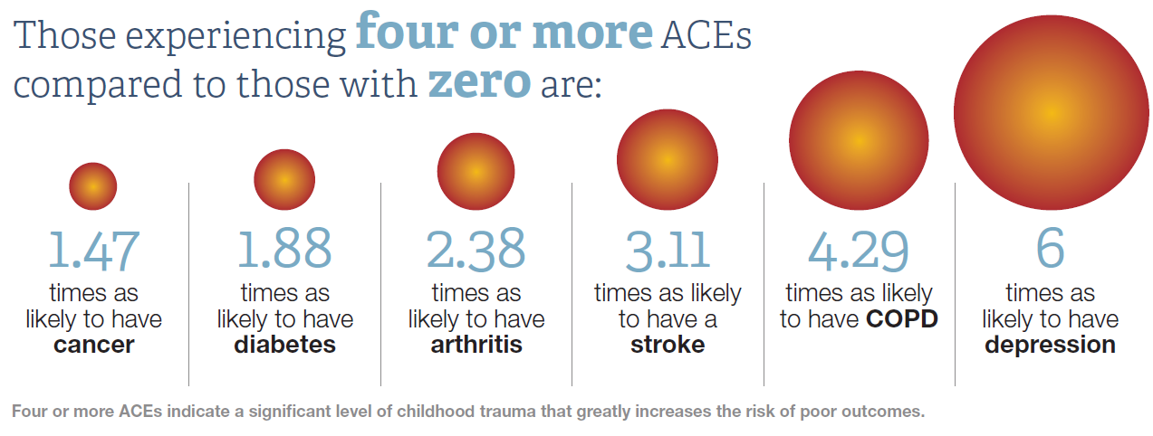
Notes:
Having four or more ACEs compared to zero significantly impacts the likelihood of:
Health
Mental health
Risky behaviors
Think about this as the parents of the children in our Iowa classrooms – dealing with health, mental health and risky behavior issues that can impact how they parent their children.
Workforce applications

Slide 8
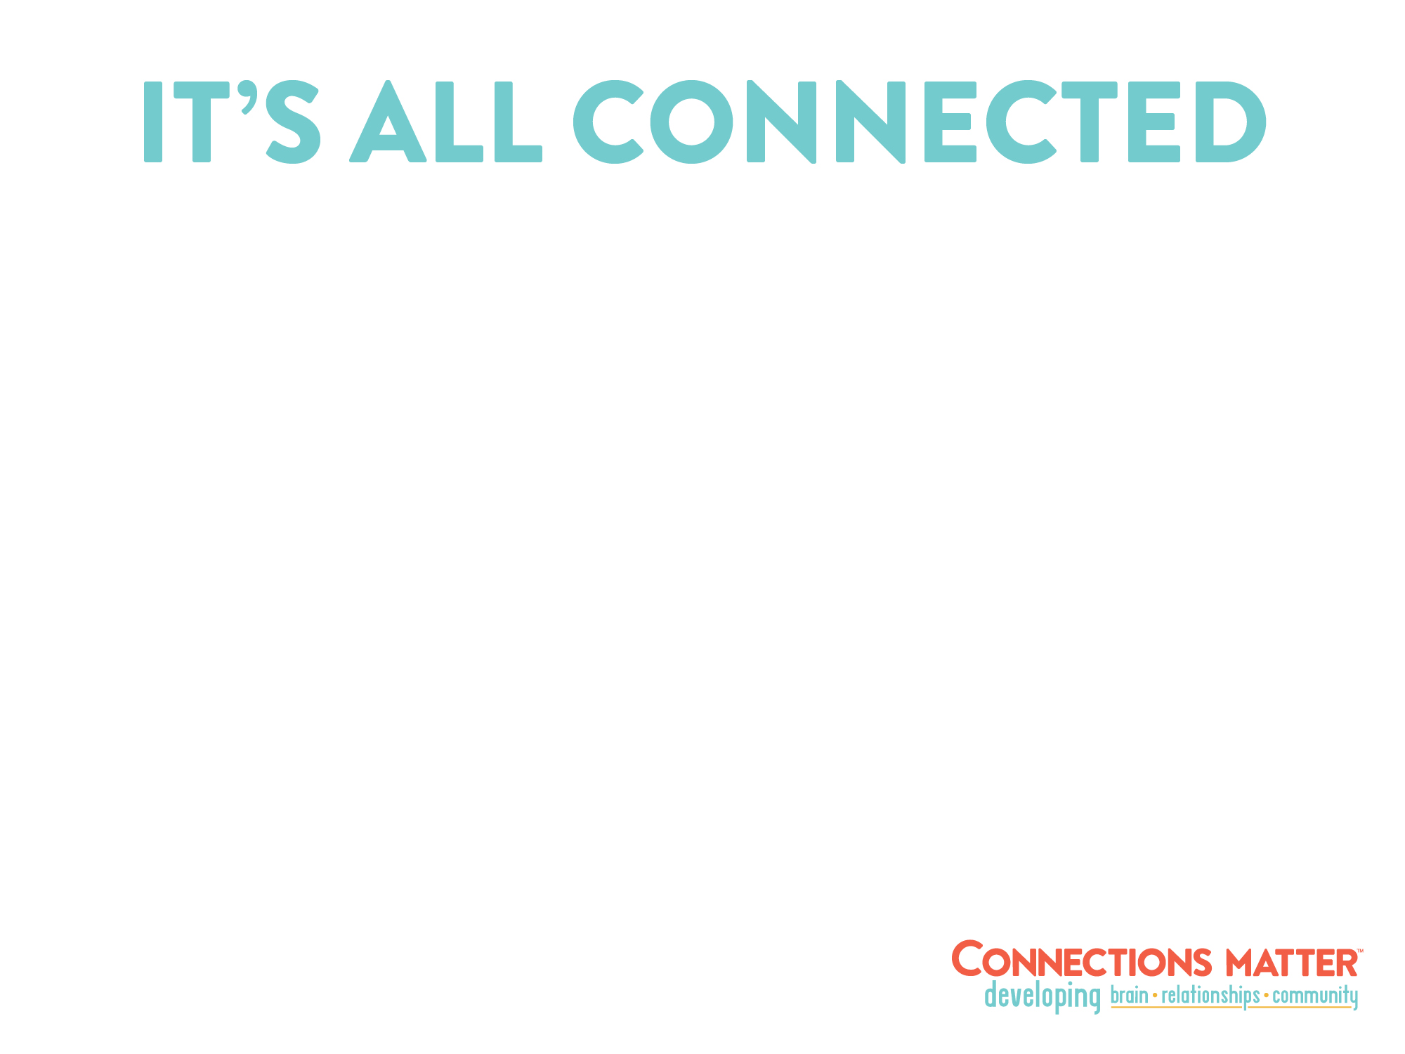

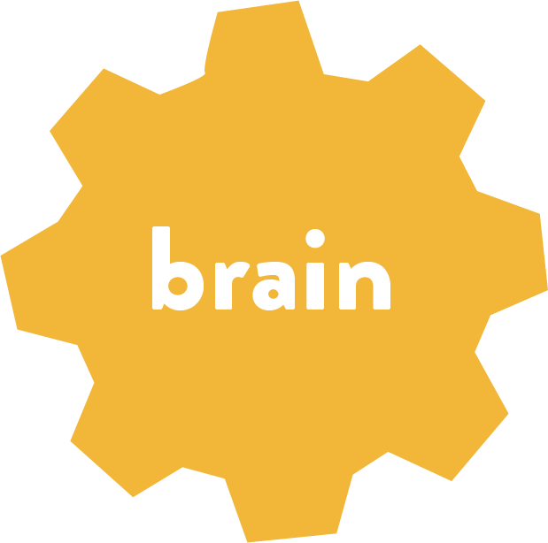

Notes:
SPEAKER NOTES
Our brain, our relationships and our schools and community are all inter-connected. This can lead to strengths and good outcomes when we take positive steps to build relationships with students and families or it can result in weaknesses when we miss opportunities to make connections that build healthy brains, relationships and community. Without a significant relationship, it is very difficult for a student to experience significant learning.
Caring connections promote:
Healthy brains ready to think and learn
Supportive relationships so students and school staff cope and thrive
Strong community where everyone succeeds

Slide 9
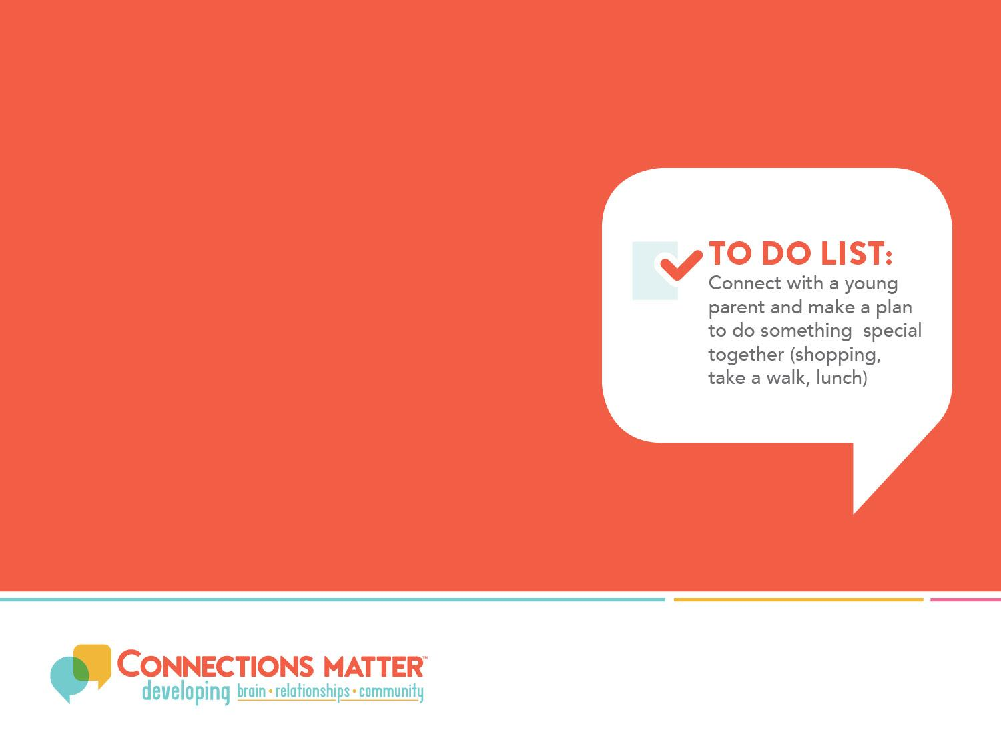
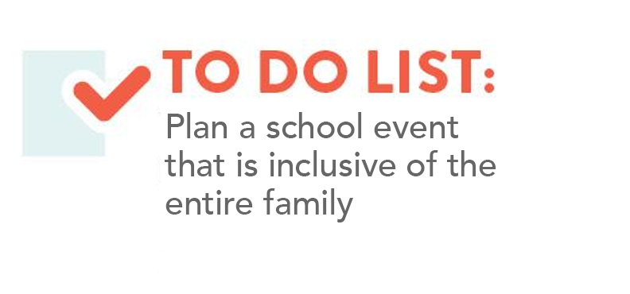
Helping Families Helps Kids
Approaches that address the needs of children without helping their families usually leave either the child or family behind
When we reach out and support children and their families together, we see far greater results than the sum of their parts
Two Generation Approach, The Aspen Institute
Notes:
SPEAKER NOTES
Two-Generation Approaches recognize that when we reach out and connect with parents, we have a powerful effect on their children too. Recognition of the importance of two-generation approaches has led to more effective whole family interventions that work with parents and their children together. These interventions address a wide range of issues including substance abuse, mental illness in a family and poverty.
For example, there’s a Head Start program in Tulsa, Oklahoma that is helping parents earn degrees in the healthcare field while their children are in Head Start. Why? Because while we know that investing in early childhood education will yield a 7-10% annual return on our investment and reduce social costs, we also know that a parent who completes a college degree doubles her/his income. A $3,000 difference in parents’ income when their children are young translates into a 17% increase in that child’s future earnings! So it makes good economic sense to invest in supporting parents and children together.
How does your school help build caring relationships with parents?
To learn more about these programs and the Two-Generation Approach go to http://ascend.aspeninstitute.org/pages/the-two-generation-approach and download the “Two-Generation Playbook.”

Slide 10
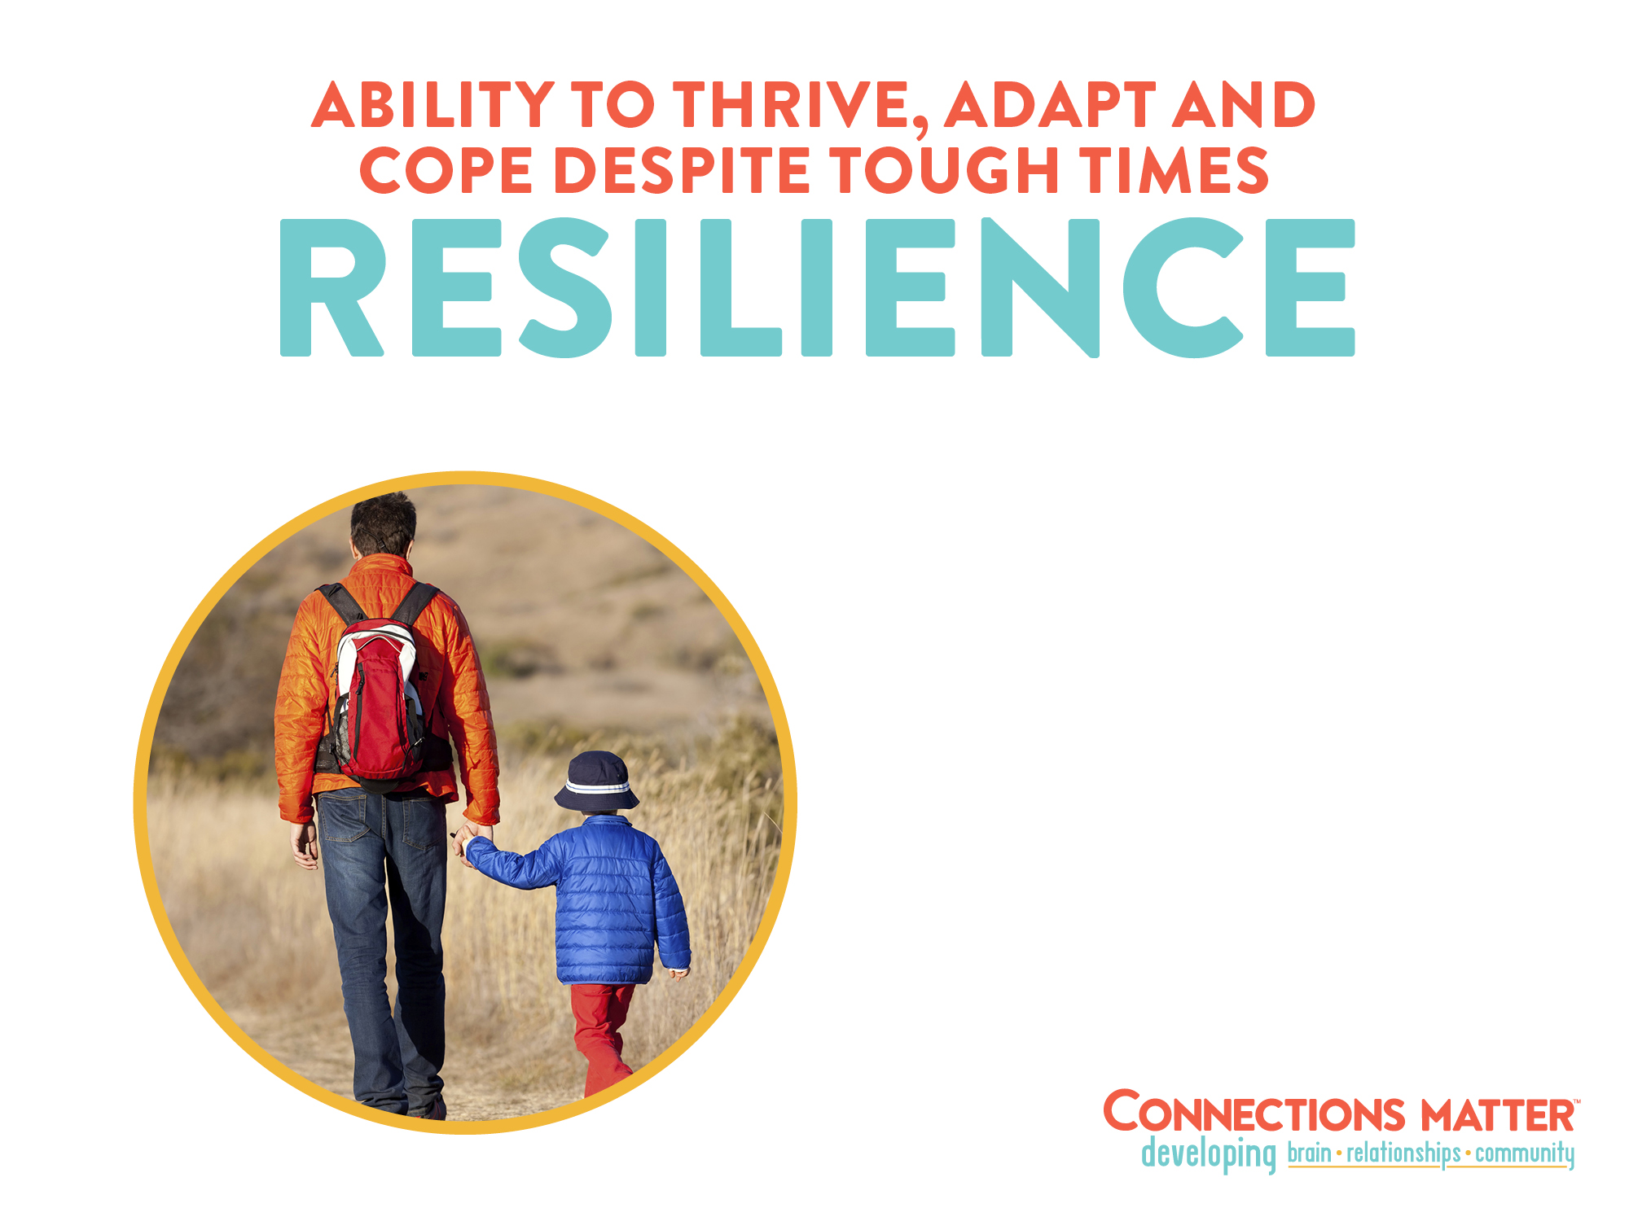

  BUT resilience does not happen all by itself…
  Relationships are the main ingredient that help us overcome tough times
Notes:
SPEAKER NOTES
The resilience of an individual depends, to a great extent, on their relationships and community. The more we learn about resilience, the more we recognize that it is the systems around us—family, school, neighborhood, church, friends and community—that influence the ability of both children and adults to be resilient. Trauma-informed schools can use resilience models to find the strongest factors of resilience in each child and use it to build strengths in new areas (making connections). Again, it’s why “Connections Matter.” How do your students know they can depend on you?

Slide 11
The Help that Helps: Resiliency
ACEs can be offset by the presence of one dependable and caring adult. More often than not, that adult is a
teacher
Foundations for healthy generations, Health, Safety, & Resilience: Foundations for Health Equality Statewide Summary-Fall 2014/Winter 2015
Notes:
Research on resiliency and ACEs now shows that having one safe, stable caring relationship is more important than whether someone has experienced ACEs.
Washington State’s data looked at whether someone had help, support, social reciprocity and social bridging – those with higher support and high aces fared better in health and mental health than those with zero aces and no help and support
Washington ACE data (abuse and household dysfunction included, neglect ACEs not counted) from 2009-2011 through telephone surveys sponsored by Washington Department of Health and the CDC
Surveyors also asked questions about Resilience factors that included themes of Support, Help, Community Reciprocity, and Social Bridging
Respondents that indicated higher levels of all four factors correlated with better outcomes, even among people with high ACE scores.
In fact, those with high ACE scores AND high support often fared better than those with ACE scores of zero and low help/support
Having high help, support, community reciprocity and social bridging seemed to mitigate the effects of the ACEs
Reference: Foundation for Healthy Generations (Washington State)

Slide 12
Breaking the cycle:
youth
RISK FACTORS IN IOWA YOUTH
Notes:
The Iowa Youth Survey includes questions about student’s behaviors and attitudes.
Our research included 18 questions from the Youth Survey about student experience to better understand youth risk factors connected to toxic stress that might reflect ACEs. Questions evaluated include bullying, use of drugs, alcohol, smoking, and also questions about resiliency such as : do I have a friend at school? Is there an adult in my school I trust? I feel my community cares about me.
These are the questions of resilience…

Slide 13
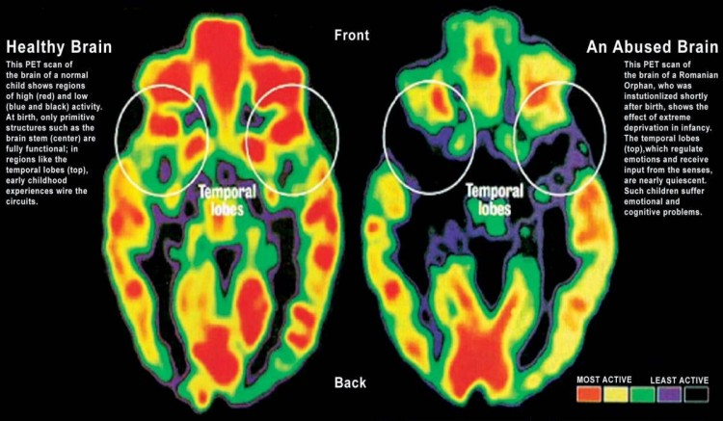
Impact of ACEs
Notes:
Center on Developing Child – Harvard University
Toxic stress: while moderate short-lived stress responses in the body can promote growth, toxic stress is strong, unrelieved activation of the body’s stress management system in the absence of protective adult support. Without caring adults to buffer children, the unrelenting stress caused by extreme poverty, neglect, abuse, or severe maternal depression can weaken the architecture of the developing brain, with long-term consequences for learning, behavior, and both physical and mental health.
Research indicates that supportive, responsive relationships with caring adults as early in life as possible can prevent or reverse the damaging effects of toxic stress response.
Brain functions affected by ACEs: (from Dr. Anda’s presentation)
Affect Regulation: Panic reactions, depression, anxiety, hallucinations
Somatic Issues: Sleep disturbances, severe obesity, pain
Substance Use: Smoking, alcoholism, illicit drug use, IV drug use
Sexuality: Early intercourse, promiscuity, sexual dissatisfaction
Memory: Amnesia (childhood)
Arousal: High stress, problems with anger, perpetrating domestic violence
Smaller brain size
Neural pathways changed : pruning and reinforcement
Learning / behavior: safety scans
THESE PROBLEMS ARE PREVENTABLE

Slide 14
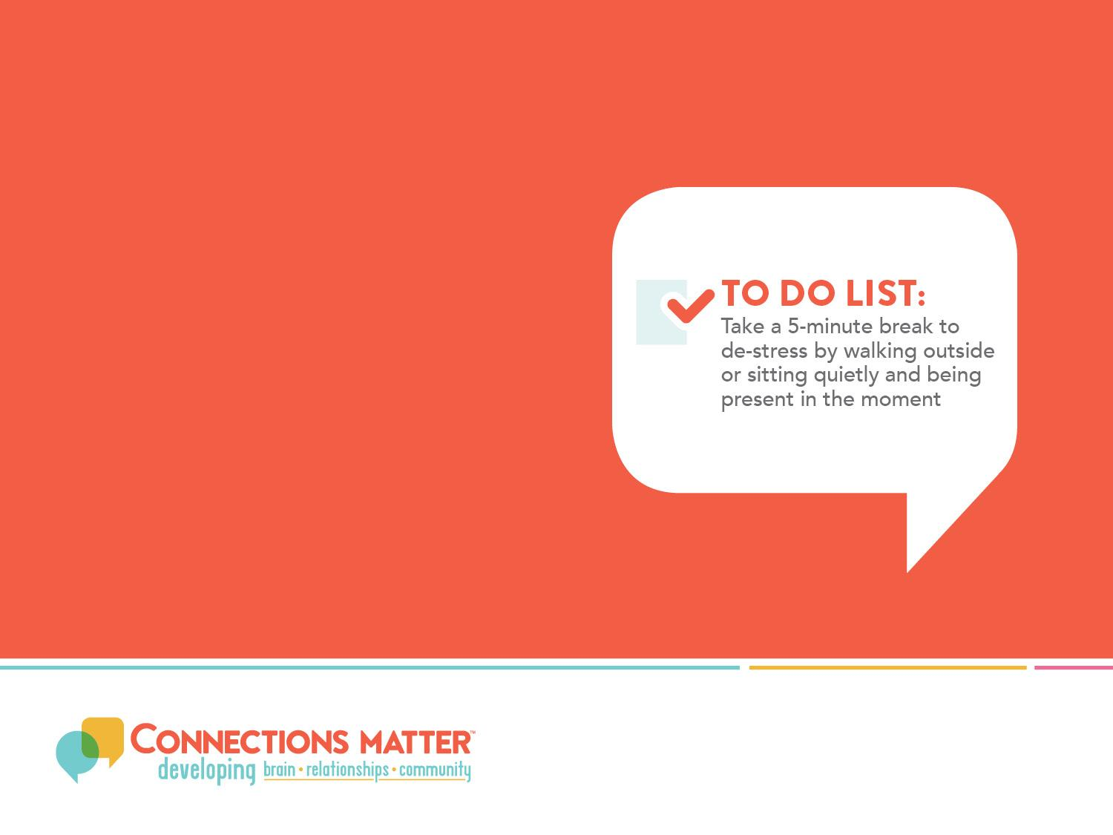
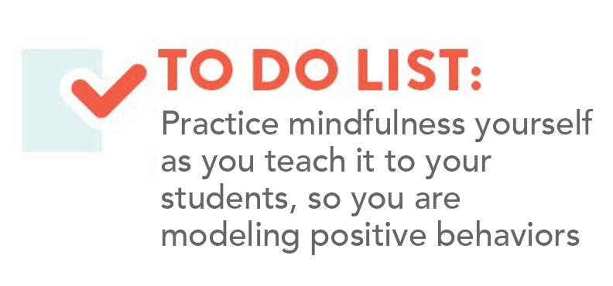
How the Brain Works
Lots of different relationships help our brains to thrive in good times and get through tough times
Our childhood brain is the foundation of our adult brain
Stress can affect the architecture
of our brain
Notes:
SPEAKER NOTES
Click on the hyperlink to play a two-minute video that talks about how our brains are built and how stress can impact that building process. This two-minute video is part of a series of videos that you can find at this website.
Think of one teacher who made a real impact on you through their relationship with you. What did that teacher do that made you feel connected?
https://www.youtube.com/watch?v=VNNsN9IJkws

Slide 15
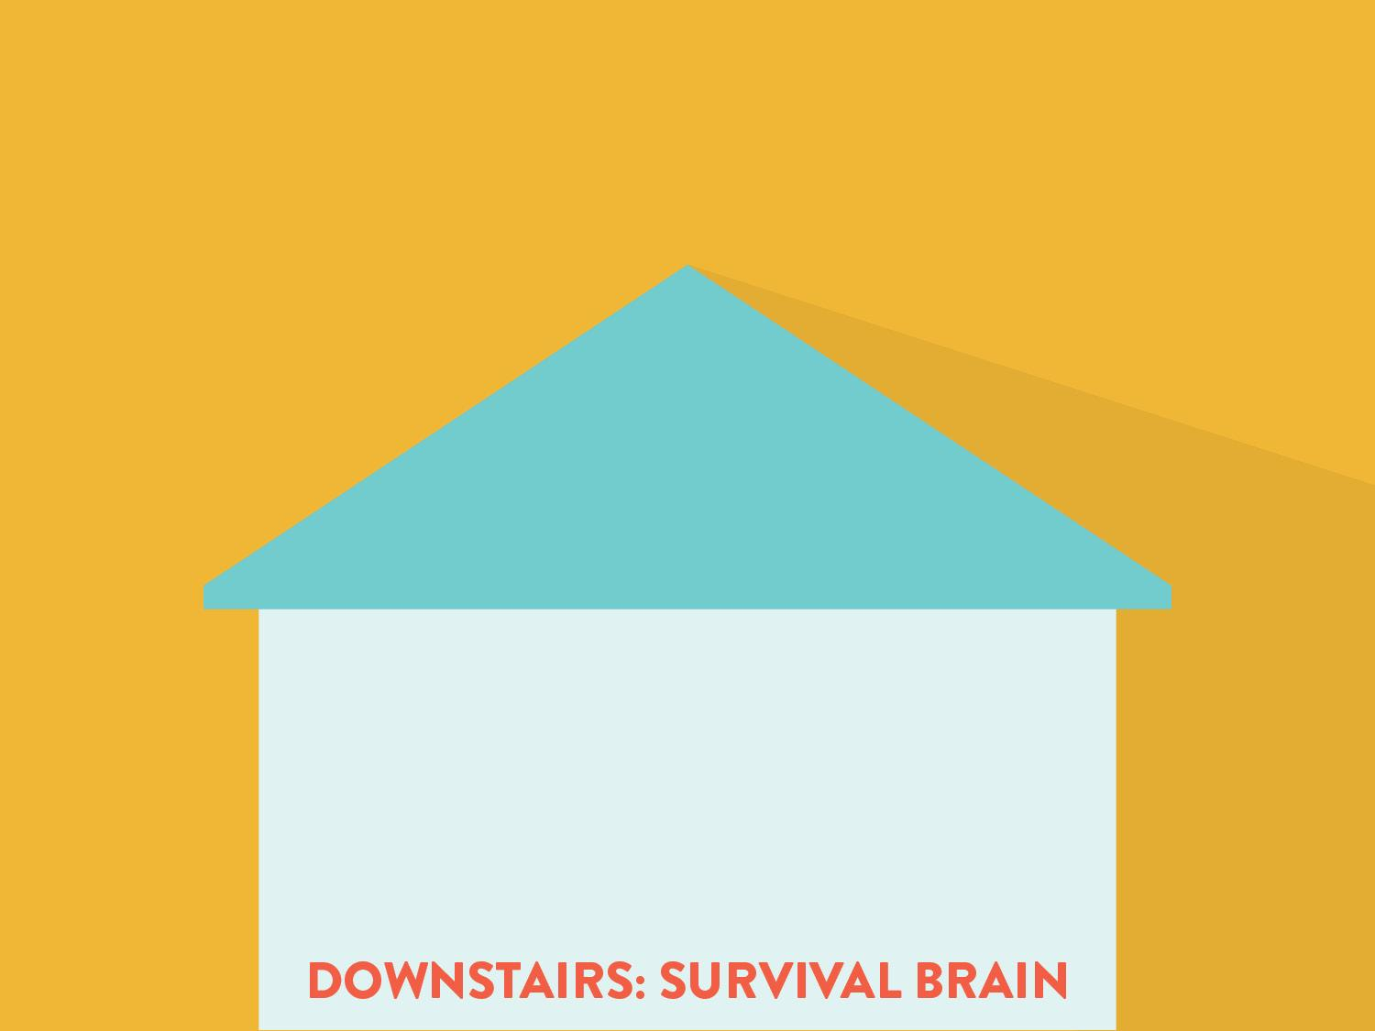
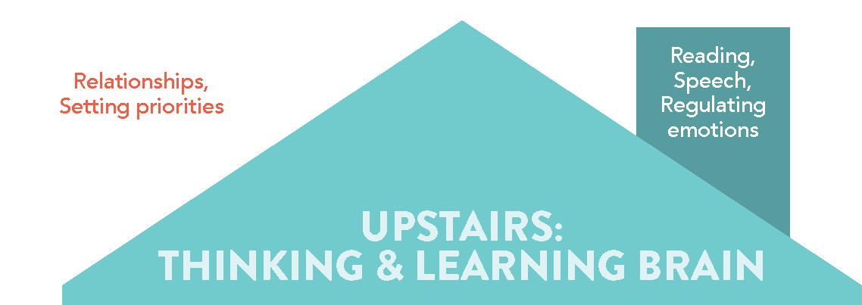
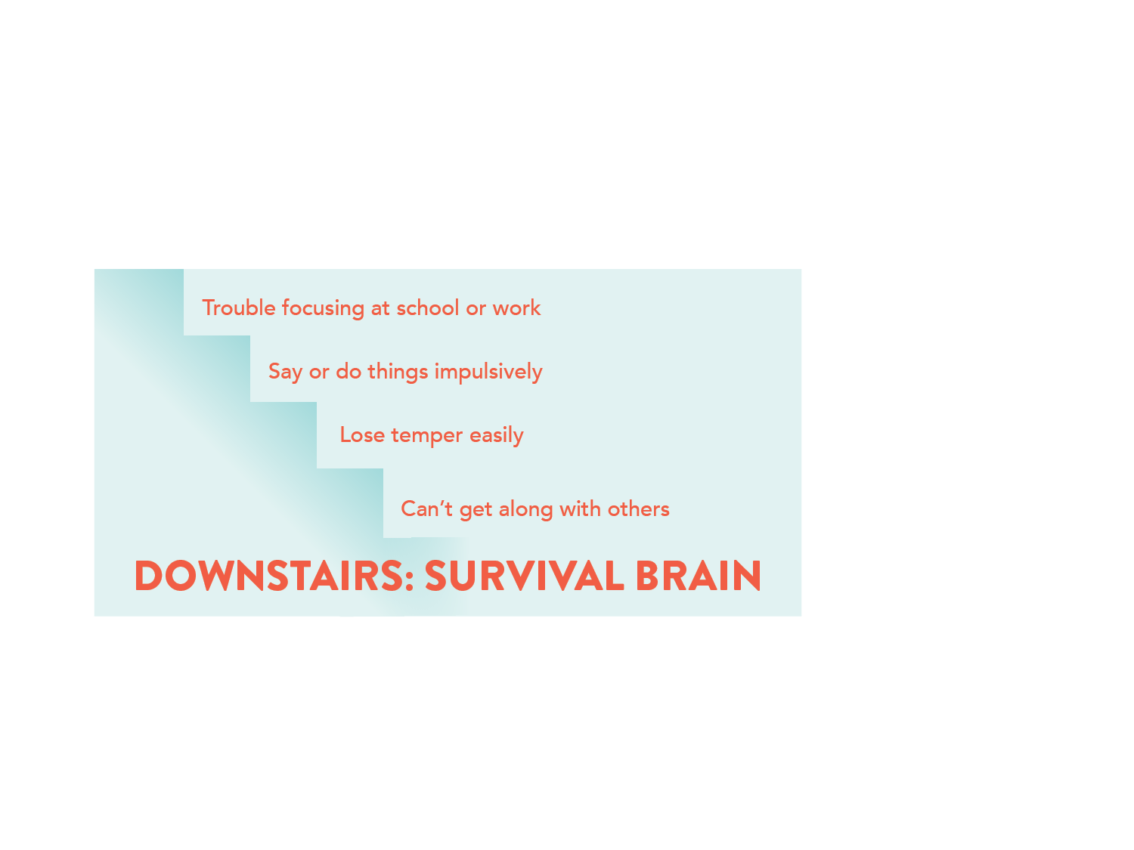
We need to feel safe to think and learn,
but stress can push us DOWNSTAIRS in our brain…
Notes:
SPEAKER NOTES
Dr. Dan Siegel introduced the concept of the “Upstairs” and “Downstairs” brain as a way to talk about how the brain works. The “Downstairs” brain is the more primitive area of our brain which focuses on survival. This is the part of our brain that regulates breathing, heart rate and other basic functions. The “Downstairs” brain also houses the emotional core of our brain and our survival reaction to stress (“Fight, Flight or Freeze” response).
The “Upstairs” area of the brain is where all of our higher functioning happens so we’re talking about decision-making, setting priorities, understanding the difference between right and wrong, building relationships and much more. The “Upstairs” brain, which is not mature until around 25 years old, helps us regulate the more impulsive, reactive “Downstairs” brain so that we think first versus just acting on our emotions.
EXERCISE
INSTRUCTIONS: Read the instructions below to the group and give everyone a few minutes to think about the question and then ask if anyone wants to share how they felt. You could even ask if anyone felt like they went “Downstairs” in their brain when they were stressed. Let participants know that they do not have to share any specifics about the stressful situation he/she was thinking about.
SCRIPT: Each of us responds differently to stress. Our personal stress response is influenced by what skills we have to manage stress and our life experiences. All stress is not bad. Mild levels of stress can help us learn how to cope with stressful situations. Higher levels of stress such as an illness or losing a job may, depending on what else is happening in our lives and the relationships we have to support us, lead to a stronger stress response. How can you minimize the level of stress in your classroom? Take a minute to think of a situation that was moderately, but not overwhelmingly, stressful for you. Think about how you felt at that time—was it hard to “get your bearings” or “think straight” at first? How did you feel? What helped you? Now think of a student who has this same trouble. Does your school teach students about their brain? How might this information about the upstairs and downstairs brain be helpful to students? In order for learning to take place, students must be using their upstairs brain. If they are in the downstairs brain, as educators, we need to look for ways to help them move to the upstairs brain for learning to happen. That is through connections.

Slide 16
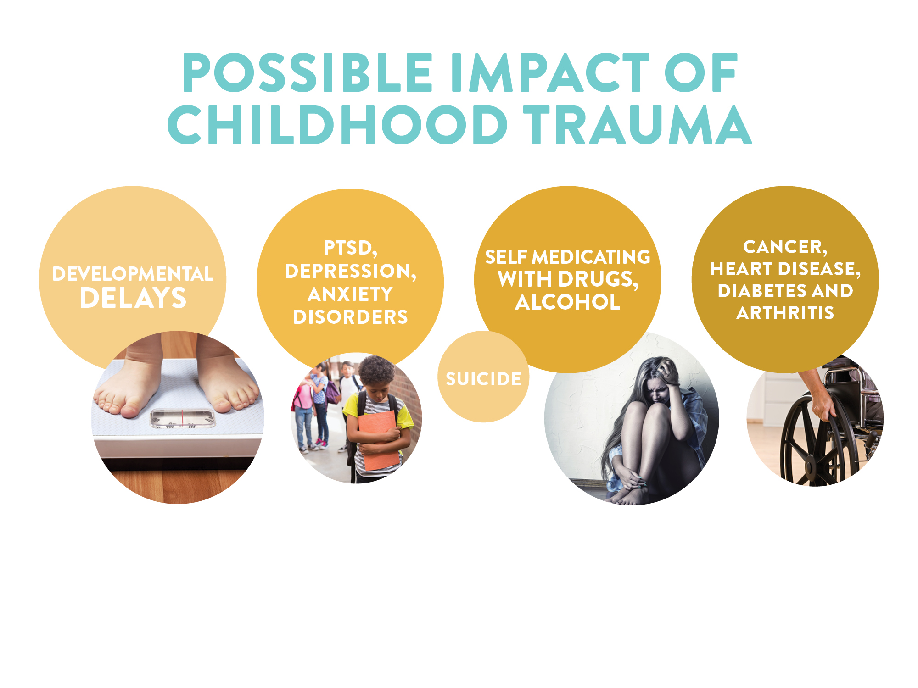




Notes:
SPEAKER NOTES
For more information about the connection between childhood trauma and the effects on health across the lifespan, go to: www.iowaaces360.org and download “Adverse Childhood Experiences in Iowa: Building Hope and Resiliency.”

Slide 17
ACE Score and Grades – Mostly A’s
Source: Minnesota Department of Education
Notes:
Minnesota 8th, 9th, and 11th Graders Describing Their Grades

Slide 18
ACE Score and Grades – Mostly B’s
Source: Minnesota Department of Education
Notes:
Minnesota 8th, 9th, and 11th Graders Describing Their Grades

Slide 19
ACE Score and Grades –Mostly C’s
Source: Minnesota Department of Education
Notes:
Minnesota 8th, 9th, and 11th Graders
Describing Their Grades

Slide 20
ACE Score and Grades – Mostly D’s
Source: Minnesota Department of Education

Slide 21
ACE Score and Grades – Mostly F’s
Source: Minnesota Department of Education

Slide 22
ACE Score and Alcohol Use
Source: Minnesota Department of Education
Notes:
Minnesota 8th, 9th, and 11th Graders reporting alcohol use in past 30 days

Slide 23
ACE Score and Cigarette Smoking
Source: Minnesota Department of Education
Notes:
Minnesota 8th, 9th, and 11th Graders reporting any cigarette smoking in past 30 days

Slide 24
ACE Score and Suicide
Source: Minnesota Department of Education
Notes:
Minnesota 8th, 9th, and 11th Graders suicidal ideation and attempts

Slide 25
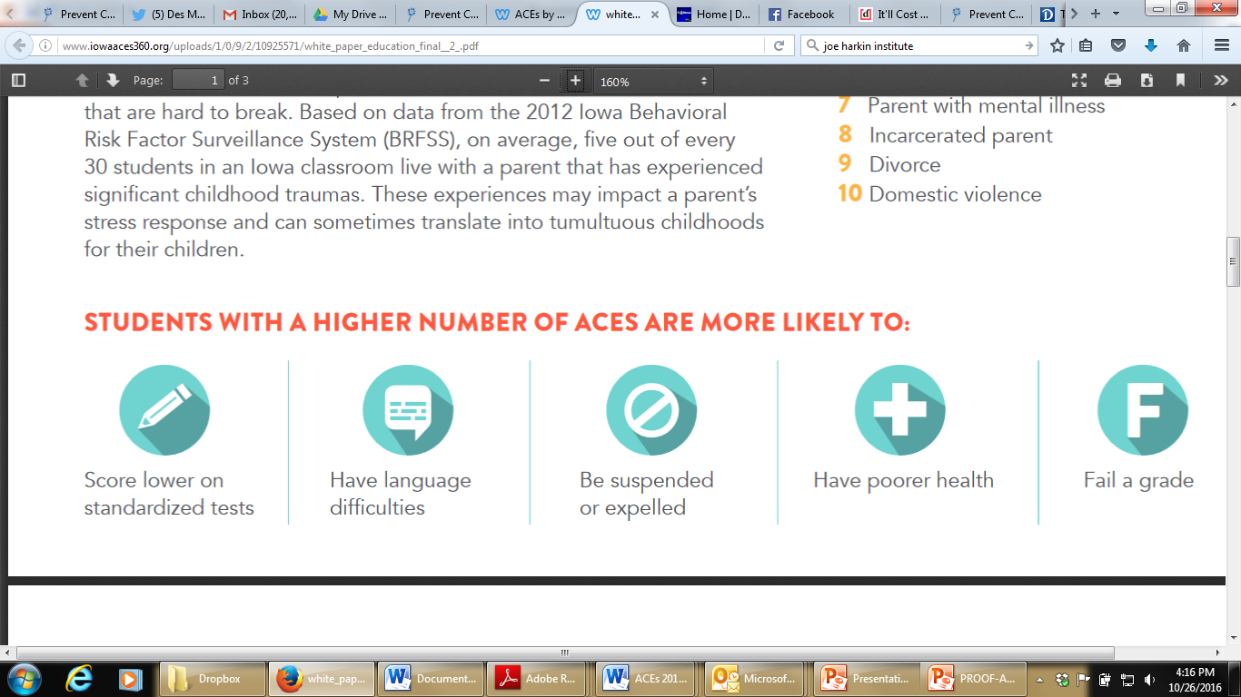
Students with higher ACEs
are more likely to…
Fail a grade
Score lower on standardized tests
Have language difficulties
Be suspended or expelled
Have poorer health
Notes:
Additional research on schools shows these outcomes.
Those with 7 or more ACEs are 100 percent likely to have a developmental delay!

Slide 26
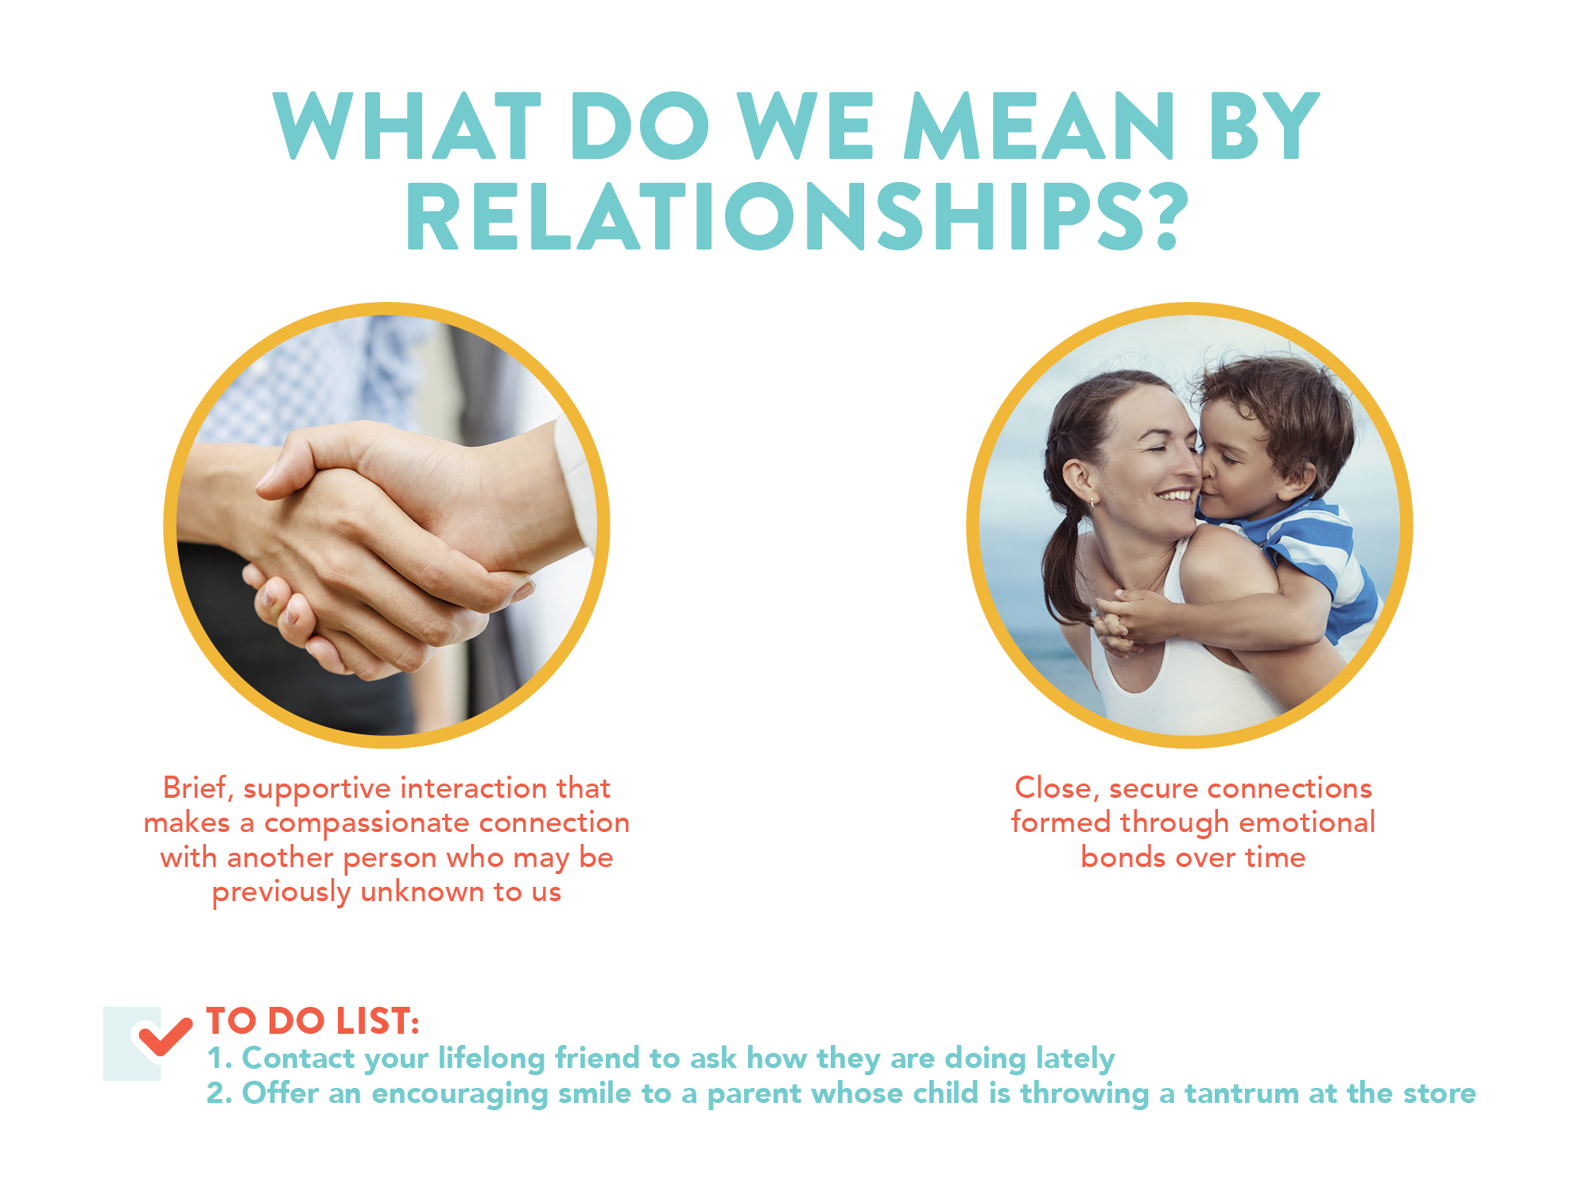


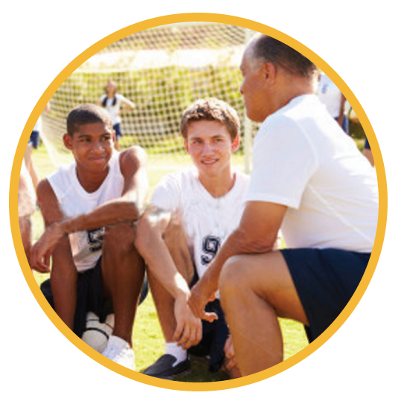
Brief, supportive interactions can make a compassionate connection with all parents and guardians
Safe & Supportive
connections are formed
over time
Offer a safe space for students in your classroom
Connect with a colleague on how you might support a struggling student
Remember that small positive interactions can make a big impact
Notes:
SPEAKER NOTES
For more information about the importance of relationships, go to http://www.takingcharge.csh.umn.edu. This website describes relationships as close, secure connections that are formed through emotional bonding and interactions. These bonds are strengthened by shared experiences—the things we do everyday as a family, with friends, to help out a neighbor or someone we see who needs a helping hand.
Becoming trauma-informed helps us see all people through the lens of compassion. Trauma-informed schools learn to make every connection with parents a positive encounter, treating every person with respect and dignity, with a belief that everyone is doing the best they can with what they have been given.
Are your brief connections impactful enough to make long term bonds that will last over time?
This website is affiliated with the Mayo Clinic and the University of Minnesota.

Slide 27
Learning to ask for help
Learning to accept help
A sense of belonging
Developing friendships
Developing problem-solving skills
Helping a child learn to express his/her feelings
Universal supports

Slide 28
Sensing triggers creating negative behavior
Modeling appropriate behavior
Establishing expectations and rules
Establishing consequences
Universal supports

Slide 29
Universal supports
Showing empathy
Expressing feelings
Helping to appreciate cultural and ethnic heritage
Working as a team
Giving back to the community

Slide 30
Universal supports
The ability to calm oneself
Learning to show appreciation
Experiencing success
Learning to self-advocate
Hope
Trust

Slide 31
Universal supports
Critical thinking skills
Attachment to a caring adult
Teaching self-discipline
Letting a student know you are available to help

Slide 32
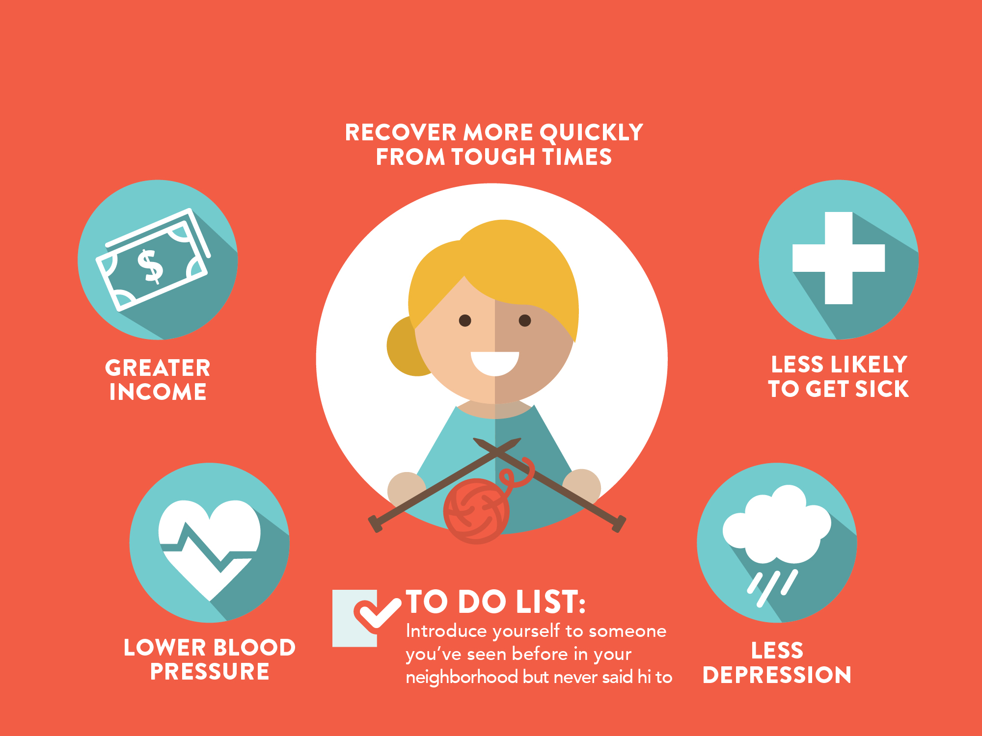






Healing Power of Relationships:
Schools and families
HIGHER STUDENT
ACHIEVEMENT
BETTER
ATTENDANCE
TO DO LIST:
Connect with families to increase school success for their child
POSITIVE PEER
CONNECTIONS
SCHOOL ENGAGEMENT
Notes:
SPEAKER NOTES
Parents who feel connected will better be able to support students and feel comfortable reaching out for help from schools and community supports. By connecting with parents ourselves or connecting them to other community supports, our students will benefit! How do you connect with your families?
How are you making these connections in your school community? Teachers who feel more connected as a team, working with grade level teams or cross-curricular teams in positive ways, will ultimately have more positive interactions with their students. Trauma-informed schools make teamwork a priority.
Resource:
Higher Resilience and School Performance Among Students with Disproportionately High Adverse Childhood Experiences at Lincoln High, in Walla Walla, Washington, 2009 – 2013 https://www.resiliencetrumpsaces.org/images/docs/LH_report_final_March_1_2015.pdf
A Strategy Paper on Improving School Performance - Increasing Resilience to ‘Trump ACEs’ https://www.resiliencetrumpsaces.org/images/docs/A_short_strategy_paper_with_end_notes_April_28.pdf

Slide 33

After four years of implementing an ACEs response, Lincoln High School (Walla Walla, Wash.) saw:
    90% drop in suspensions
    Zero expulsions
    5x increase in graduation rates
Notes:
The change at Lincoln High School – featured in the Paper Tigers documentary - started when the principal took away one nugget of information about ACEs:
Stressed brains can’t learn!
This shared framework among all staff and faculty started a culture change that has significantly changed the outcomes of this alternative high school – which can be applied to all schools!
Starts with a shared conversation and learning

Slide 34
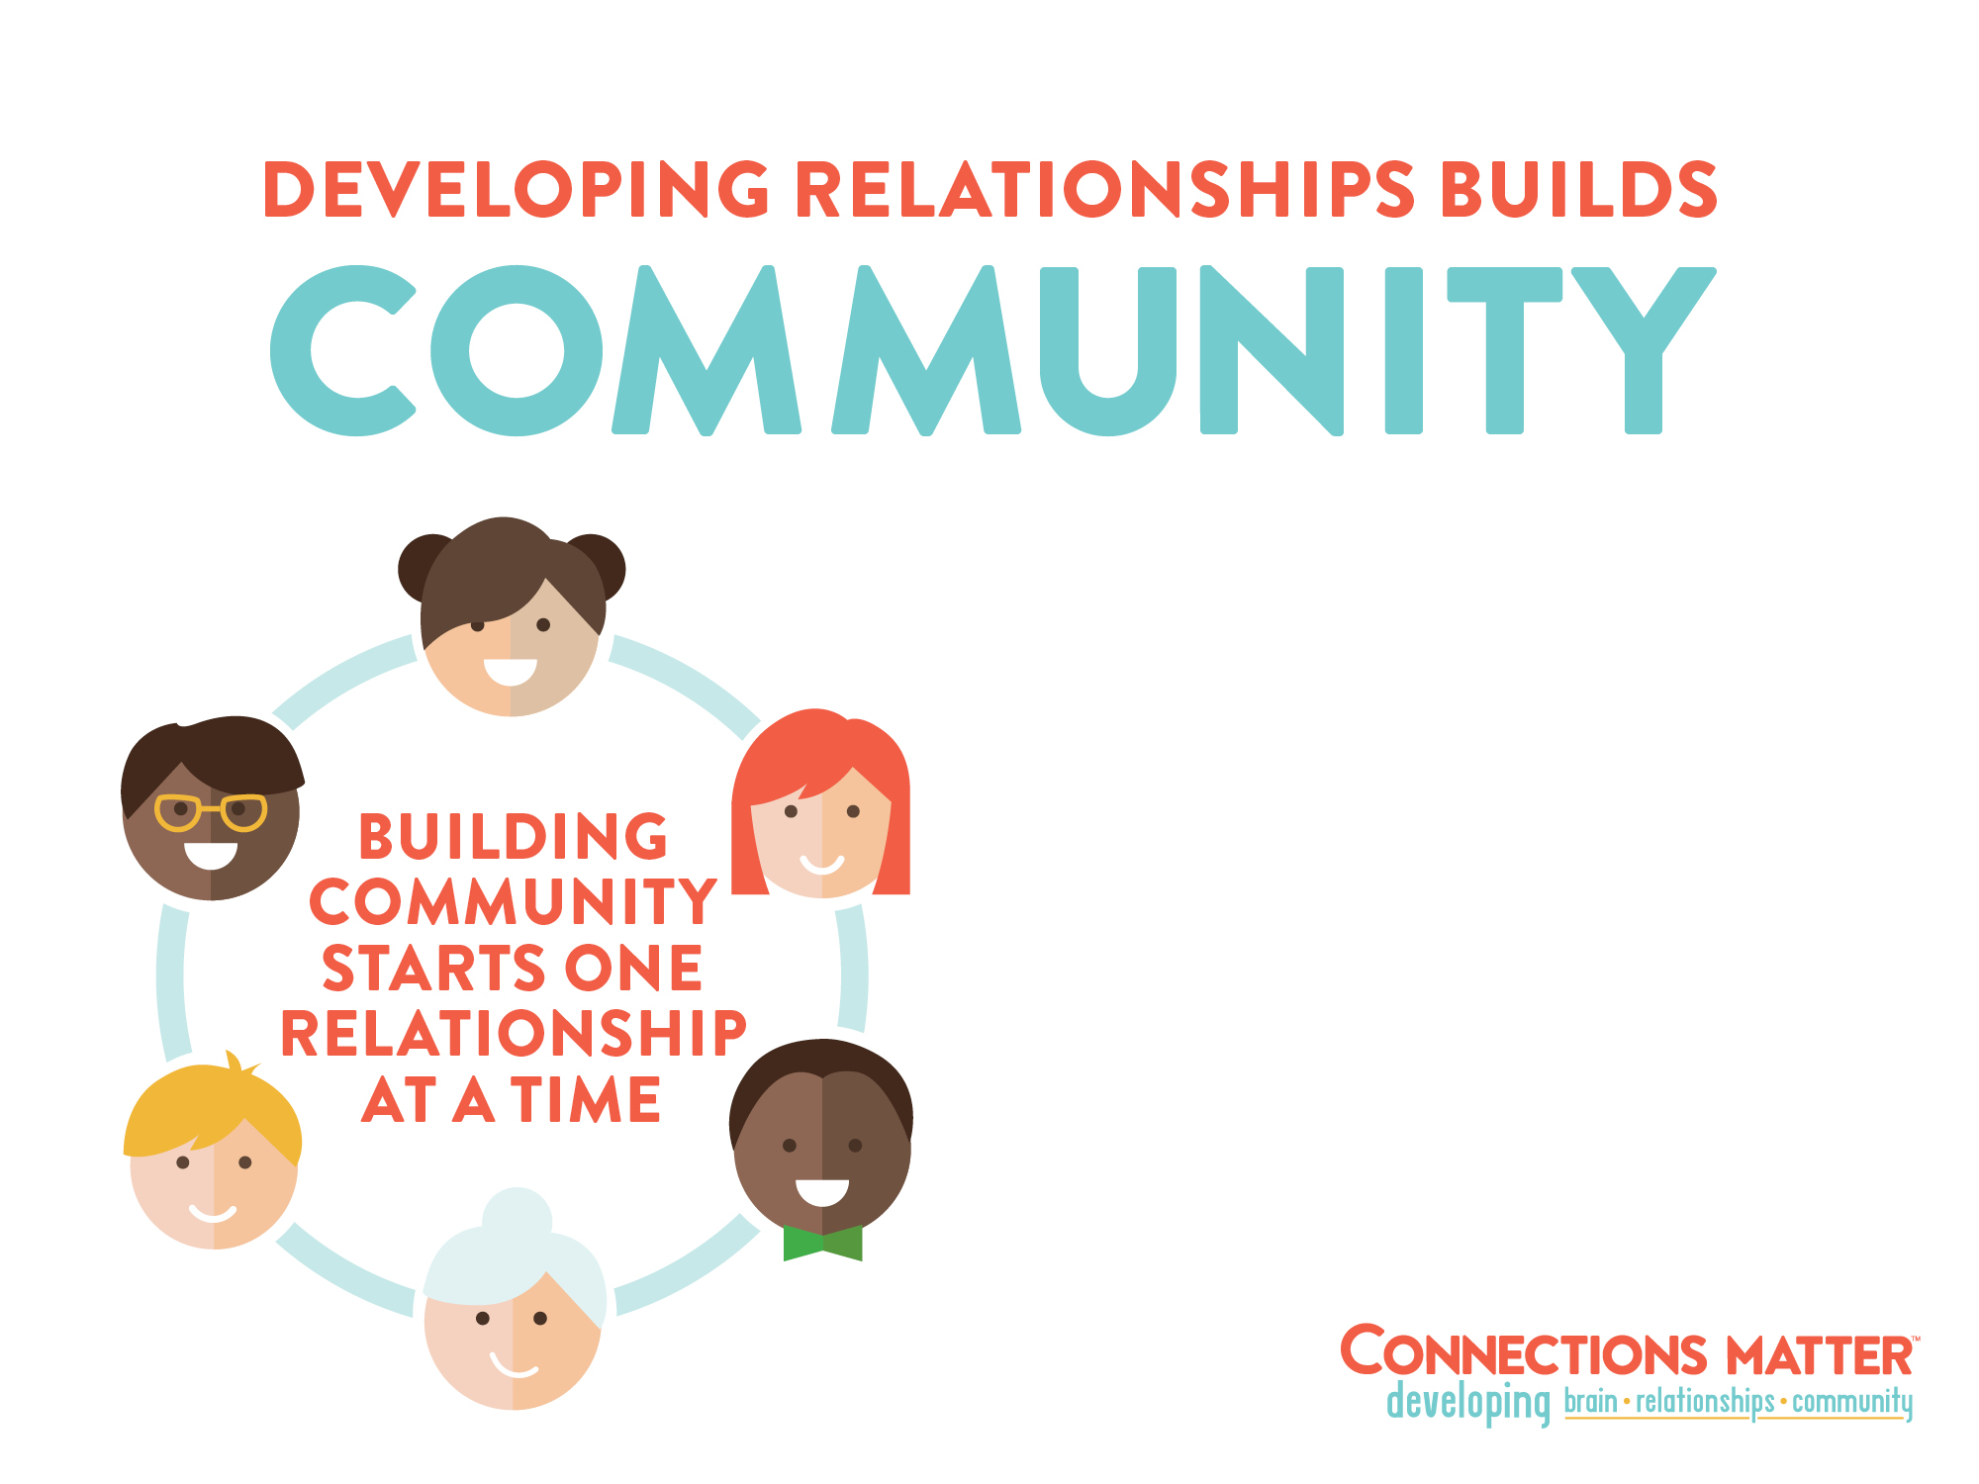
Safer for everyone (less crime,
suicide, substance abuse,
and homelessness)
Children are more likely to
succeed in school/life
Members are physically and
mentally healthier
Notes:
SPEAKER NOTES
It’s not a theory; it’s a fact. Caring, successful communities are built through healthy, supportive relationships, one relationship at a time. Communities that are connected through close, supportive relationships are safer, children do better – even those children who face struggles and tough times – and overall, people are healthier.
How is your school connected to the surrounding community? How are you personally involved with your community? How do you impact the community around your students?
REFERENCES
Resiliency: What We Have Learned by Bonnie Benard, 2004, WestEd Publications Center, San Francisco, CA
National Academies Press, Neurons to Neighborhoods, 2000. Download free PDF at: http://www.nap.edu/catalog/9824/from-neurons-to-neighborhoods-the-science-of-early-childhood-development
Szalavitz M, Perry B. Born for Love, 2010. Harper Collins, New York, NY

Slide 35
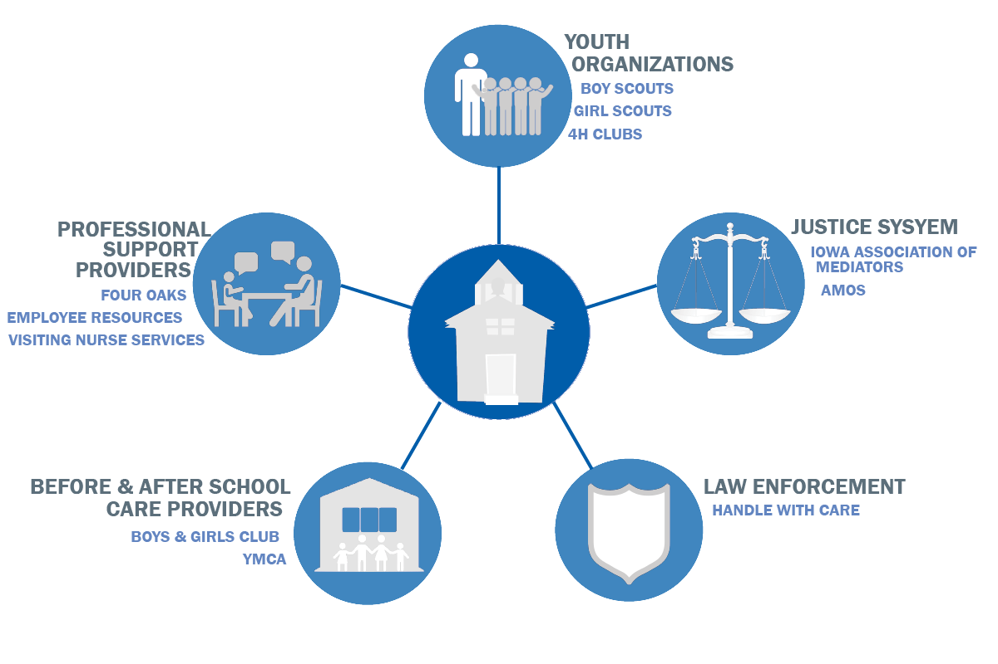
Partners in a MTSS Collaborative Culture
Notes:
Collaborative Culture Goals:
To cultivate educator’s facilitation skills to create trust among colleagues, develop collective wisdom, action that supports student learning
To utilize peer to peer processes to help colleagues work collaborative to solve problems, make decisions, mange conflict
To cultivate effective skills in listening, presenting ideas, leading discussions, clarifying, mediating and identifying the needs of self and others to advance shared goals
Community Partners in building a collaborative culture for teachers and students
UNIVERSAL SUPPORTS
STUDENT-FACING COLLABORATIVE PARTNERS
YOUTH ORGANIZATIONS
Youth organizations with a mission statement centered on social, emotional, behavioral learning (character).
These are student-facing community partners who share common goals and expertise
Vision: BSA: The Boy Scouts of America will prepare every eligible youth in America to become a responsible, participating citizen and leader
Girl Scouting builds girls of courage, confidence, and character, who make the world a better place.
4H: Healthy, happy, thriving people who make a positive difference in their communities
.
BEFORE/AFTER SCHOOL CARE PROVIDERS
Boys and Girls Clubs, Y’s

Slide 36



Targeted and Intensive Supports
Managing conflict and minimizing impact of family or community trauma
Supporting students experiencing high levels of stress outside of school
Notes:
JUSTICE SYSTEM
Purpose of mediation process is to use questioning, listening, and observation to become more aware of the perspectives of others, creating opportunity to work together and create a positive work environment. Mediation training for older students (Jr High – High School) builds capacity for early intervention in conflict resolution with a neutral third party peer facilitating the discussion and building consensus. http://www.iowamediationservice.com/ims-training/ http://amosiowa.org/calendar/school-mediation-advanced-training/
LAW ENFORCEMENT
“Handle with Care" provides the school with a “heads up” when a child has been identified at the scene of a traumatic event. It could be a meth lab explosion, a domestic violence situation, a shooting in the neighborhood, witnessing a malicious wounding, a drug raid at the home, etc. Police are trained to identify children at the scene, find out where they go to school and send the school a confidential email or fax that simply says . . . “Handle Johnny with care”. That’s it. No other details.
In addition to providing notice, officers also build positive relationships with students by interacting on a regular basis. They visit classrooms, stop by for lunch, and simply chat with students to help promote positive relationships and perceptions of officers.
Schools
Teachers been trained on the impact of trauma on learning, and are incorporate many interventions to mitigate the negative impact of trauma for identified students, including: sending students to the clinic to rest (when a HWC has been received and the child is having trouble staying awake or focusing); re-teaching lessons; postponing testing; small group counseling by school counselors; and referrals to counseling, social service or advocacy programs. The school can also implemented many school-wide interventions to help create a trauma sensitive school (Greeters; pairing students with an adult mentor in the school; utilization of a therapy dog; and simple communication tools for students such as “thumbs up/thumbs down” to indicate if a student is having a good day or a bad day).
Counseling
When identified students exhibit continued behavioral or emotional problems in the classroom, the counselor or principal refers the parent to a counseling agency which provides trauma-focused therapy
Iowa Schools already using HWC
Schools in the Quad Cities currently use this process through a partnership with their Child Abuse Prevention Council and Police Department. Training and support was funded with DECAT.
To date, this school year they have had 227 Handle With Care notices from 4 different law enforcement agencies that have given 7 different school districts a “heads up” to implement a trauma-informed approach before school starts the following day. Below are specifics for each law enforcement agency and school district.
They have also had feedback from school districts that show the real difference Handle With Care notices are making in the classroom.
I love the updates! It lets me know who to be aware of or alerted to who may need services etc..” Tory Dohrn Fillmore Elementary School Counselor
Teachers have said it helps them to keep a watchful eye on the kiddoes involved with these types of incidences. Otherwise behaviors might have gone unnoticed and/or misinterpreted. “There have been occasions where teachers asked me (school counselors) to pop in just to see what I think. That would not have happened without knowledge of the HWC. From the school counselors perspective: I feel the same way. It helps us to be more aware, understanding, and watchful—not just the day after, but for weeks after in case residual emotions pop up etc. I do appreciate this program.” Glennda Currence, Elementary School Counselor
A counselor went a step further by implementing an internal HWC notification. “At times we notice a student comes to school “off” or something happens during the day and the counselor will send out a Handle with Care notice to the teachers.”
INTENSIVE SUPPORTS:
PROFESSIONAL SUPPORT PROVIDERS
Four Oaks, VNS : Provide wrap-around support services and interventions for students and families at high risk. Their intervention planning can include teachers.
Employee Resources : Employee Family Resources in Central Iowa – under contract with school districts to provide early intervention and support. Eg: first three visits to a counselor/therapist are free. A longer term referral can be made after the third visit if deemed necessary. Some schools have placed and EFR counselor in their school one day a week to create better access for students. EFR services are also available to all staff in the district

Slide 37
Handle With Care
Partnership with Police Departments
227 Notices Since August 1st, 2016
Police Departments | HWC Notices | School Districts | HWC Notices | Average Age: 10.5
Bettendorf | 83 | Bettendorf | 78
Davenport | 140 | Davenport | 110
Buffalo | 2 | Home School | 1
Scott County Sheriff | 2 | North Scott | 2
 |  | PV | 8
 |  | St. Paul | 2
 |  | No Response | 16
 |  | JFK Preschool | 1
 |  | All Saints | 1
 |  | Not School Age | 8

Slide 38
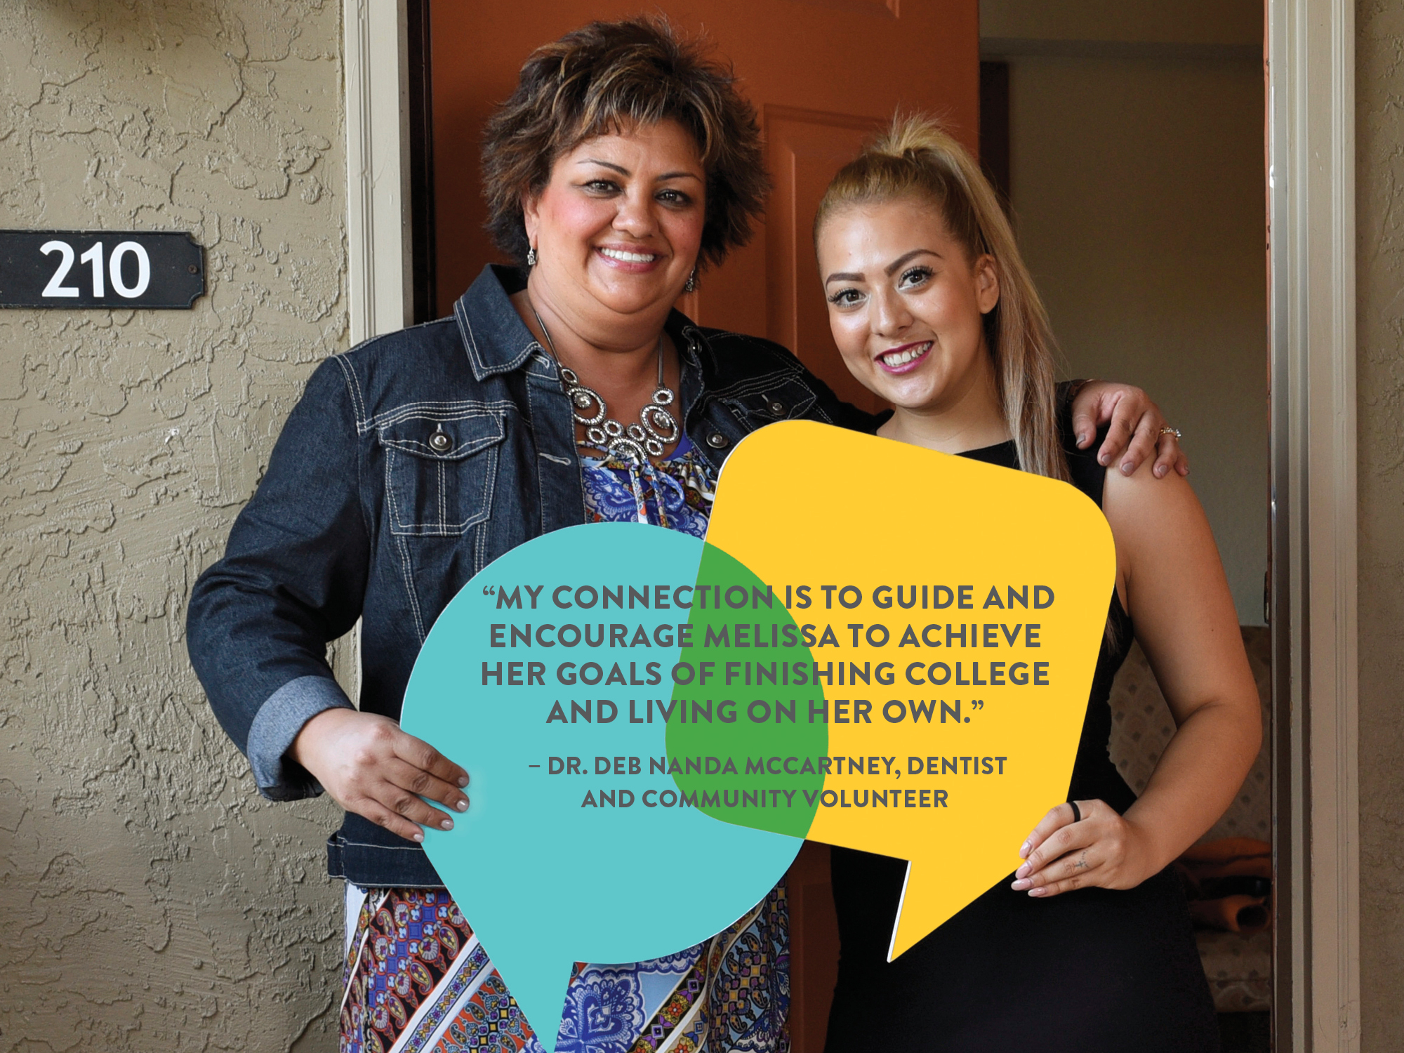

Slide 39
Trauma-Sensitive Schools
Prairie Crest Elementary, Linn County, Iowa
  35 Staff attended initial training
  “Relax and Return” Classroom design
  Reframing job descriptions
  Increased worker collegiality
  Co-teaching
  Changes in tracking system
  Changes in discipline policy
  Whole school approach
Notes:
Reframed how they are looking at kids from “child being disrespectful” or labeled to “what’s going on with this child? Educators incorporating new language and skills-reframe from adults managing behavioral issues, to teaching coping skills
Relax and return cubby
School increased connectiveness-Have more celebrations at the school to make more positive, inviting
Incorporating into staff meetings-not a program, a lens they are using to work through

Slide 40
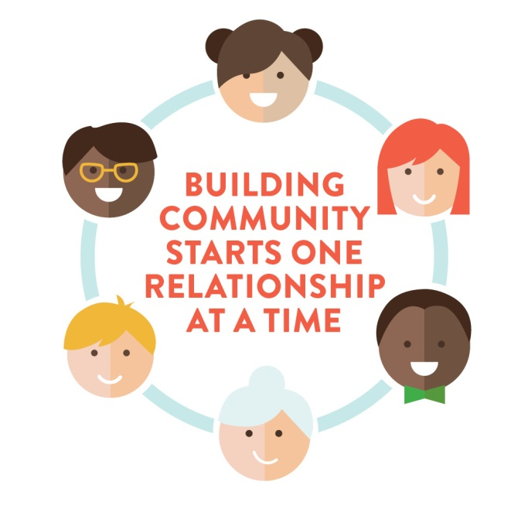
Over 10 to 15 years, Cowlitz Co., Wash. saw a decrease in the following areas:
Births to teen mothers - 62%
Infant mortality - 43%
Youth suicide and attempts - 98%
Youth arrests for violent crime - 53%
High school dropout rates - 47%
Similar results seen in other counties.
Notes:
Schools are important part of the community change needed to Address ACEs.
Washington’s model fro community change used ACEs and brain science as a framework for addressing major issues in communities across the state. Goal is to increase learning and use data to build leadership capacity among all members in the community to invent the actions/strategies that will address trauma.
The Self-Healing Community Model, Washington, developed strong networks that promoted much greater collaboration across sectors. They empowered local leadership and nurtured sector leaders to think about whole systems, not just their part of a system. They also used data to decide how and where to focus efforts and to learn from what was working. They made visible changes that helped to instill a real sense of hope in communities that had given up on the prospect of a better world for their children.
Over 10 to 15 years in Cowlitz Co., Wash.:
Births to teen mothers went down 62% and infant mortality went down 43%;
Youth suicide and suicide attempts went down 98%;
Youth arrests for violent crime dropped 53%;
High school dropout rates decreased by 47%;
Similar results were seen in other counties.
ACROSS THE STATE, over a decade, communities were able to demonstrate a decrease not only in the rates of childhood trauma in the next generation of young adults but also a reduction in physical and mental health problems (among young adults). And billions of dollars worth of savings!!!

Slide 41
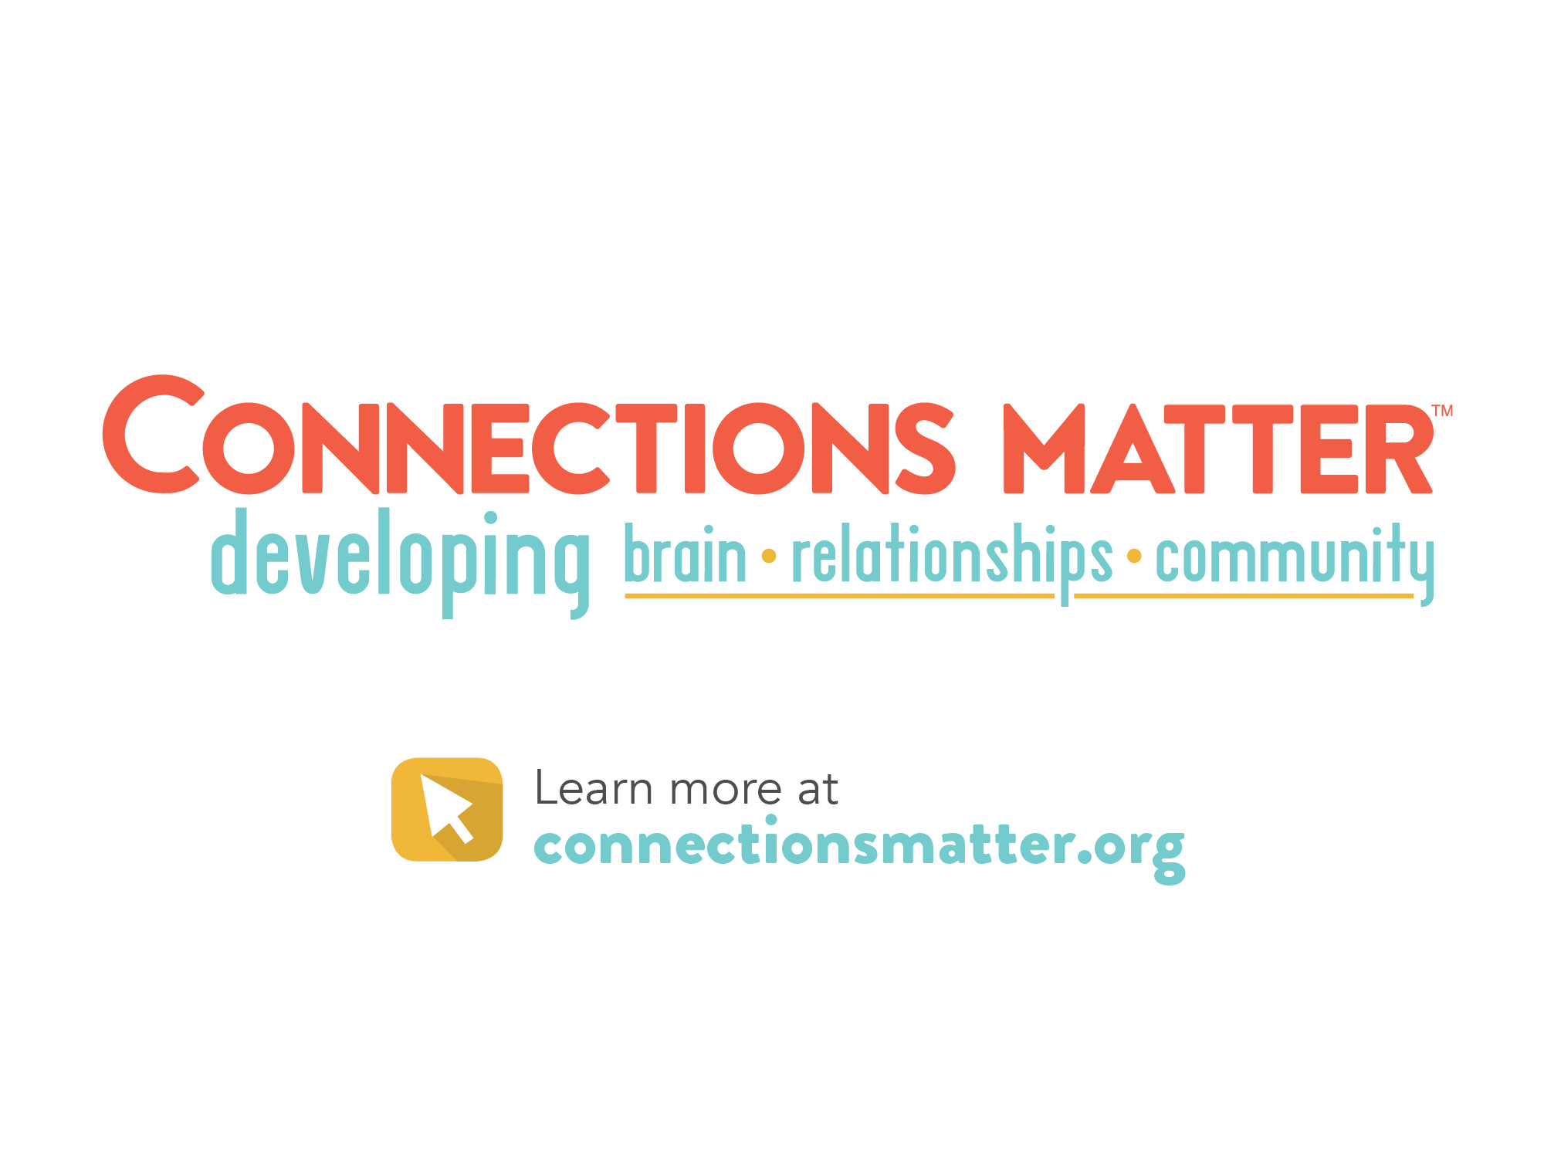
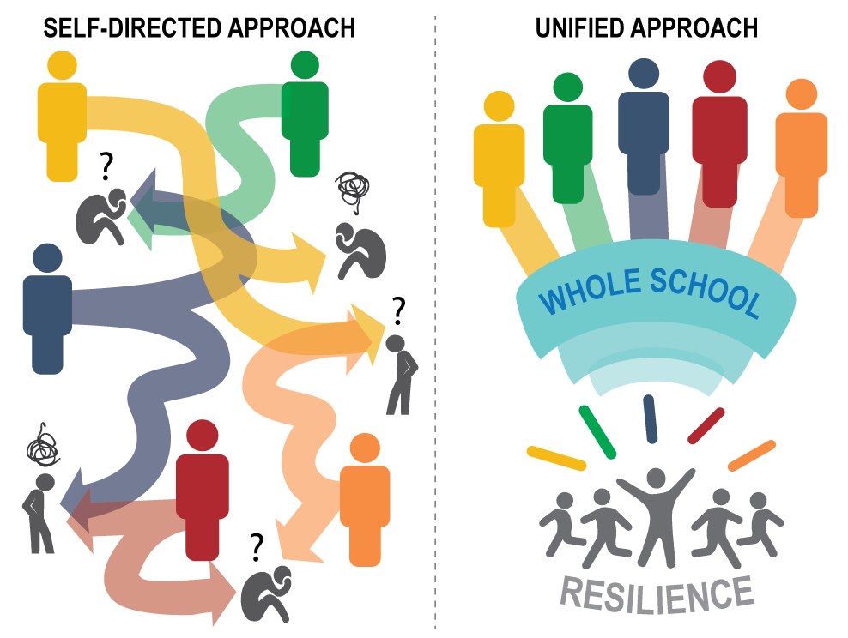
Notes:
Speaker’s Notes:
The process of becoming a trauma sensitive school requires a unified approach. Experience tells us that when teachers, administrators, parents, and support staff (including bus drivers, custodians, lunch staff, before and after care coordinators) work together with a shared mission and vision, the outcomes are better for students.
Without this shared language and vision, students often are left confused…and teachers/administrators become frustrated.
It is important that the teachers and administrators also prioritize self-care, recognizing their own triggers and strengthening their social support system.
Change theory states that for change to occur, at least 75% of the community impacted must know about the change and understand the vision. A key leadership team of influencers anchoring the effort improves the outcome of success. These teams should develop a flexible, understandable, communicable vision and a communication plan. A “quick win” will build enthusiasm for the work.
Activity:
Brainstorm ideas on becoming a more trauma-informed school – use these as examples to get the conversation moving:
Build a leadership team with commitment to whole-school approach to becoming trauma-informed.
Plan for professional learning time for all staff throughout the year.
Commit to physical, social/emotional safety for all students and staff at all times, resulting in less punitive approach and more collaborative, problem-solving approach.
Commitment to school-wide social/emotional learning and building resilience in all staff and students.
Implement plans to increase connection and engagement of students to the school community.
Planned times for teamwork and embracing shared staff responsibility of all students.
Leaders anticipation of students changing need for additional supports and connections to other resources.
ConnectionsMatter.org offers additional learning resources, including many of the links referenced today.
These websites offer additional information and resources as well:
www.iowaaces360.org
Information on adverse childhood experiences (ACEs) in Iowa
www.traumainformedcareproject.org
Information on trauma-informed care approach and trainings in Iowa
www.albertafamilywellness.org
Videos on brain development, stress and other resources
http://developingchild.harvard.edu
Videos on brain development, stress and other resources

Slide 42
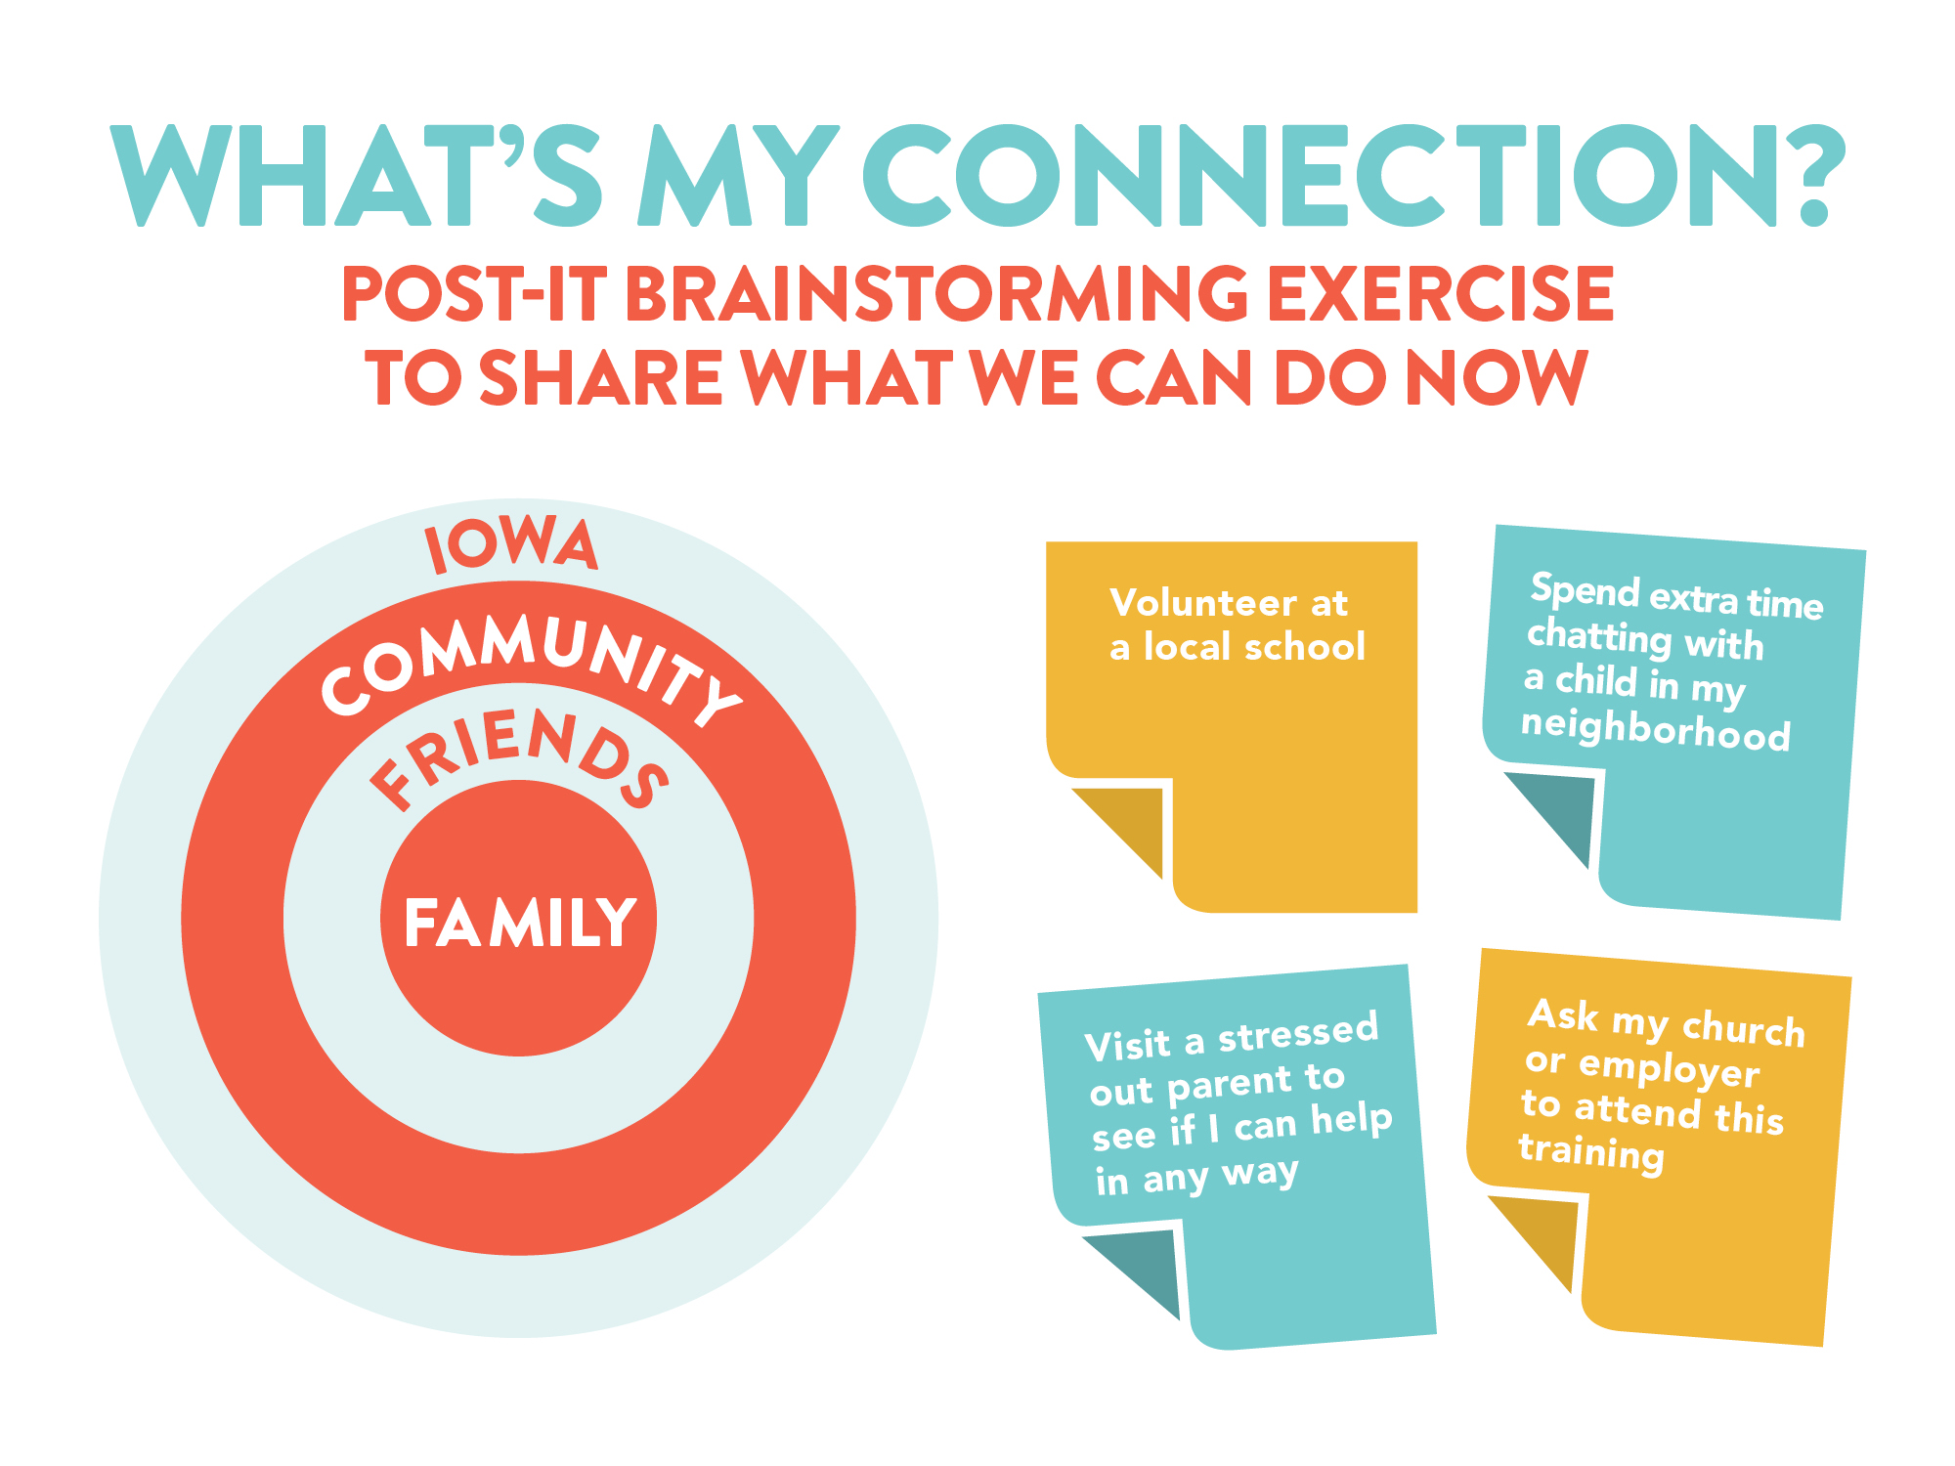
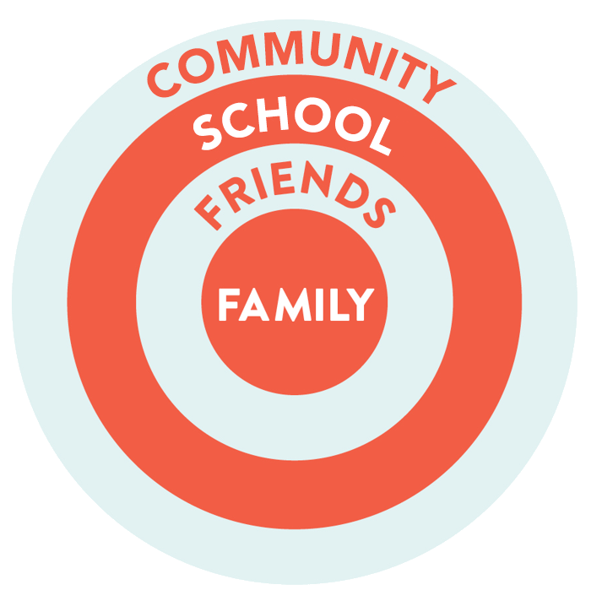
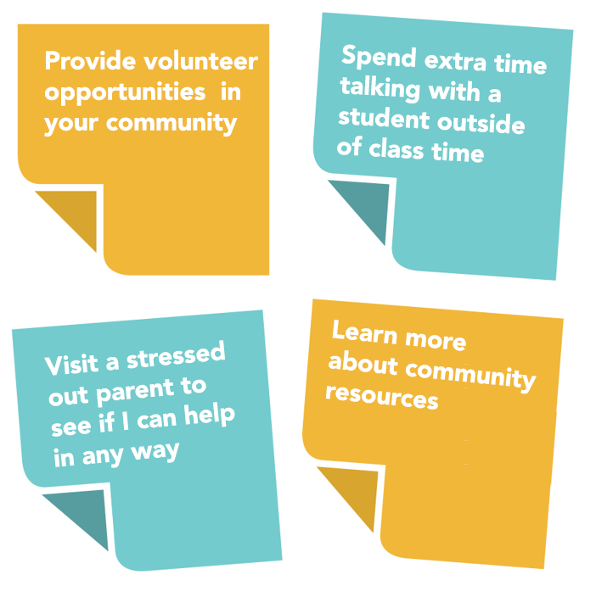
Notes:
SPEAKER NOTES
Add other examples….(from team)
INSTRUCTIONS FOR CLOSING EXERCISE
1. Each participant should have at least 4 “Post-Its.”
2. Think of examples of ways you can connect with someone for as many of the circles (family, friends, school, community) as possible.
3. Write down your examples on the Post-Its.
4. Post your suggestions and look at ideas from others.
20 MINUTE ALTERNATIVE
Ask participants to write down just 1 idea on a “Post-It” to post and share.

Slide 43
Notes:
ConnectionsMatter.org offers additional learning resources, including many of the links referenced today.
These websites offer additional information and resources as well:
www.iowaaces360.org
Information on adverse childhood experiences (ACEs) in Iowa
www.traumainformedcareproject.org
Information on trauma-informed care approach and trainings in Iowa
www.albertafamilywellness.org
Videos on brain development, stress and other resources
http://developingchild.harvard.edu
Videos on brain development, stress and other resources

