Slide 1
Change Provider vs Add/Transfer

Slide 2
Matthew is a Speech Only kid at Hansen Elementary in Cedar Falls. Matthew is transferring from Hansen Elementary to Southdale Elementary in Cedar Falls. The next few slides will show you the dos and don’ts of transferring Matthew to a new school.
SCENARIO 1:

Slide 3
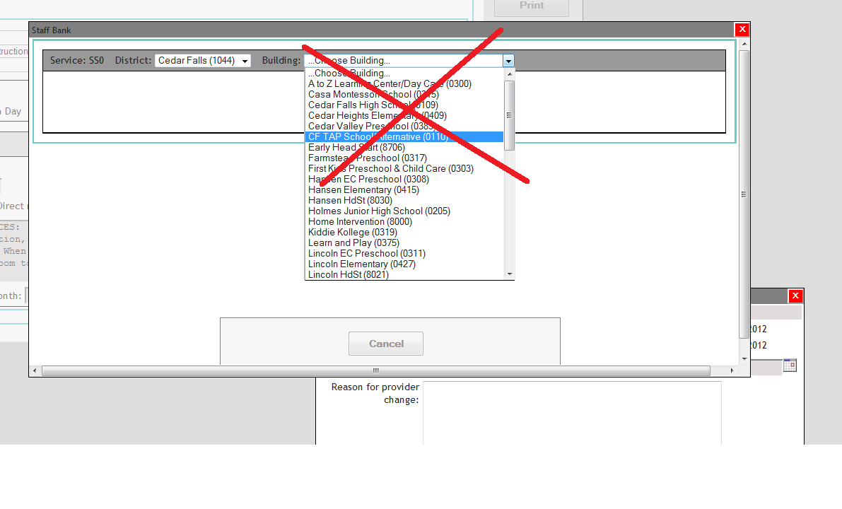
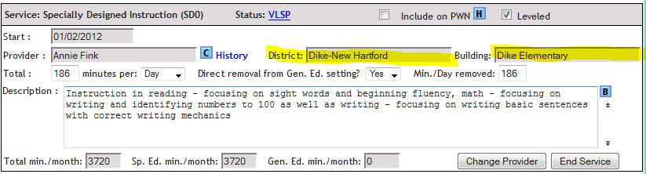
Don’t
Do not use the Change Provider button on the F page in order to change a kid’s attending building.
The Family Page’s Attending District/Building must match the Attending District/Building on the F page.
When they don’t, you will see the name of the attending district and building next to the service provider’s name as seen in the screenshot to the right

Slide 4
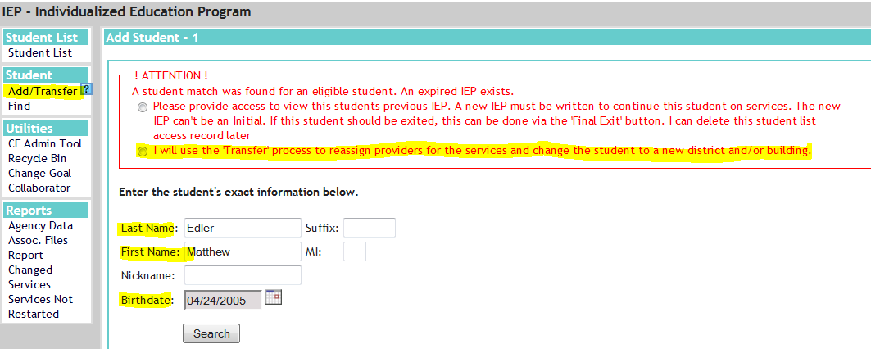
Do
Use the Add/Transfer button in order to transfer Matthew from Hansen to Southdale.
Click the Add/Transfer button and enter in Matthew’s last name, first name and DOB.
You will then select the option highlighted in the screenshot pictured.

Slide 5
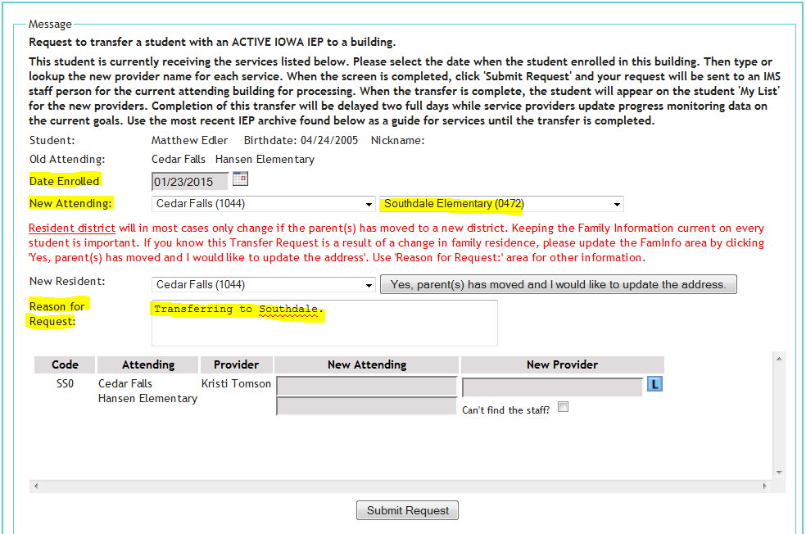
Do
After you select the appropriate option, a transfer request screen will appear.
In this case, we will select a date enrolled, the new attending building (Southdale) and enter a reason for the request.
NOTE: You can use this same process if the child is moving to another district as well. You would simply choose the new district from the New Attending section, which would produce the new district’s building for you to choose from. You can also change the resident district via the New Resident section and enter in a new parent address via the button shown.

Slide 6
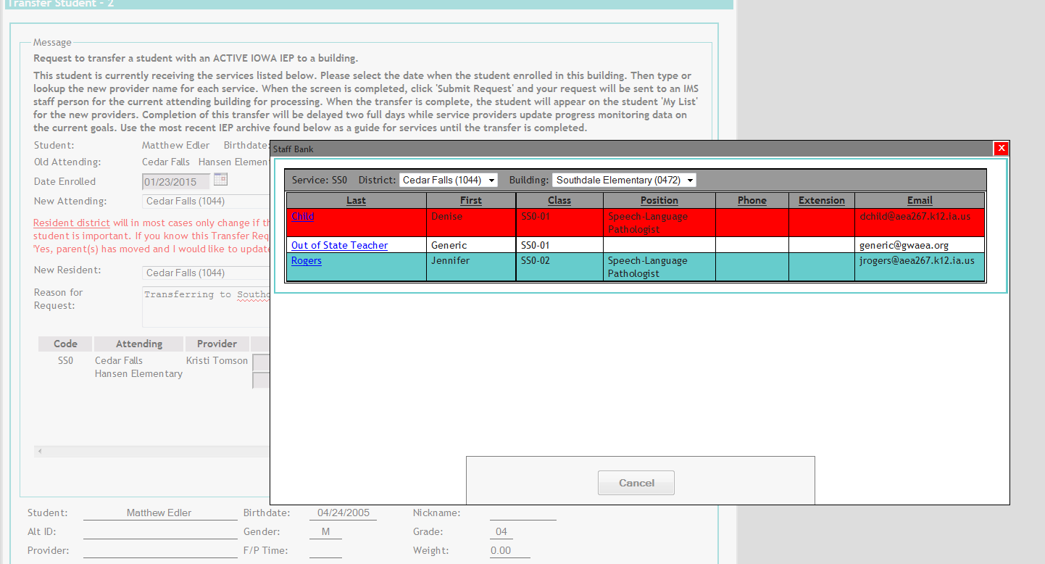
Do
After we have provided a Date Enrolled, a new Attending building (or district) and a reason for the request, the next step would be to select the new SLP from the list provided.
In this case we are selecting Denise Child to be Matthew’s new SLP. (Highlighted in Red)
Note: Again, you should not change the name of the building or district from the drop downs provided in this box. If the correct provider is not listed, you will need to contact either JR Trembly or Cindy Baker to add that provider to that district/building.

Slide 7
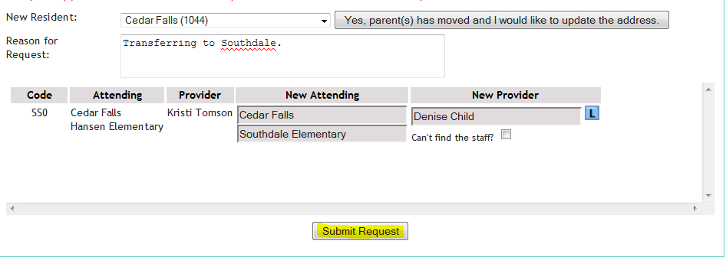
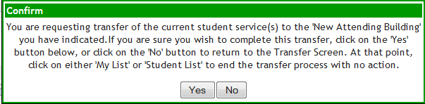
Do
The next step will be to click the “Submit Request” button.
You will then be prompted with a confirmation box asking if you are sure you want to transfer this kid to the new district/building. Click yes if you are ready or no if you need to change something or cancel the request all together.

Slide 8
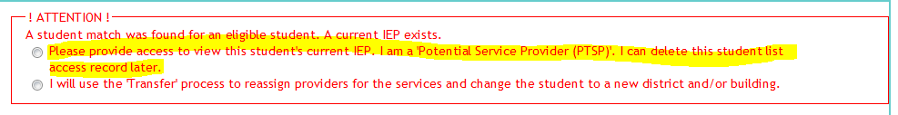
The request will then be sent to the Data Entry staff person responsible for that district. They will then process it on the IDEA website as well as the standalone system. The standalone system is what the rosters are pulled from. Once it is entered into the standalone system, you should see the changes reflected on your roster.
IMPORTANT: The previous process should only be used by an SLP if the kid in question is SPEECH ONLY. If the child has other services such as an instructional or transportation service, this process needs to be completed by a Team Rep. This is because the Team Rep will know who will be providing the other services at the new school.
If you are wanting to gain access to the child’s IEP if the child has not been transferred to you yet, you can always add yourself as a Potential Service Provider. You would add the kid via the Add/Transfer process, but instead would select the option pictured below:

Slide 9
SCENARIO 2:
Alexis is a Speech Only kid at Fred Becker Elementary in Waterloo. Kim Crowe is her Speech Provider. Kim and Leigh Anne Hansen have decided to divvy up their caseload at Becker and changing Alexis’ speech provider on her F page from Kim to Leigh Anne.
The following slides will show the process of changing the provider of a Speech service to another SLP within the same attending building/district.

Slide 10
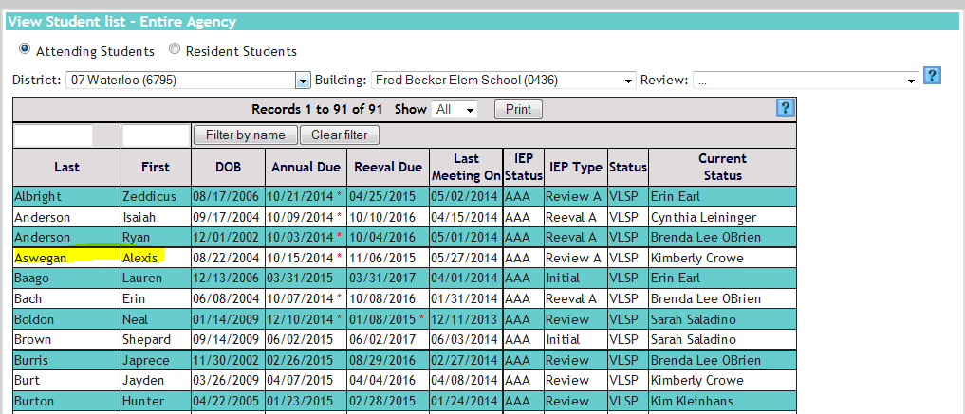
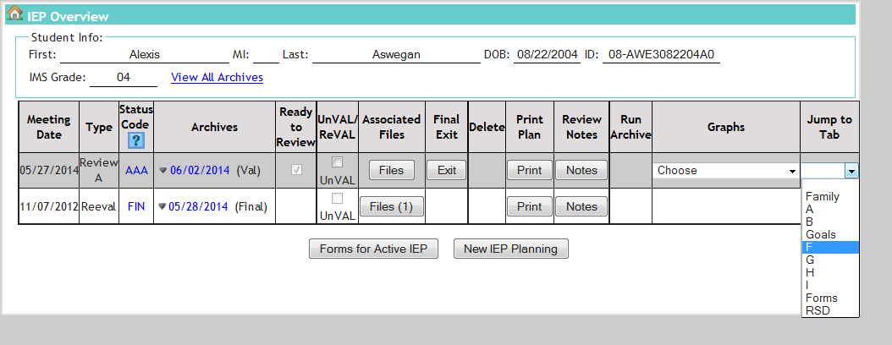
Step 1:
Since Leigh Anne is the receiving SLP, it will be her responsibility to initiate the change provider request.
Since Leigh Anne is assigned at Fred Becker, she has access to Becker’s entire student list.
Leigh Anne’s job is to locate Alexis in Fred Becker’s list and Navigate to her F page.

Slide 11
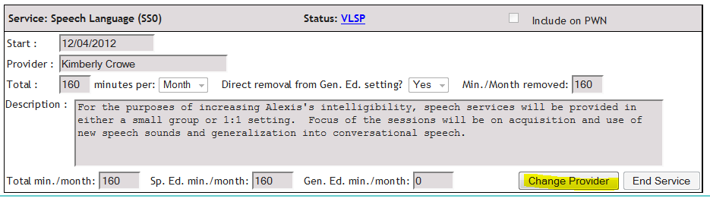
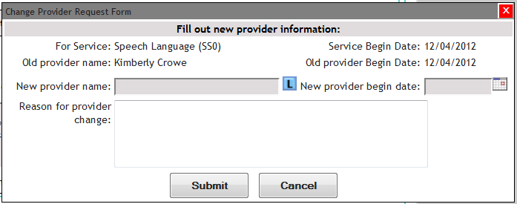
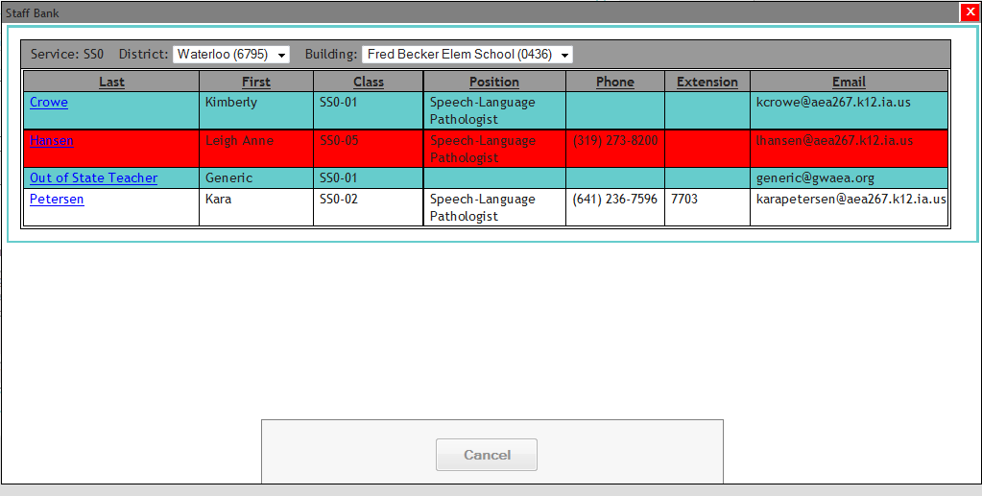
Step 2:
Once on Alexis’ F page, Leigh Anne will select the “Change Provider” button at the bottom of the speech service.
The next step would be to use the Lookup or “L” button, to find herself in the Waterloo/Fred Becker Staff Bank
Note: If you do not show up in this list, please contact JR Trembly or Cindy Baker so you can be added to the assignments for that District/Building.

Slide 12
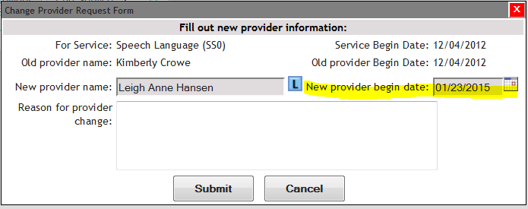
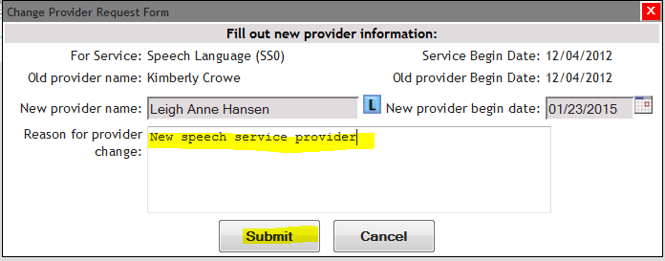
Step 2 (cont.):
After Leigh Anne has selected her name, she will need to select a “New Provider Start Date” which needs to be after the “Old Provider Begin Date”
She then will provide a reason for the change request and click submit at the bottom to finish the request or cancel to back out of it.

Slide 13
This request will be sent to data entry where it will be processed and be reflected on the child’s IEP. It will also be entered into the standalone system that is used to pull rosters. Once it has been processed in the standalone system, the child should show or not show on your roster.
IMPORTANT: This process should only be used to change a provider of a speech service to another SLP within the same attending district/building. If the child is transferring to another school, please refer to Scenario 1.

